Slide 1
HCMI 4225: Costs of Health Care
Shane Murphy – shane@uconn.edu

Slide 2
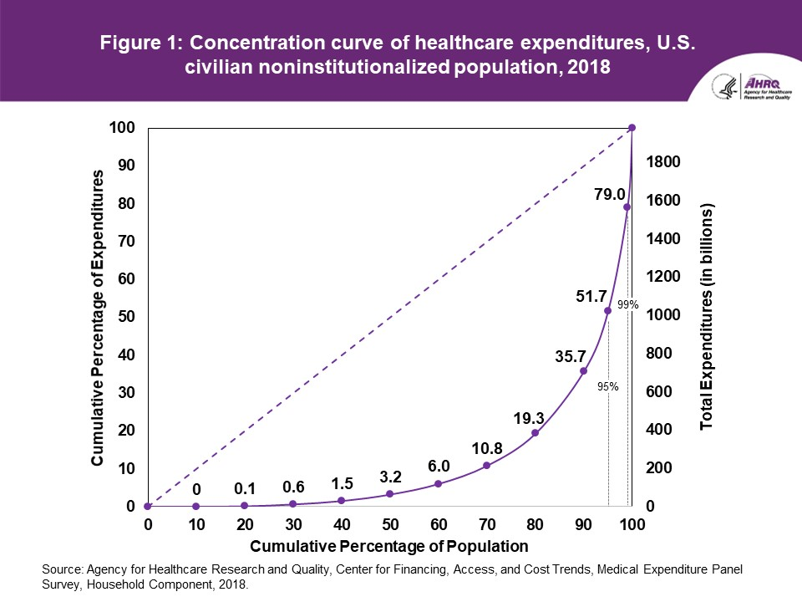

Slide 3
Percentile of population ranked by spending and amount spent during the year
Lower Threshold | Upper Threshold | Lower Spending | Upper Spending
99% | 100% | $72,212 | a lot
95% | 99% | $26,355 | $72,212
90% | 95% | $14,651 | $26,355
70% | 90% | $3,776 | $14,651
0 | 50% | 0 | $1,317

Slide 4
Low spenders (bottom 50%)
In any given year, half the non-institutionalized population is barely touching the medical system.
Benefit design indifferent as either they are not using any services so no theoretical cost sharing applies
the few services that they do use are already exempted from cost-sharing (flu shots)
the plans that they are offered have high enough cost-sharing that there is no difference to them between a $500 deductible and a $5000 deductible

Slide 5
High spenders (top 10%)
Someone who knows that they have a $75,000 per year condition will not be influenced directly by cost sharing tweaks for one plan that is a little heavier on deductible while another plan is heavier on coinsurance.
In either plan, they are extremely likely to hit out of pocket maximums and the difference in benefit design will only be on cash flow and cognitive complexity.

Slide 6
Medium high spenders (50% to 90%)
Cost-sharing is probably relevant retrospectively for individuals who are in the 50th to the 90%th percentile of spending.
This group has ~32% of all medical spending in the country.
If we think that optimal cost-sharing design can do something to healthcare expenditures, this is where the squeeze will be.

Slide 7
How insurance subsidies benefit consumers
Consider two types of subsidy: Cost sharing reductions and premium reductions
People in the bottom 50% of the spending will more strongly benefit from a dollar in premium reducing subsidies than cost-sharing reductions.
People at the very top of the spending distribution are indifferent as to the form of assistance as they will get the full benefit either way
It is the people in between where a dollar spent in reducing maximum allowable deductibles instead of reducing premiums are in a complex situation.
Someone who has $5,000 in deductible eligible claims will be better off if maximum deductible is reduced from $5,200 to $4,500. They are no better off if maximum allowed deductible is reduced from $8,850 to $7,500.

Slide 8
Source:
https://meps.ahrq.gov/data_files/publications/st533/stat533.shtml

Slide 9
Relationship between cost and quality
Healthcare spending buys a certain set of healthcare goods
Beds per capita
Physicians/nurses/midwives per capita
Insurance/financial coverage
Universal support for basic health needs
UHC tracer index of 11 interventions: Coverage of four childhood vaccinations (BCG, measles, three doses of diphtheria-pertussis-tetanus, and three doses of polio vaccines); skilled birth attendance; coverage of at least one and four antenatal care visits; met need for family planning with modern contraception; tuberculosis case detection rates; insecticide-treated net coverage; and antiretroviral therapy coverage for populations living with HIV
WB coverage index of three basic primary care interventions: three doses of diphtheria-pertussis-tetanus vaccine; at least four antenatal care visits; and children with diarrhoea receiving appropriate treatment

Slide 10
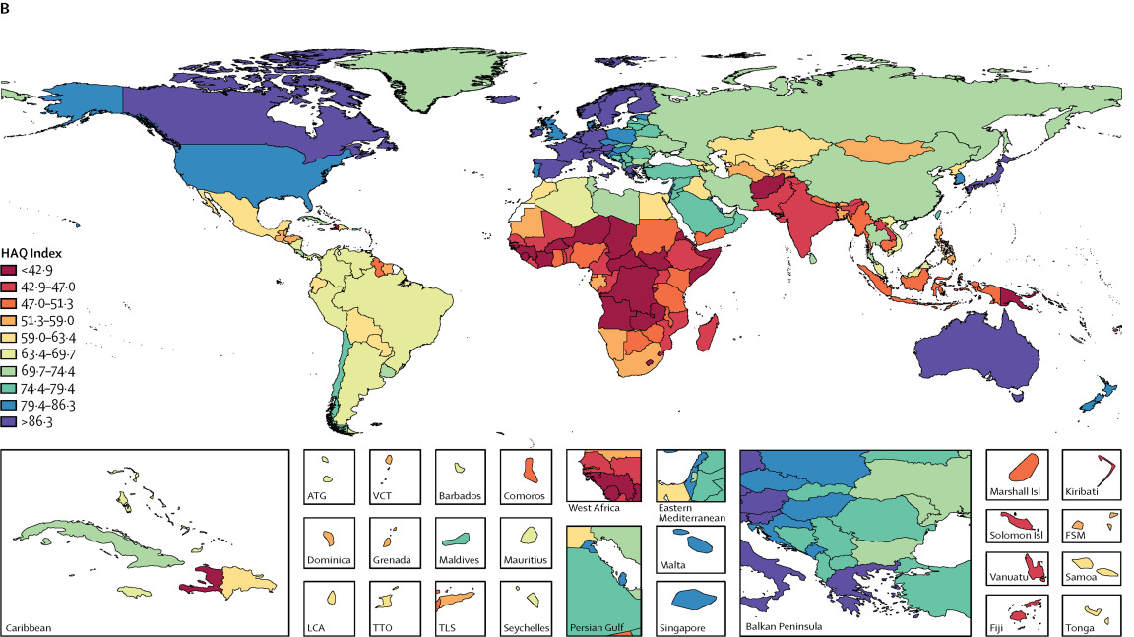
Hospital Access and Quality index

Slide 11
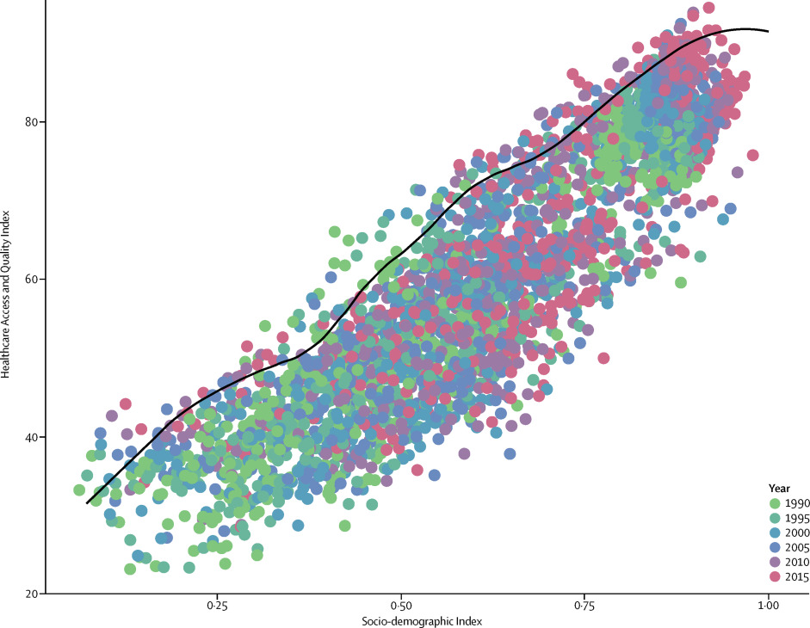
Comparing HAQ to expected HAQ
Absolute performance vs relative performance

Slide 12
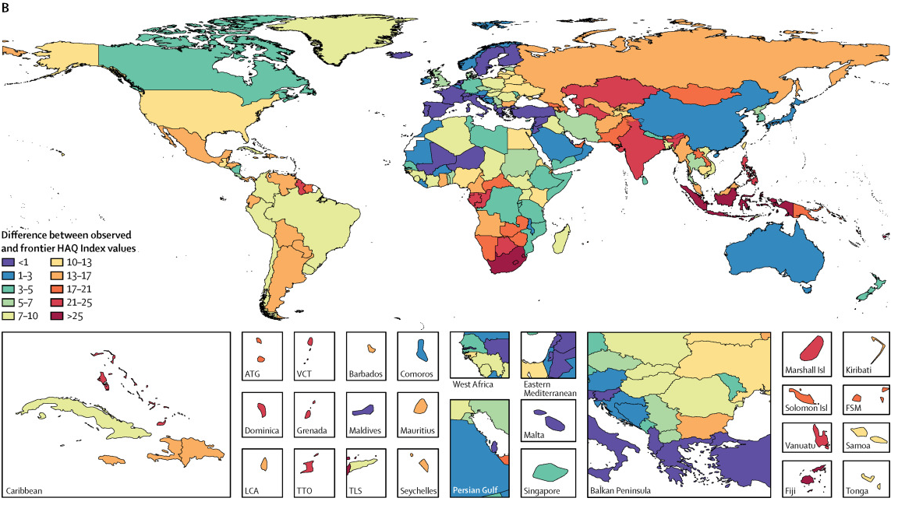
Comparing HAQ to expected HAQ

Slide 13
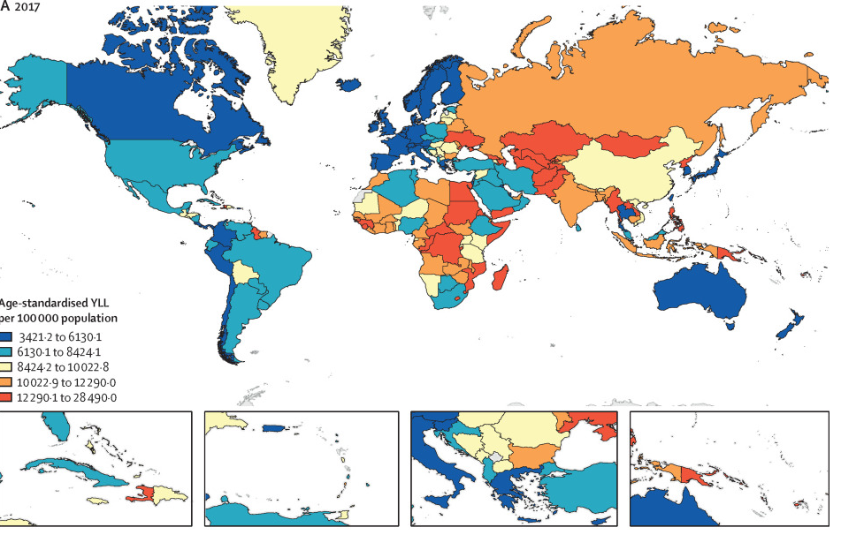
Amenable Mortality/Premature Mortality
Deaths from causes amenable to changes in health behavior or to changes in health care access and quality
NCDs

Slide 14
Amenable Mortality/Premature Mortality
Deaths from causes amenable to changes in health behavior or to changes in health care access and quality
NCDs

Slide 15
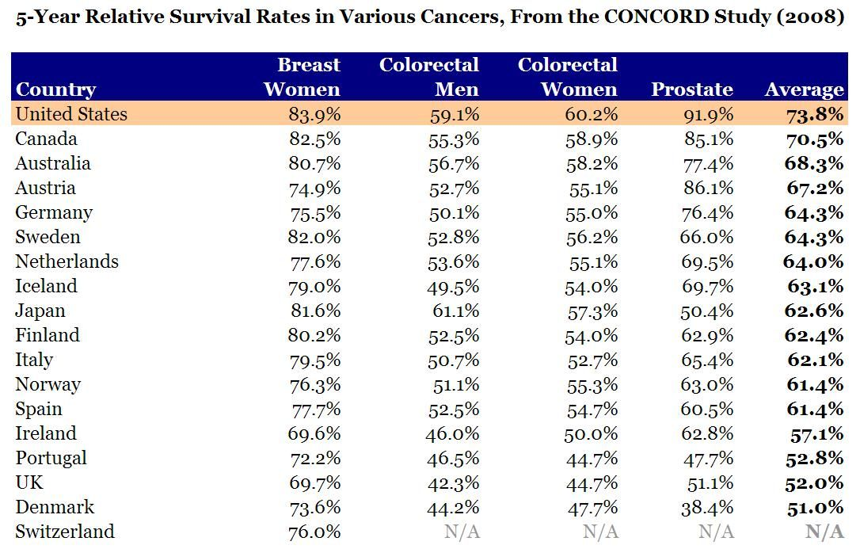
Cancer

Slide 16
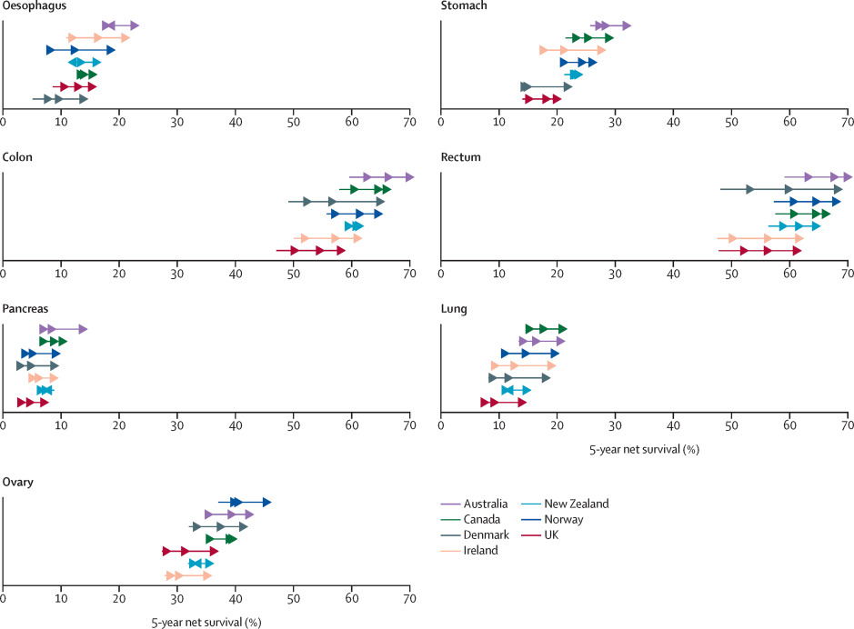
Cancer

Slide 17
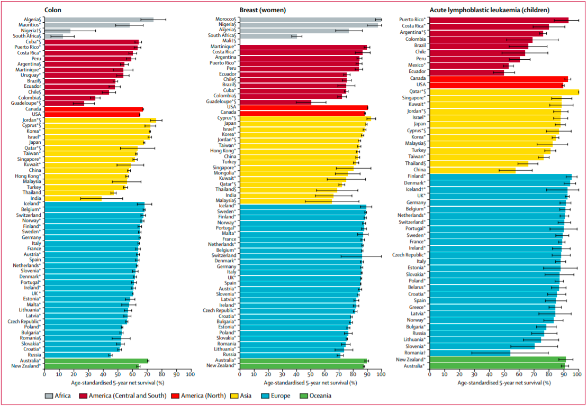

Slide 18
Sources
Martinez, Ramon, Peter Lloyd-Sherlock, Patricia Soliz, Shah Ebrahim, Enrique Vega, Pedro Ordunez, and Martin McKee. "Trends in premature avertable mortality from non-communicable diseases for 195 countries and territories, 1990–2017: a population-based study." The Lancet Global Health 8, no. 4 (2020): e511-e523.
Arnold, Melina, Mark J. Rutherford, Aude Bardot, Jacques Ferlay, Therese ML Andersson, Tor Åge Myklebust, Hanna Tervonen et al. "Progress in cancer survival, mortality, and incidence in seven high-income countries 1995–2014 (ICBP SURVMARK-2): a population-based study." The Lancet Oncology 20, no. 11 (2019): 1493-1505.
Barber, Ryan M., Nancy Fullman, Reed JD Sorensen, Thomas Bollyky, Martin McKee, Ellen Nolte, Amanuel Alemu Abajobir et al. "Healthcare Access and Quality Index based on mortality from causes amenable to personal health care in 195 countries and territories, 1990–2015: a novel analysis from the Global Burden of Disease Study 2015." The Lancet 390, no. 10091 (2017): 231-266.
Allemani, Claudia, Tomohiro Matsuda, Veronica Di Carlo, Rhea Harewood, Melissa Matz, Maja Nikšić, Audrey Bonaventure et al. "Global surveillance of trends in cancer survival 2000–14 (CONCORD-3): analysis of individual records for 37 513 025 patients diagnosed with one of 18 cancers from 322 population-based registries in 71 countries." The Lancet 391, no. 10125 (2018): 1023-1075.
Coleman, Michel P., Manuela Quaresma, Franco Berrino, Jean-Michel Lutz, Roberta De Angelis, Riccardo Capocaccia, Paolo Baili et al. "Cancer survival in five continents: a worldwide population-based study (CONCORD)." The lancet oncology 9, no. 8 (2008): 730-756.

Slide 19
Chandra, C., et al(2011). Hospital cost structure in the USA: what's behind the costs? A business case.
Significant waste exists across the entire medical supply process that needs to be eliminated.
Uses simulation to estimate the effect of streamlining administrative processes

Slide 20
Fuchs, V. R. (2013). How and why US health care differs from that in other OECD countries.
Because funding in most OECD countries is usually through a tax-supported system, administrative costs are usually much lower than in the United States, with its fragmented sources of funding and payment.
OECD countries use the concentration of funding to negotiate aggressively with drug companies and physicians and to control investment in hospitals and equipment.
For Medicare in the US, legislation and political pressure prevent such an approach.
OECD countries provide more physicians and more acute care hospital beds, whereas the United States provides much more high-tech services, such as magnetic resonance imaging (MRI) scans and mammograms, proportionately more specialists, more amenities (privacy and space in hospitals), and more standby capacity as evident in a higher ratio of MRI scanners available to MRI scans performed.

Slide 21
Dieleman, J. L., et a;. (2017). Factors associated with increases in US health care spending, 1996-2013.
Annual health care spending on inpatient, ambulatory, retail pharmaceutical, nursing facility, emergency department, and dental care increased by $933.5 billion between 1996 and 2013, from $1.2 trillion to $2.1 trillion.
5 factors in order of importance:
Changes in service price and intensity were associated with a 50.0% (UI, 45.0%-55.0%), or $583.5 (UI, $525.2-$641.4) billion, spending increase.
Increases in US population size were associated with a 23.1% (uncertainty interval [UI], 23.1%-23.1%), or $269.5 (UI, $269.0-$270.0) billion, spending increase
aging of the population was associated with an 11.6% (UI, 11.4%-11.8%), or $135.7 (UI, $133.3-$137.7) billion, spending increase
Changes in disease prevalence or incidence were associated with spending reductions of 2.4% (UI, 0.9%-3.8%), or $28.2 (UI, $10.5-$44.4) billion
Changes in service utilization were not associated with a statistically significant change in spending

Slide 22
Woolhandler, S., et al (2003). Costs of health care administration in the United States and Canada.
Administration accounted for 31.0 percent of health care expenditures in the United States and 16.7 percent of health care expenditures in Canada.
Between 1969 and 1999, the share of the U.S. health care labor force accounted for by administrative workers grew from 18.2 percent to 27.3 percent. In Canada, it grew from 16.0 percent in 1971 to 19.1 percent in 1996.

Slide 23
Papanicolas, I., at al. (2018). Health care spending in the United States and other high-income countries.
The United States spent approximately twice as much as other high-income countries on medical care, yet utilization rates in the United States were largely similar to those in other nations.
Prices of labor and goods, including pharmaceuticals, and administrative costs appeared to be the major drivers of the difference in overall cost between the United States and other high-income countries.

Slide 24
Anderson, G. F., et al. (2019). It’s Still The Prices, Stupid: Why The US Spends So Much On Health Care
On key measures of health care resources per capita (hospital beds, physicians, and nurses), the US still provides significantly fewer resources compared to the OECD median country.
In 2016, the US had 26 percent fewer hospital beds per capita, 20 percent fewer practicing nurses, and 19 percent fewer practicing physicians per capita, compared to the OECD median country.
Since the US is not consuming greater resources than other countries, the most logical factor is the higher prices paid in the US.

Slide 25
Lorenzoni, L., et al. (2014). Health-care expenditure and health policy in the USA versus other high-spending OECD countries.
Health price levels contribute the most to explaining the higher spending in the USA, and recent price dynamics largely explain declines in health expenditure growth
High and increasing rates of generic drug use, an important shift from inpatient to outpatient hospital care, along with some effective price control measures on plans and providers by Medicare and Medicaid, were some of the key factors responsible for the slowdown in health-care expenditure growth in the USA

Slide 26
Anderson, G. F., et al. (2003). It’s the prices, stupid: why the United States is so different from other countries.
The data show that the United States spends more on health care than any other country.
However, on most measures of health services use, the United States is below the OECD median.

Slide 27
Kantarjian, H., & Rajkumar, S. V. (2015). Why are cancer drugs so expensive in the United States, and what are the solutions?.
The health care industry in the United States is for-profit (unlike in European and other advanced nations), which appears to result in ill consequences driven by the demands for high profits: high drug prices (including cancer drugs) and high health care costs (18% of our gross domestic product vs 5%-9% in Europe).

Slide 28
Kesselheim, A. S., Aet al. (2016). The high cost of prescription drugs in the United States: origins and prospects for reform.
High drug prices are the result of the approach the United States has taken to granting government-protected monopolies to drug manufacturers, combined with coverage requirements imposed on government-funded drug benefits.
Per capita prescription drug spending in the United States exceeds that in all other countries, largely driven by brand-name drug prices that have been increasing in recent years at rates far beyond the consumer price index.
In 2013, per capita spending on prescription drugs was $858 compared with an average of $400 for 19 other industrialized nations.

Slide 29
Siddiqui, M., & Rajkumar, S. V. (2012). The high cost of cancer drugs and what we can do about it.
It is very expensive to move findings from bench to bedside and to perform all the regulatory studies (including phase 1, 2, and 3 clinical trials) to gain approval.
Because most cancers are incurable, patients are treated with each approved agent (sequentially or in combination), creating a virtual monopoly because the use of one drug does not automatically mean that the others are no longer needed.
Even when the monopoly is broken with the arrival of “new and improved” versions of an approved drug, the older (and by now generic) drug tends to be viewed as substandard treatment, thereby perpetuating the situation.
Cancer, and the seriousness of the diagnosis, plays a role in that patients and physicians are often willing to pay the high price of treatment even for marginal improvements in outcome.
Our systems provide an incentive to administer more chemotherapy, and there are legal barriers that prevent agencies such as the FDA from taking economic and cost-effectiveness considerations into account when approving new drugs

Slide 30
Squires, D., & Anderson, C. (2015). US health care from a global perspective: spending, use of services, prices, and health in 13 countries.
Higher spending appeared to be largely driven by greater use of medical technology and higher health care prices, rather than more frequent doctor visits or hospital admissions.

Slide 31
Cutler, D. (2013). Why does health care cost so much in America? Ask Harvard’s David Cutler.
Administrative costs
Duke University Hospital has 900 hospital beds and 1,300 billing clerks.
U.S. spends more than other countries do on many of the same things.
Drugs, physician salaries, medical equipment
Utilization of high cost procedures
If a person has a heart attack in the United States, they’re much more likely to get open heart surgery than they are in most other countries.
In all of Ontario there are 11 hospitals that can do open heart surgery. Pennsylvania has roughly the population of Ontario and it has a bit over 60 hospitals that can do open heart surgery.

Slide 32
Gawande, A. (2009). The cost conundrum.
More frequent tests and procedures, more visits with specialists, and more frequent admission to hospitals.
Patients in high-cost areas were actually less likely to receive low-cost preventive services
Accountability is limited, doctors don’t know if they are improving overall community health, only if they are following best practice for the patients they see.

Slide 33
Aaron, H. J., & Ginsburg, P. B. (2009). Is health spending excessive? If so, what can we do about it?.
Most studies attribute one-half to two-thirds of the gap to the advance of medical technology, which lengthens the menu of beneficial interventions or improves their quality.
Excessive use resulting from insurance
Fee-for-service payment rewards providers for supplying particular services rather than for producing favorable outcomes or efficiently treating an episode of illness.
Inefficient organization of health care delivery needlessly boosts U.S. health spending.
Prices of drugs in the United States are higher than in other countries
Also discusses alternative reasons which may not be a good explination

Slide 34
Reinhardt, U. E., et al. (2004). US health care spending in an international context.
GDP per capita
Higher prices
Limited supply of providers (low physicians and nurses per capita)
Highly complex and fragmented payment system that weakens the demand side of the health sector and entails high administrative costs
Unwillingness to ration care

Slide 35
Bodenheimer, T. (2005). High and rising health care costs. Part 1: seeking an explanation.
the weakness of a competitive free market within the health system, by the rapid diffusion of new technologies
excessive costs of administering the health system
absence of strong cost-containment measures
undue market power of health care providers

Slide 36
Shrank, William H., Teresa L. Rogstad, and Natasha Parekh. "Waste in the US health care system: estimated costs and potential for savings." Jama 322, no. 15 (2019): 1501-1509.
Cost of waste, $760 billion to $935 (25% of total spending):
Failure of care delivery, $102.4 billion to $165.7 billion;
Failure of care coordination, $27.2 billion to $78.2 billion;
Overtreatment or low-value care, $75.7 billion to $101.2 billion;
Pricing failure, $230.7 billion to $240.5 billion;
Fraud and abuse, $58.5 billion to $83.9 billion;
Administrative complexity, $265.6 billion.
Estimated annual savings from measures to eliminate waste:
Failure of care delivery, $44.4 billion to $97.3 billion;
Failure of care coordination, $29.6 billion to $38.2 billion;
Overtreatment or low-value care, $12.8 billion to $28.6 billion;
Pricing failure, $81.4 billion to $91.2 billion;
Fraud and abuse, $22.8 billion to $30.8 billion.
Administrative complexity, ?

Slide 37
Chernew, Michael E., and Jermaine Heath. "How Different Payment Models Support (or Undermine) a Sustainable Health Care System: Rating the Underlying Incentives and Building a Better Model." NEJM Catalyst Innovations in Care Delivery 1, no. 1 (2019).
Article unavailable, sorry

Slide 38
Primary factors
Technology
Administrative costs
Pharmaceutical prices
Service intensity and utilization
Insurance market fragmentation
Stakeholder disagreement in government
Waste

Slide 39
Solutions
One way to look at the major causes is to consider the conjunction of higher utilization in the US than in peer countries, paying a higher price in the US for the same interventions compared to peer countries, and choosing higher priced interventions for the same disease when compared to peer countries (Dieleman et al 2017, Anderson et al 2019).
What can be done is a slightly different question. My impression is that the politics around the question are a bit mixed an there is good evidence that there isn't sufficient interest in tackling the major causes of the high cost of care. Consider each of the three pieces I suggested above. Higher utilization and choosing a higher priced intervention are both derived from choices made by patients and their providers. There is a lot of pushback against restricting the choices of patients and interfering with the patient-provider relationship. And, in my opinion, legislation interfering with patient choice and with the patient-provider relationship is more successful when the legislation is based in cultural issues of interest to the legislator (see Tracy 2011, which discusses restrictions on doctors asking about weapons in the home, also consider abortion or contraception restricting legislation) than when legislation is focused on cost.
Changing the third piece above, the high price paid in the US, also runs into barriers. Due to the balance of interests of individuals and businesses made as part of decision making in US congress, bills seeking to regulate prices, particularly in the pharmaceutical industry, are not easy to pass. Some may see this as a sign of corruption, but problematic or not, this influence is a part of the structure of US society and prevents using regulation to lower prices. One price reform that I could see passing in the short term is all-payer models where the prices paid are equalized for all payers (whether private insurance, medicare, medicaid, tricare, or whatever). Maryland is the only state that still has an all-payer system, and their model has had many ups and downs and other states have abandoned it, but there is research that suggests that it works and should be reconsidered in other states (Antos et al 2017).
If regulation can't be used to regulate patient or provider choice and can't be used to regulate prices, then the next option is to use the forces of the free market to push down prices. Healthcare is a difficult industry for these types of solutions as well, although there are right-wing proposals, such as those you can find on CATO's website. These proposals are unpopular, both among health economists and among the general population, but for completeness, here are two. First, there are proposals to defund the Food and Drug Administration so that the cost of testing medicine can be lowered and testing can be performed more efficiently in the private market. Another potential free-market solution is to incentivize catastrophic insurance plans on individual markets over more comprehensive plans on group markets. This would reduce the excess utilization and push down prices by forcing providers and drug companies to compete on price with a more price sensitive patient/consumer. As I suggested, these seem inappropriate and unlikely to lead to ebetter health outcomes or, really, to significantly lower costs.
In my classes, I teach that students should expect to have to work within a system that isn't ideal from any perspective and their focus should be on taking care of people in reverse order of their power, so patients first, then physicians, then institutions and payers. Higher powered stakeholders in health have a lot of control over the system and most solutions such as regulating prices are either unacceptable to them or, as with the right-wing proposals untenable to the general public. But, to paraphrase Hemmingway, my hope is that change will come very slowly at first, then all at once.
Sources:
Anderson, Gerard F., Peter Hussey, and Varduhi Petrosyan. "It’s still the prices, stupid: why the US spends so much on health care, and a tribute to Uwe Reinhardt." Health Affairs 38, no. 1 (2019): 87-95.
Antos, Joseph, Nelson J. Sabatini, Donna Kinzer, and Howard Haft. "Maryland’s all-payer model—achievements, challenges, and next steps." Health Affairs Blog, January 31 (2017).
Dieleman, Joseph L., Ellen Squires, Anthony L. Bui, Madeline Campbell, Abigail Chapin, Hannah Hamavid, Cody Horst et al. "Factors associated with increases in US health care spending, 1996-2013." Jama 318, no. 17 (2017): 1668-1678.
Tracy, Erin E. "Three is a crowd: the new doctor–patient–policymaker relationship." Obstetrics & Gynecology 118, no. 5 (2011): 1164-1168.

Slide 40
HCMI 4225: Payments
Shane Murphy – shane@uconn.edu

Slide 41
Incentives Matter
Incentives – things that motivate people to take certain actions
Extrinsic – the motivation is some outside demand or reward
i.e. a reward or monetary payment, avoiding a penalty/fine, etc.
Intrinsic – the motivation is internal, or for its own sake
i.e. feelings of personal fulfillment or personal satisfaction
What role do incentives play in understanding how health insurance affects people’s behaviors?
Notes:
Key idea in economics – incentives matter

Slide 42
Traditional Methods of Payment (Health Provider Reimbursement Models)
Per Diem
The hospital is paid for all services delivered to a patient during 1 day (private insurance, PPOs/HMOs).
Fee-For-Service
The physician or hospital is paid a fee for each service (for example, medication, IV fluids, ECG, surgical procedure) provided (uninsured, some private insurance).
Capitation
One payment is made for each patient’s treatment during a month or year (has now virtually disappeared; previously, largely HMOs).
Diagnosis-Related Groups (DRGs)
Physician or hospital is paid one sum for all services delivered during one illness; there is a different set case-price for each of approximately 750 distinct DRGs (Medicare).

Slide 43
Traditional models of Health insurance
Also called “Fee for Service” (FFS) models of health insurance
Most common type of health insurance before the 1980’s
Physicians operated in solo practices rather than network of providers
Premiums determined by a community rating
Relatively low or no deductible and copayment amounts, indemnity
Typically consumers have free choice of healthcare provider
Main function of insurer: Manage financial risk associated with medical care
Insurer pays the lowest of the Usual, Customary, or Reasonable (UCR) charge for any medical services given by physicians
Argument against FFS models: Physicians have an incentive to “overutilize” medical services
Notes:
Pre 1980’s – HI easy to define b/c consumer, insurer, health care provider relationships were easier to define.
Community rating – premium based on risk characteristics of the entire membership.
Experience rating – individuals/groups into different risk categories (risk pools) based on identifiable characteristics (age, gender, industry, prior illness)
UCR – lowest of: Usual = actual charge of the Dr. – Customary charge of the Dr. – or the Prevailing charge in the local area.
Traditional fee-for-service gives physicians incentive to “overutilize” medical services.

Slide 44
What is Capitation?
Insurer pays provider a set dollar amount for each enrolled person
Payment made whether or not that person seeks care
Payment is based on the average expected health care utilization
Physician incentive to consider the cost of treatment:
How might this affect use of medical services? Quality of Care?
Avoid the most costly patients
Focus on preventive healthcare – it’s cheaper to prevent an illness than to treat it
Focus on more cost-effective treatment options
Any pitfalls to consider with this type of structure?
Physicians essentially become the insurer (they take on the risk of healthcare costs), but don’t usually hire actuaries to estimate risks or have underwriters or purchase reinsurance to mitigate risks.
Law of large numbers and insurance – so how does that affect providers?
Notes:
Capitation pays a set amount for each enrolled person assigned to them, per period of time, whether or not that person seeks care. The amount of remuneration is based on the average expected health care utilization of that patient, with payment for patients generally varying by age and health status.
Under capitation there is an incentive to consider the cost of treatment. Pure capitation pays a set fee per patient, regardless of their degree of infirmity, giving physicians an incentive to avoid the most costly patients
Providers who work under such plans focus on preventive health care, as there is a greater financial reward in the prevention of illness than in the treatment of the ill. Such plans divert providers from the use of expensive treatment options.
Because their risks are a function of portfolio size, providers can reduce their risks only by increasing the numbers of patients they carry on their rosters, but their inefficiency relative to that of the insurers' is far greater than can be mitigated by these increases.

Slide 45
DRGs
Diagnosis Related Group; MSDRG (MS = Medicare Severity; designed for elderly)
A complex system that essentially classifies all hospital inpatient cases into 1 of approx. 750 DRGs
DRGs are assigned by a grouper program based on International Classification of Diseases (ICD) diagnoses, procedures, age, sex, and the presence of complications and comorbidities
DRGs have been used since 1983 to determine how much Medicare pays a hospital, since patients within each category are similar clinically and are expected to use the same level of hospital resources
For MS-DRGs, Medicare (CMS) assigned one of three severity levels to each diagnosis code.
MCC – major complications or comorbidities
CC – complications or comorbidities
Non-CC – non complications or comorbidities
A hospital is only reimbursed one DRG per admission regardless of the number of diagnosis treated. In some cases, the patient’s charges are greater than the DRG payment and the hospital must absorb the loss. The patient cannot be billed for the difference. If, on the other hand, the DRG payment is greater than the patient’s charges, the hospital is allowed to keep the difference.
Outpatient uses a similar system as of year 2000 only DRGs are replaced by APC “ambulatory payment classification”

Slide 46
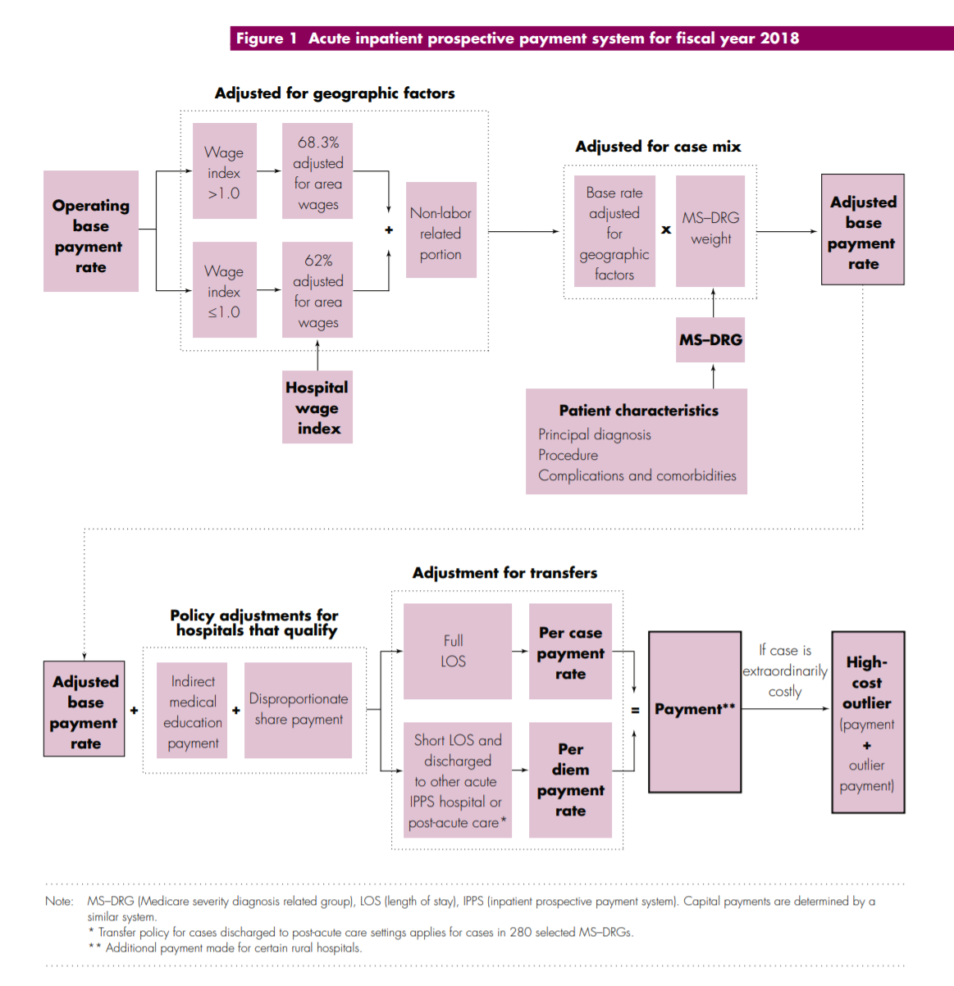

Slide 47
Managed Care model of health insurance
New in the 1970’s: Managed Care Organization (MCO) were developed with the goal to control the utilization and costs of medical care
Premiums determined by an experience rating
Relatively higher deductible and copayment amounts than traditional
Emphasize cost-effective methods of providing comprehensive services
Main functions of insurer: Integrate financing and delivery of health care
Maintaining networks of providers
Utilization review
Quality control
Alternative compensation schemes
Notes:
The original goals of MCO’s were to eliminate the high-cost, low-benefit medicine associated with traditional fee-for-service indemnity insurance (the moral hazard problem). Proponents thought MCO’s would reduce the need for more expensive specialty and inpatient care.
Experience rating – individuals/groups into different risk categories (risk pools) based on identifiable characteristics (age, gender, industry, prior illness)
delivery of health care – this includes Maintaining networks of providers and reviewing providers
Traditional fee-for-service gives physicians incentive to “overutilize” medical services.

Slide 48
Managed Care and Physician Incentives
Health Maintenance Organization (HMO)
A Primary care provider (PCP) acts as a gatekeeper
Four distinct types of HMO:
Staff model: Physicians employed by HMO on a salary basis
→ no incentive to over-provide care
Group model: HMO contracts with one group practice, paid by capitation
→ Physicians incentivized to limit services/use of medical services
Network model: HMO contracts with multiple group practices, paid by capitation
Individual Practice Association (IPA) model: HMO contracts with multiple doctors in various practices, paid by a discounted fee-for-service
→ Some incentive to overutilize exists
Notes:
Capitation pays a set amount for each enrolled person assigned to them, per period of time, whether or not that person seeks care. The amount of remuneration is based on the average expected health care utilization of that patient, with payment for patients generally varying by age and health status.
Under capitation there is an incentive to consider the cost of treatment. Pure capitation pays a set fee per patient, regardless of their degree of infirmity, giving physicians an incentive to avoid the most costly patients
Providers who work under such plans focus on preventive health care, as there is a greater financial reward in the prevention of illness than in the treatment of the ill. Such plans divert providers from the use of expensive treatment options.

Slide 49
Managed Care and Physician Incentives, ctd.
Preferred Provider Organization (PPO)
Insurer contracts w/ multiple physicians, pays by discounted FFS
Some incentive for over-utilization exists
Enrollees pay higher deductible or copay to see physicians outside of network
Point-of-Service (POS) plans
Like a PPO: Insurer contracts w/ multiple physicians & Enrollees pay higher deductible or copay to see physicians outside of network
Like an HMO: Enrollees also assigned a primary caregiver to act as gatekeeper for specialists and inpatient care.
Note: Some of these distinctions have become blurred in practice/over time
Notes:
Note: Some of these distinctions have become blurred in practice/over time; for example:
-- Now conventional insurance plans usually involve some type of utilization review program
--
Note: Now we have a few more types of plans –
-- Exclusive provider organizations (EPOs) – no coverage at all for out-of-network providers
Consumer-driven healthcare plans (CDHPs) – in contrast with patient-driven healthcare of the traditional models and payer-driven healthcare of the HMO’s
-- Catastrophic coverage plans – eligible if under age 30 – lower premium but very high deductibles, 1st 3 primary care visits do not count towards deductible
-- High-deductible health plans (HDHPs), which may be linked to health savings accounts (HSAs) -- lower premium but much higher deductibles and out of pocket costs
Note: Following the ACA, we also classify plans based on levels of coverage – Bronze, Silver, Gold, Platinum (this is a separate classification from the plan types/structures we are talking about here).

Slide 50
Medicaid Managed Care
Over 70 percent of Medicaid recipients were receiving their care via private health plans
Managed care plans can do things that state Medicaid agencies cannot:
Use sophisticated network contracting, information technology, and utilization management systems to squeeze out low-value care and improve the health of beneficiaries.
States with Medicaid MCOs often have to administer Medicaid in geographic areas the MCOs don't operate
So while MCOs reduce state administrative overhead, this can be limited
States seeking budget predictability may set per-member-per-month before MCO contracts are created
CMS requirement that rates be "actuarially sound" provides limited protection
Managed care can reduce utilization
but state Medicaid single payer pays lower per-unit costs
Notes:
https://www.healthaffairs.org/do/10.1377/hblog20180430.387981/full/
https://www.healthaffairs.org/do/10.1377/hblog20180430.510086/full/

Slide 51
Bundled Payments and ACOs
Bundled payment
An accountable provider is established for each episode of care
A price is established which should account for all payments involved in the episode
Providers, including the accountable provider and other possible providers such as clinics, therapists, etc. are reimbursed during the episode.
The total cost of the episode of care is compared to the established price
If the total cost is greater than the price, the accountable provider reimburses the insurance company/Medicare
If the total cost is less than the price, the accountable provider receives the difference
The accountable provider may reimburse other providers involved in care a share of the total savings
Notes:
https://catalyst.nejm.org/aco-bundled-payment-coexist/

Slide 52
Bundled Payments and ACOs
Accountable Care Organizations
“An organization of health care practitioners that agrees to be accountable for the quality, cost, and overall care of Medicare beneficiaries who are enrolled in the traditional fee-for-service program who are assigned to it“ –CMS definition
Similar to an HMO but provider led rather than payer led
ACOs are composed mostly of hospitals, physicians and other healthcare professionals, but may include health departments, social security departments, safety net clinics and home care services
Notes:
https://catalyst.nejm.org/aco-bundled-payment-coexist/

Slide 53
Bundled Payments and ACOs
Coexistence is based on separate lanes for the two models
ACO to enhance primary care
Grown from 27 in 2012 to more than 550 in 2018
Bundled payment model to improve specialty care.
Bundled payments currently mostly used for joint replacement care
The Affordable Care Act includes provisions that encourage bundled payments and ACOs
Some concern this will catalyze mergers and vertical integration
Mixed evidence for reduced cost and improved quality so far
Notes:
https://catalyst.nejm.org/aco-bundled-payment-coexist/

Slide 54
Accountable Care Organizations
Definition: A group of physicians (possibly including a hospital) that assumes responsibility for annual Medicare spending for a defined patient population. (defined by the Medicare Payment Advisory Commission – MedPAC)
MedPAC reimbursements to ACOs combines Fee-for-service and P4P.
The idea of ACOs existed prior to the ACA, but the ACA is now seen as creating ACOs through this reimbursement strategy
Idea originated with Pete Welch in 1989

Slide 55
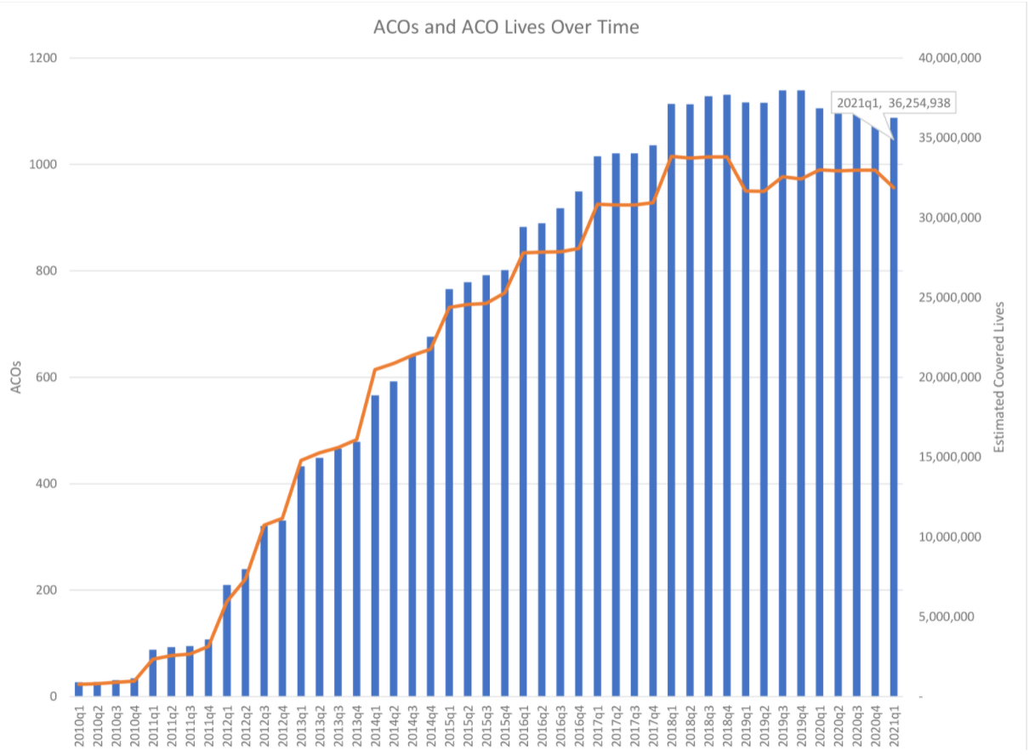
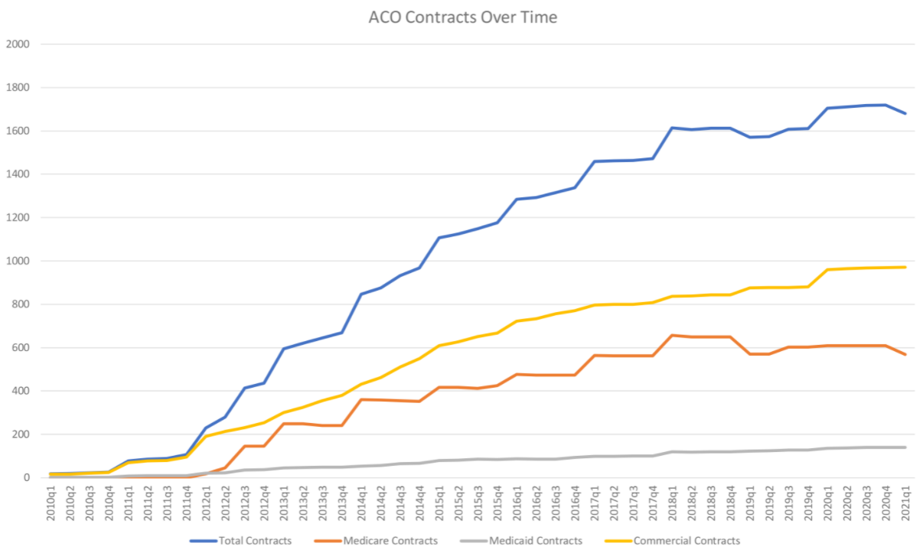
Growth in ACOs
As of 2021, ~950 ACO contracts cover 36 million people (>10% of the US population)
Commercial and Medicare contracts both significant

Slide 56
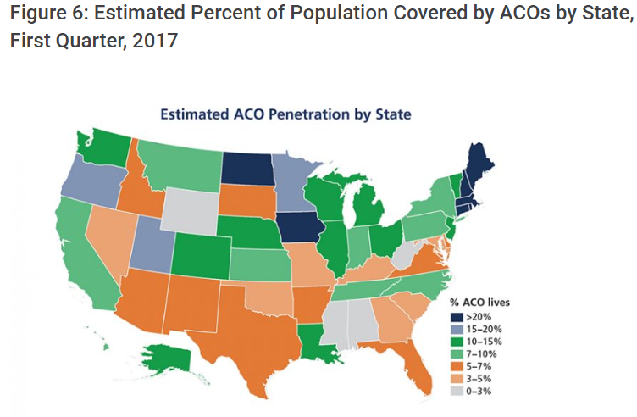
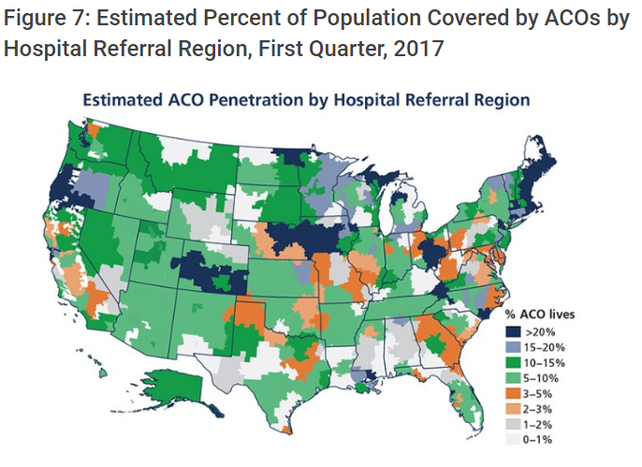
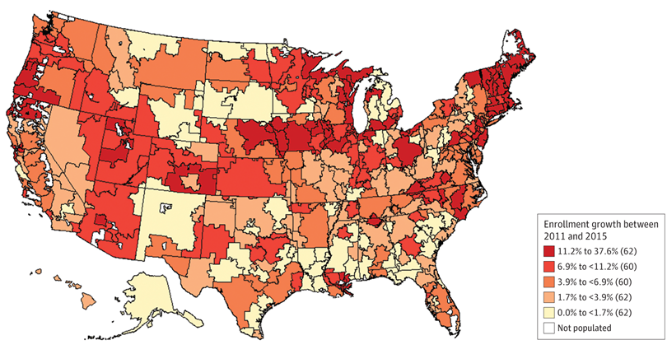
Growth in ACOs
Regional patterns:
ACOs strong in New England, Northern Prairie States, Western Great Lake States
Growing fast in the West
Lagging in the South

Slide 57
Theoretical Pros & Cons of VI
Pros – consolidation and VI could increase efficiency
Economies of scale
Ease of access to capital
Decreased management/regulatory duties for physicians
Eliminate duplicative services – through electronic medical records (EMR)
Improved coordination of care – all caregivers are under one roof, EMRs
Physicians receiving salary do not face the lower cost paid by Medicare/Medicaid patients – this could increase patient access to physicians
Increased financial stability and work-life balance, reduced risk for physicians
Cons – consolidation and VI could also decrease efficiency
Reduced organizational flexibility
Loss of focus on the core business
Diffusion of expertise
More complex management challenges
Adverse effects of reduced compensation
Notes:
For physicians, VI means there is often a tradeoff between physician autonomy and support from a healthcare system.

Slide 58
VI vs Horizontal mergers: Market power and the HHI
Herfindahl-Hirschman Index (HHI), a measure used by the DOJ and Federal Trade Commission (FTC) as an indicator of market competition.
HHI is the sum of the squared market shares of all firms in a market.
So, if a market has four companies and each has a 25 percent market share, the HHI would be 2,500 or 252 + 252 + 252 + 252.
If a market has four companies and 3 have 10 percent market share and the forth has 70, the HHI would be 5,200 or 100 + 100 + 100 + 4900.
Smaller numbers indicate greater competition.
A monopoly market with one firm has an HHI of 10,000
What will happen to the HHI after a horizontal merger?
HHI will increase – change in HHI is a good measure of the effect of a horizontal merger on market competitiveness
What will happen to the HHI after a vertical integration?
HHI may not change – HHI is less useful to understand the effect of vertical integration on market competitiveness

Slide 59
Hospital and Physician Vertical Integration (VI)
Mid-1990’s Clinton Healthcare Reforms
HMO & MCO growth in 1990’s incentivized hospitals to purchase PCP’s to build a referral base -- “captured lives”
Early evidence of reductions in hospital revenues led to decline in VI in early 2000’s
Evidence that salaried physicians worked less hard than those who owned their practices
Another push towards VI in the 2010’s following the ACA
Accountable Care Organizations incentivize VI.
Notes:
Berenson, Robert A. “A Physician's Perspective On Vertical Integration.” Health Affairs. Vol. 36, Iss. 9, (Sep 2017): 1585-1590.

Slide 60
Examples of Hospitals and Physician VI
Kaiser Permanente and Sutter Health, both in California
University of Pittsburgh Medical Center
Partners Healthcare Massachusetts
Closer to home:
Vertical Integration
Connecticut Children’s Medical Center to purchase HeadZone, a concussion center in Shelton serving ages up to 22
Aetna-CVS-Caremark-MinuteClinics
Horizontal mergers also common
Yale New Haven Hospital acquired the assets of the Hospital of Saint Raphael in 2012
Western CT Health system and Hudson Valley Hospital System merged in 2018
Notes:
https://www.courant.com/business/hc-biz-danbury-hospital-network-merger-20180328-story.html
http://www.hartfordbusiness.com/article/20180802/NEWS01/180809973/ct-childrens-med-center-to-purchase-shelton-concussion-clinic

Slide 61
So, Are MCO’s “good” or not?
Ideally, MCOs should encourage preventive and coordinated primary care, which reduces the need for more expensive specialty/inpatient care.
But often most MCOs are concerned with short-term profitability.
Why pay for cholesterol-lowering pills when the enrollee is likely to leave your HMO years before he has a heart attack?
In general, studies show that HMOs provide medical cost savings of 15-20%, mostly through reduced hospital care.
The impact of HMOs on quality of care is less definite.
Health care providers treat patients belonging to a variety of plans.
Notes:
MCO’s were designed with the problem of moral hazard in mind, and focused in changing patient and provider incentives to reduce wasteful/unnecessary medical care. However if we think about what incentives MCO’s are facing -- Perhaps there is moral hazard involved there as well?
We have been debating the effect of MCOs on the cost and quality of medical care for some time now.

Slide 62
New Methods: Pay for Performance
A pay-for-performance (P4P) model provides a financial incentive to providers who meet defined performance goals
Often used as a first step in transitioning toward more value-based care; easily combines with current fee-for-service methodology
Traditionally has been implemented as an “upside only” (bonus) approach to promote increased quality; more recently, the developing trend is to add a downside (penalty) component for poor performance on defined measures
Value-based purchasing ties payment to quality
Focus on specific conditions
Acute Myocardial Infarction (AMI), Heart Failure, Pneumonia
Coronary Artery Bypass Graft (CABG), Total Hip and Knee Replacement (THKR), Chronic Obstructive Pulmonary Disease (COPD)
Surgeries (as measured by SCIP), Healthcare-associated infections

Slide 63
New Methods: Pay for Performance
Literature reflects potential ethical “pitfalls” and unintended consequences of this approach. For example, this model:
Creates a potential incentive to deselect patients who are difficult to treat and would make meeting the performance goals more difficult
Creates a potential incentive to provide unnecessary care—care unnecessary for appropriate patient care but helpful to meet the performance goal

Slide 64
Pay for Performance: HACs
In 2008, Medicare reduced payments to hospitals for hospital-acquired conditions
Cuts between 0% and 1% of payments (penalty only)
In the short term, there were hospital-level decreases in numbers of hospital-acquired infections, but these were difficult to sustain
In 2012, there was no measurable effect on rates of central line–associated infections or catheter-associated urinary tract infections nationally

Slide 65
Pay for Performance: excess readmissions and mortality
In 2008, Medicare reduced payments to hospitals for excess readmissions (HRRP) and excess mortality
Excess was measured based on comparing the hospital’s expected rates given their patient risk to their actual rates
6 conditions were included: Pneumonia, AMI, COPD, THKR, CABG, Heart failure.
Revenue neutral for Medicare – winners and losers
Effects up to 3% of costs
Mixed evidence for success, but overall reduction in excess readmission has been seen

Slide 66
New Methods: Merit Based Incentive Payment System
Medicare Access & CHIP Reauthorization Act (MACRA) of 2015
Repeals Sustainable Growth Rate(SGR) Formula
Introduced Merit Based Incentive Payment System (MIPS) for clinicians
Provides bonus payments for participation in eligible alternative payment models to encourage participation
Current quality and value programs for physicians and practitioners will be streamlined into MIPS
Annual update to physician fee schedule
FY2016 through 2018 =.5% increase
FY2019 = +/- 4% based on MIPS performance score
FY2020 = +/- 5% based on MIPS performance score
FY2021 = +/- 7% based on MIPS performance score
FY2022 onward = +/- 9% based on MIPS performance score

Slide 67
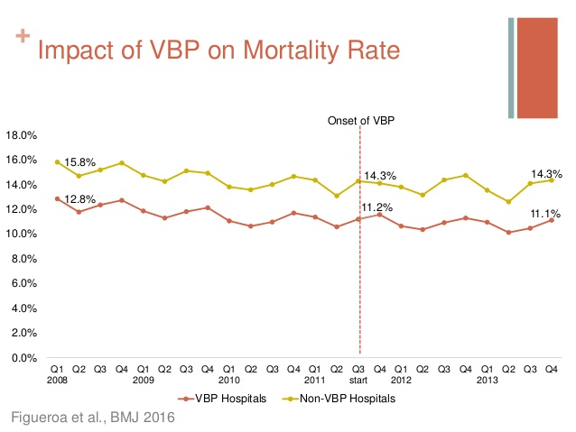

Slide 68
HCMI 4225: Gaming the Marketplace & Accountable Care Organizations
BUSN 202: Mon/Wed 12:30 PM – 1:45 PM
Shane Murphy – shane@uconn.edu

Slide 69
Challenges for Private Health Insurance Companies derived from Changing Public Policy Landscape
Re-insurance
Providing low premiums in a changing regulatory environment
Cost Sharing Reductions for low income individuals
Lowers out of pocket maximums
Increases Actuarial Value (increasing coverage amounts)
Federal funding cut – Insurance companies have chosen to continue to provide
Advanced Premium Tax Credits
Gaming System
Silver Gapping
Silver Spamming
Accommodating New Models of Health Insurance
Accountable Care Organizations
Medical Home and Bundled Payment Models
Managed Care Organizations

Slide 70
Re-insurance pools
Two flavors
State run external money
External source of state based money is added to the pool of money collected by premiums.
Only adopted in few states
CMS run catastrophic reinsurance
Funded by premiums
High-cost risk pool
Reimburses issuers for 60 percent of an enrollee’s aggregated paid claims costs exceeding $1 million.
Reinsurance reduces overall premiums
Reduces high premiums more than low premiums
Reduces non-subsidized premiums and raises subsidized premiums

Slide 71
Advanced Premium Tax Credits (APTC) (and Gold gapping aka silver loading)
Advanced Premium Tax Credits (APTC) are how people get subsidized to buy Qualified Health Plans on Exchange.
Based on an individual’s income as determined by their family unit’s FPL percentage and the cost of the second least expensive Silver plan offered on Exchange in their area.
Second least expensive plan is called the benchmark plan
The subsidy arrangement means that individuals with the same exact financial situation will pay the same amount post-APTC subsidy for the second lowest cost Silver plan across the country.
Zero premium plans happen when a plan is priced below the silver benchmark and the relative premium spread is bigger than the individual’s expected personal contribution.
For the 100-138% cohort, the personal contribution for a single individual ranges from $22/month to about $55 per month for the benchmark silver plan.
The goal is for premiums of cheapest plans not to exceed 9.66% of income

Slide 72
Silver gapping (and Gold gapping)
Advanced Premium Tax Credits (APTC) are how people get subsidized to buy Qualified Health Plans on Exchange.
Based on an individual’s income as determined by their family unit’s FPL percentage and the cost of the second least expensive Silver plan offered on Exchange in their area.
Second least expensive plan is called the benchmark plan
The subsidy arrangement means that individuals with the same exact financial situation will pay the same amount post-APTC subsidy for the second lowest Silver plan across the country.
Zero premium plans happen when a plan is priced below the silver benchmark and the relative premium spread is bigger than the individual’s expected personal contribution. For the 100-138% cohort, the personal contribution for a single individual ranges from $22/month to about $55 per month for the benchmark silver plan. The benchmark plan is a silver plan with 94% AV CSR benefits. That translates into a deductible ranging from zero to a few hundred dollars and an out of pocket max of less than $2,000. Compared to a baseline silver, this is a great improvement in the quality of the benefit. It is still significantly worse than Medicaid if we assume appointments can be found.
Silver gapping is the measure of the spread between the least expensive Silver plan in a county and the benchmark Silver plan.
The bigger the spread, the better the deal that subsidized folks may be able to get.
The smaller the spread, the worse (comparative) deal subsidized buyers get.
Silver gapping is only about the relative differences in price and not about the absolute price levels.
Increase in premiums from cancelling CSR reimbursement is thus partially offset by increasing APTC to consumers
Although Insurance companies must be aware of an use this strategy
Total payments from the government and receipts by insurance companies are less affected by cancelling CSR reimbursement

Slide 73
Silver Gapping
Maximizing silver gap maximizes the relative value of the APTC subsidy
Carriers offer a low price Silver and then a higher priced Silver as the benchmark
Drive people to the #1 Silver plan as it will be comparatively cheaper than the #2 Silver. It will also have the ability to drive people to very low premium Bronze plans.
Example in CA:
Region 16 that Molina made its play and gained its share. Molina put up both the cheapest silver and the cheapest bronze plans in that region — massively undercutting the benchmark silver plan, and thus offering buyers a major discount on the Cost Sharing Reduction (CSR) subsidies available only with silver. For a 40 year-old earning $23,000, a shared under 200% of the Federal Poverty Level (FPL), Molina silver is just $74 per month in Region 16 in 2016, vs. the benchmark silver’s $119 (Health Net). Molina’s bronze plan at that age and income level is just $1 per month, vs. $55 for the nearest competitor.

Slide 74
Silver Spamming
The goal of an insurer in the Silver Spam strategy is to offer the #1 and #2 silver plans in the region with a very small gap between those two.
Furthermore if they can keep the price of the second Silver significantly lower than the price of the first Silver plan offered by a competitor, they’ll capture a large segment of the market.
The objective of the Silver Spam strategy is to take away choice.
The relative value of the APTC when applied to the purchase of the 1st Silver is not much higher than it is when applied to the #2 benchmark Silver.
If there is a large gap between the Silver Spammer’s Silver plans and the next best offer, the Silver Spammer will capture a large proportion of the market for Silver and should (all else being equal) capture a decent proportion of the Bronze market.
Example in Chicago:
For a 40 year old non-smoker, Celtic/Ambetter offers the 1st and 2nd Silver at $195 and $198, as well as the next four Silvers. The first non Celtic/Ambetter Silver is priced at $249.
The Celtic/Ambetter Silvers are all HMOs, and they all are sharing the same very narrow network. The benefit configuration (deductibles and co-insurance) change, but the out of pocket maximums are all tightly clustered. These six plans are functionally similar plans. The business decision to introduce these six plans, and more importantly the #2 Silver at just a few bucks more than #1 is a membership recruitment decision.
Both these “APTC hacking” strategies capitalize on regions with a small number of insurers

