Slide 1
HCMI 4225: Insurance and Hospital billing

Slide 2
Administrative costs
Administrative costs represent between 25% and 34% of US healthcare expenditures
62% of the Administrative costs in the US are billing and insurance-related
Largely these are costs for the providers
Primary care billing costs 4 times as much in the US as in Canada

Slide 3
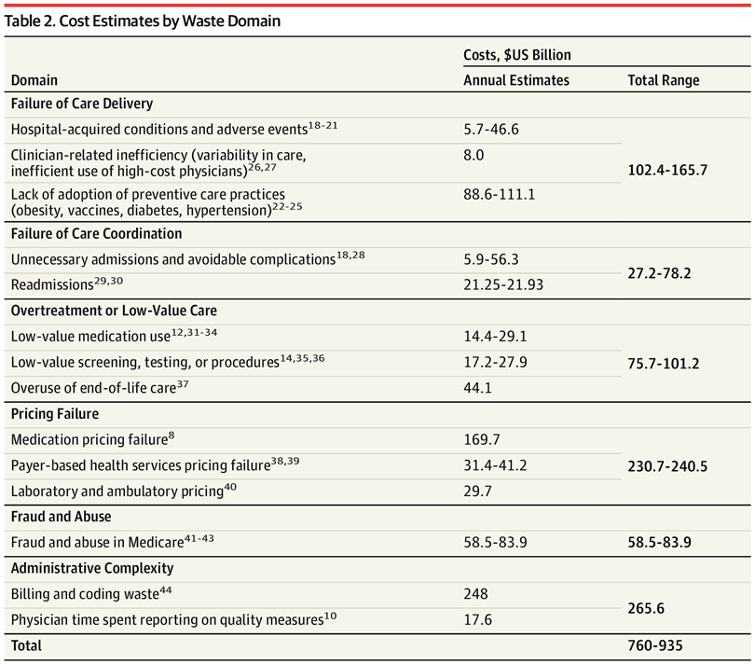

Slide 4
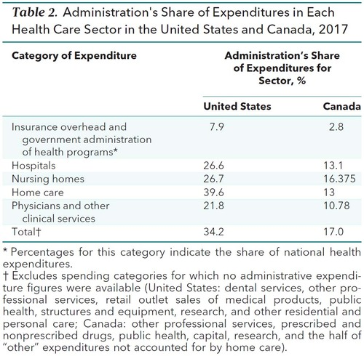
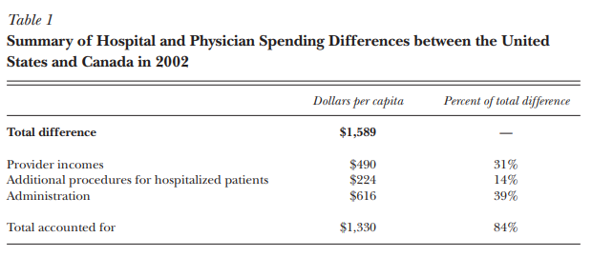
Administrative Costs

Slide 5
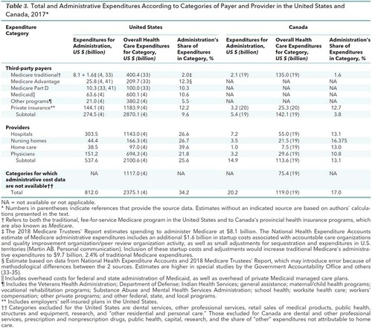
Administrative Costs

Slide 6
Electronic Health Records (EHR)
One attempt to control these was establishing EHR systems
Patient record coding is usually processed manually using the HER system
Automated coding is rare outside of primary care and clinic visits
We’ll come back to this

Slide 7
Hospital revenue cycle process
Four parts
Pre-encounter
Intra-encounter
Hospital Post-Encounter
Professional Post-Encounter

Slide 8
Scheduling
Collect patient demographic and insurance information
Minimal time costs
Pre-registration
Hospital care often requires pre-registration, pre-authorization, or pre-certification
Some cases can be handled within 24 hours, most need 3-5 days
Manual review of patient charts and response to payer questions through online interfact
Required for all inpatient stays and surgeries
Also for radiology, cardiology, oncology, neurology, PT, OT, and speech pathology
Some urgent/emergent cases (occasionally via retro-authorization)

Slide 9
Registration
Insurance verification, co-payment, paperwork (often payer-specific)
Longer for inpatient care
Note: these are high turnover jobs that serve as entryways into health careers
Physician Billing tasks:
Documenting review of systems
Filling in data elements for billing
Often these two are beyond what is clinically necessary
Obtaining authorization from payers
Conversations with billing organizations
Utilization management phone calls
Responding to coding enquiries
Charge entry is generally automated

Slide 10
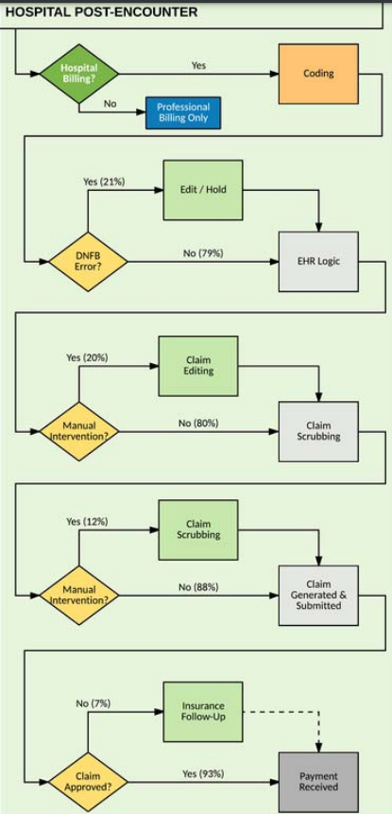
Hospital Post-Encounter
Coding
Four teams (actually five): inpatient, ED, ambulatory surgery and observation, and clinic visits (and coding denial handling)
Three skill sets:
Surgical coders
Emergency department coders
Exception-based pre-billing coders who process edits for ambulatory visits in the outpatient setting and physician rounding in the inpatient setting
May be payer-specific
EHR logic
Error handling
Discharged not final billed (DNFB) errors
Claim Scrubbing
Checks for errors that will lead to payer denial
Cases include exceptions to standard billing practices such as services without co-pay (like vaccines)
Separate software from EHR, sometimes manual

Slide 11
Hospital Post-Encounter

Slide 12
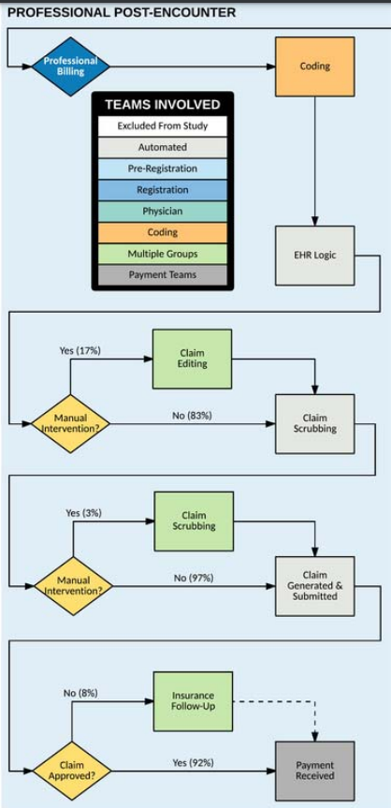
Professional Post-Encounter
Coding
Four teams (actually five): inpatient, ED, ambulatory surgery and observation, and clinic visits (and coding denial handling)
Three skill sets:
Surgical coders
Emergency department coders
Exception-based pre-billing coders who process edits for ambulatory visits in the outpatient setting and physician rounding in the inpatient setting
May be payer-specific
EHR logic
Error handling
Discharged not final billed (DNFB) errors
Claim Scrubbing
Checks for errors that will lead to payer denial
Cases include exceptions to standard billing practices such as services without co-pay (like vaccines)
Separate software from EHR, sometimes manual

Slide 13
Denials
Billing denials team
Provider enrollment team
Non-coverage
Can be appealed asserting medical necessity
Denials are either eventually paid or written off
One study found write-offs made up about 1.25% of gross charges
No-response follow up is infrequent

Slide 14
Payment process
Cash management
Manages relationships with banks and merchants (mostly credit card companies)
Bills are sent out automatically
Payment posting – logging payments into software
Some (7% in one study) payments must be manually posted
Manual cases also require manual processing of explanation of benefits (EOB)
Different organizations structure processes differently with teams combined or duties distributed in different ways

Slide 15
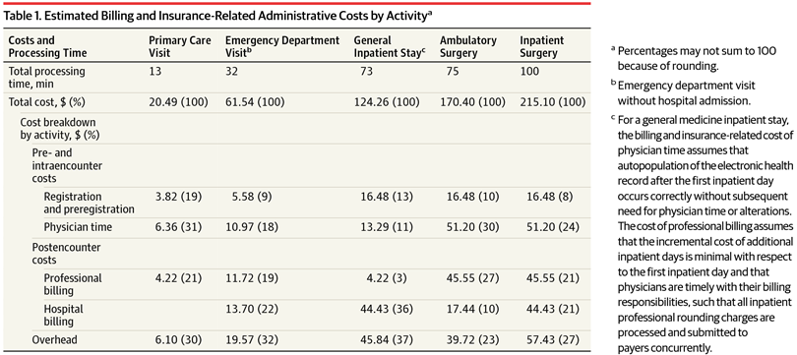
Cost of billing times

Slide 16
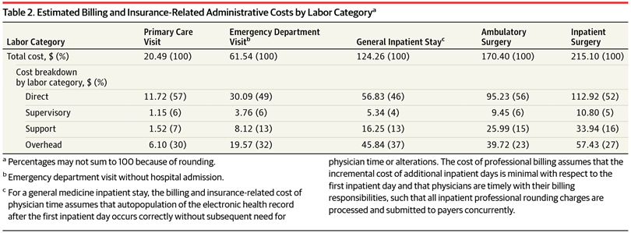
Cost of billing times

Slide 17
Cost of billing times

Slide 18
Inpatient Physician time use
Interns: A mean (SD) of 15.9 hours of a 24-hour period (66%) was spent in indirect patient care, mostly interactions with the patient’s medical record or documentation. A mean (SD) of 3.0 hours was spent in direct patient care (13%) and 1.8 hours in education (7%).
Intensive Care:
Physicians, 14.73-17.96% of their time was spent in patient rooms, compared with 40.63%-30.09% spent in the physician work room and the remaining 44.64% -51.95% elsewhere.
Nurses, 32.97%-32.85% of their time was spent in patient rooms, 11.34%-11.79% spent just outside patient rooms. They spent 11.58%-13.16% of their time at the nurses' station and 23.89%-24.34% elsewhere
From a patient's perspective, time with at least one health care worker of a designated type in their intensive care unit room, were distributed as follows: 13.11%-9.90% with physicians, 86.14%-88.15% with nurses, and 8.14%-7.52% with critical support staff (eg, respiratory therapists, pharmacists).

Slide 19
Administrative Cost Savings possible
Overall, interacting with payers cost U.S. physician practices a mean of $169 302 annually per physician and accounted for 21.8% of gross receipts, equivalent to $151.2 billion nationally or $465 per capita.
The comparable estimates for Canada were $36 825 per physicians, 10.78% of gross receipts, and $87 per capita.
Health care administrative costs in the United States in 2017 totaled $812.0 billion, $2497 per capita ($2696 per insured person), or 34.2% of total spending in the categories for which data are available.
The comparable estimates for Canada are $551 per capita ($593, assuming U.S. wage rates in doctors' offices), or 17.0% of expenditures.
The difference amounts to over $1900 per capita (or over $2100 per insured person)
In the United States, 531.2 persons per 10 000 population worked in health care delivery settings, including 129.7 per 10 000 population in administrative occupations.
The comparable figures for Canada were 458.9 per 10 000 population overall, and 88.9 per 10 000 population in administration.

Slide 20
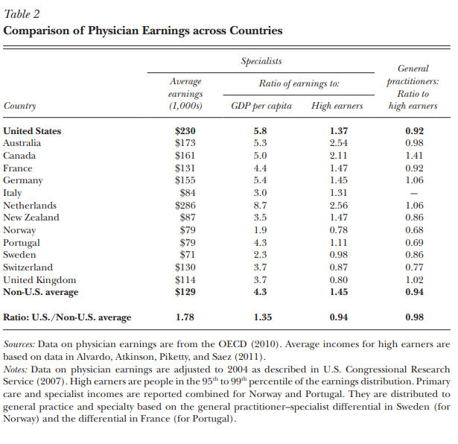

Slide 21
Sources
Tseng, Phillip, Robert S. Kaplan, Barak D. Richman, Mahek A. Shah, and Kevin A. Schulman. "Administrative costs associated with physician billing and insurance-related activities at an academic health care system." Jama 319, no. 7 (2018): 691-697.
Butler, Rachel, Mauricio Monsalve, Geb W. Thomas, Ted Herman, Alberto M. Segre, Philip M. Polgreen, and Manish Suneja. "Estimating time physicians and other health care workers spend with patients in an intensive care unit using a sensor network." The American journal of medicine 131, no. 8 (2018): 972-e9.
Himmelstein, David U., Terry Campbell, and Steffie Woolhandler. "Health care administrative costs in the United States and Canada, 2017." Annals of internal medicine 172, no. 2 (2020): 134-142.
Cutler, David M., and Dan P. Ly. "The (paper) work of medicine: understanding international medical costs." Journal of Economic Perspectives 25, no. 2 (2011): 3-25.
Shrank, William H., Teresa L. Rogstad, and Natasha Parekh. "Waste in the US health care system: estimated costs and potential for savings." Jama 322, no. 15 (2019): 1501-1509.

