Slide 1
HCMI 4225: Health and Social Insurance
Busn 203: Mon/Wed 12:30 AM – 1:45 PM
Shane Murphy – shane@uconn.edu
Office Hours: ?

Slide 2
Welcome to class!
Introductions:
  What is your name and major?
  What is one, two, or three pieces of content (tv show, movie, book, podcast) that are explain something about you?
  What is your favorite animal (optional)?

Slide 3
Class organization
  Homework (10 points each)
    Due on Wednesdays?
      One week grace period
      After one week, one point will be deducted
  Quizes? (10 points each)
    About once a week
    Open note/open internet/open friend
  Office Hours
  Discussions
    Google Docs sign ups
  Midterm
    October?
  Final Paper
    Presentation option
  Final Exam

Slide 4
Health and Social Insurance Course Topics
What is it and why does social insurance exist?
  Justifications
  History
What is the current state of health and social insurance in the US?
  Particular focus on the ACA (Medicaid expansion, health exchanges)
What is the future of health and social insurance?
  Trends in insurance products
  Reform proposals
  International comparisons

Slide 5
Health Providers
Your normal days may be your patients’ worst days
Your job is to manage crises
  Pandemics, overburdened facilities, cost overruns and revenue shortfalls, uninsured patients, mental illness in patients and fellow staff/prividers
There will be a pandemic or near pandemic most years
There will be major shifts in the financing, regulations, and/or organizational structure of health care in your area/state/region most decades if not more often

Slide 6
Past Epidemics
2002-2004 South Asian Respiratory Syndrome (SARS)
2009 H1N1 (or swine flu) pandemic
2012 Middle Eastern Respiratory Syndrome (MERS).
2014 polio outbreak
2014 outbreak of Ebola in Western Africa
2015–16 Zika virus epidemic
2018–20 Kivu Ebola epidemic
2019–20 novel coronavirus outbreak (Covid-19)

Slide 7
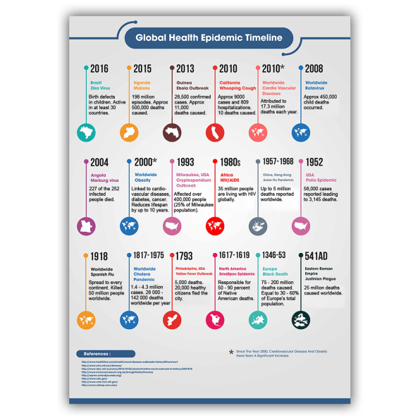

Slide 8
HIV/AIDS
TLC – Waterfalls (May 1995)
  https://www.youtube.com/watch?v=8WEtxJ4-sh4?t=140
Thom Gunn - The Man with the Night Sweats (2009)
  https://www.poetryfoundation.org/poems/47956/the-man-with-night-sweats
David France – How to Survive a Plague (January 2012)
  Available on HuskyCT, HBO Max/AMC+/DirectTV, and for rent/purchase at other services
Russell T Davies – It’s a Sin (January 2021)
Our Lady J – Pose (2018-2021)

Slide 9
Health Landscape and Health Costs
Key points:
  Expenditure is growing
  The United States is different
  Measurement of mortality and morbidity
    Importance of direct discussion of mortality and morbidity for health professionals
  Causes of mortality and morbidity vary
    By age, sex, and disease
  Entry points into the healthcare system vary
    By age, sex, and disease
  Drivers of health care expenditure vary
    By age, sex, and disease

Slide 10
Contemplation Question
Health expenditure and GDP in the United States are rising. Is Health Expenditure as a share of GDP also rising? Should it be?

Slide 11
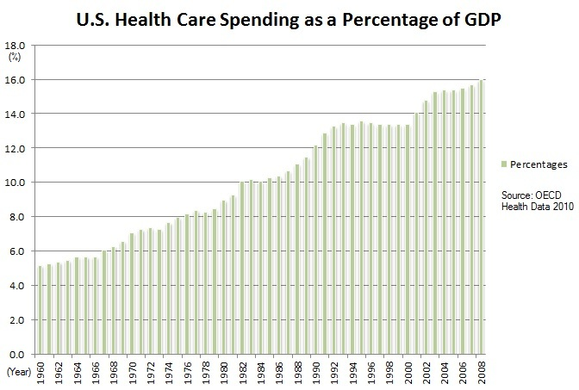
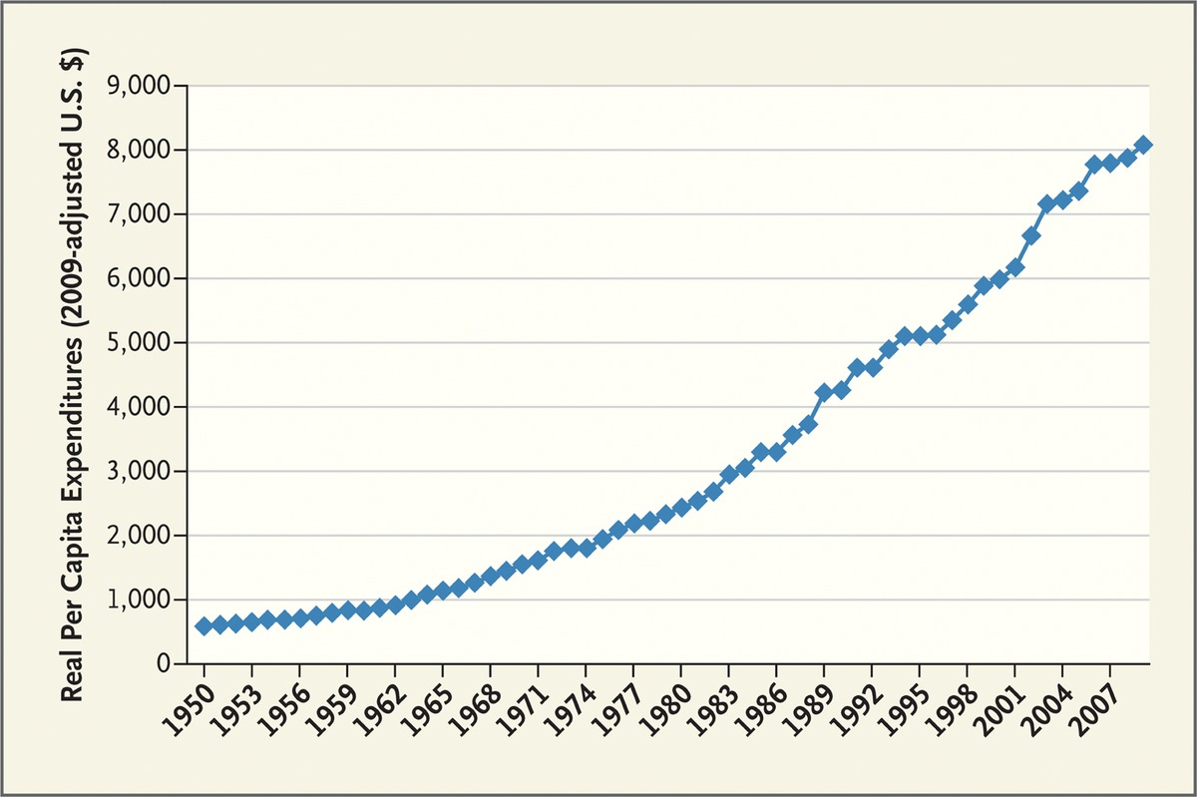
US Health Expenditure
Expenditure are increasing both in real terms and as a percentage of GDP
Fuchs 2012

Slide 12
Contemplation Question
Is the United States and outlier?
How could we tell?

Slide 13
Comparing National Health Expenditures

Slide 14
Comparing National Health Expenditures (Preston Curve)

Slide 15
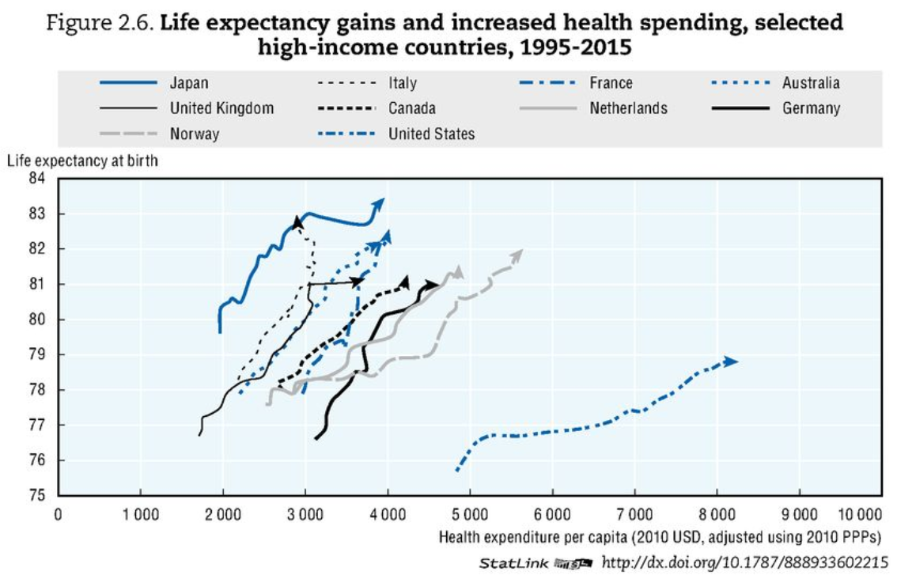
Comparing National Health Expenditures
OECD Health Data 2017

Slide 16
Unresolved Question
Is it bad that the United States is an outlier?
Is the United States wildly abnormal?
Is the income diversity (or other diversity) in the United States driving its outlier status?
Does Health Expenditure have a different meaning in the United States than elsewhere?

Slide 17
Measures of health
Mortality Rate: deaths per year usually per 100,000 people
Morbidity: illness, measured also as a rate per 100,000
YLL: years of life lost to a disease
DALY/QALY: sum of YLL and years of life lived with a disability

Slide 18
Disease Groups
Communicable Diseases
Neoplasms
Cardiovascular Diseases
Chronic Respiratory Diseases
Cirrhosis
Digestive Diseases
Neurological Diseases
Mental and Substance Abuse Diseases
DUBE
Musculoskeletal Disorders
Non-communicable Diseases
Injuries
Well Care
Risk Factors

Slide 19
Visualizing US Health and Health Expenditure
Health:
  https://vizhub.healthdata.org/gbd-compare/
Health Expenditure:
  https://vizhub.healthdata.org/dex/

Slide 20
Discussion Question
What causes the most disability?

Slide 21
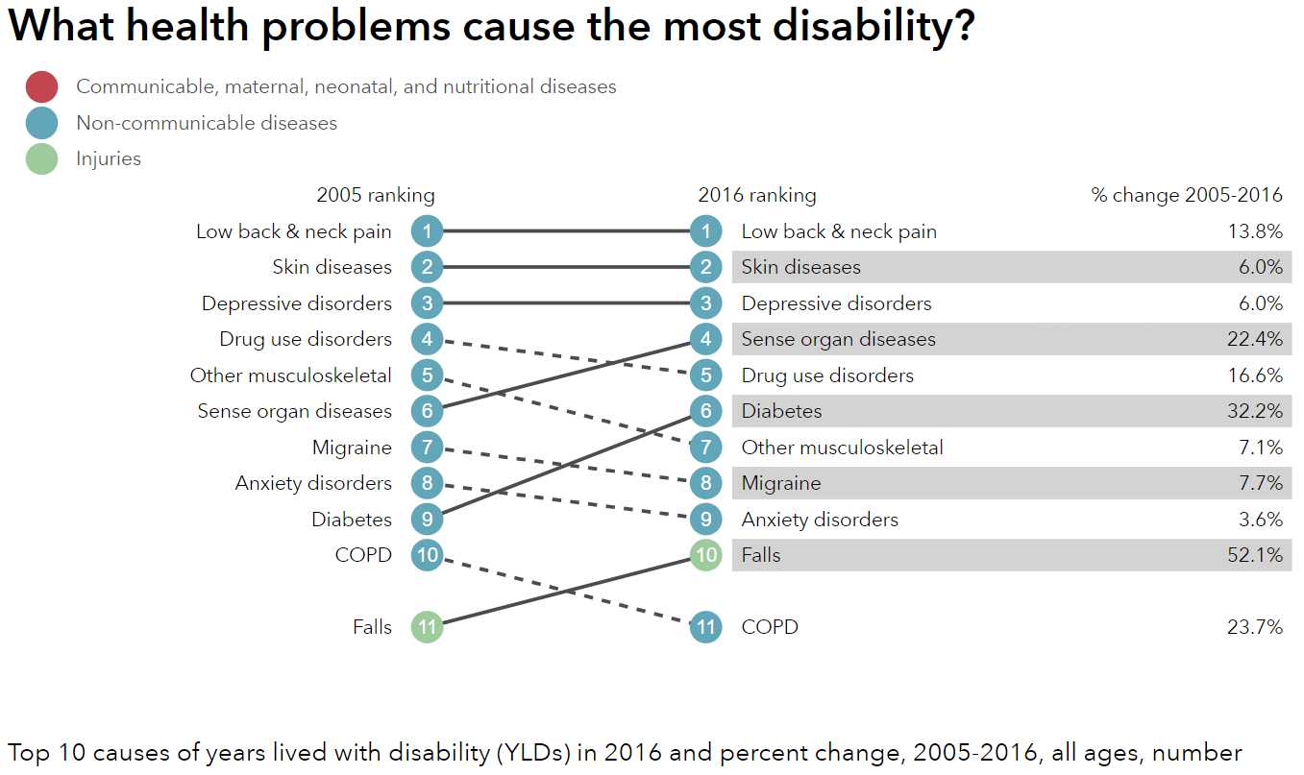
http://healthdata.org/us-health

Slide 22
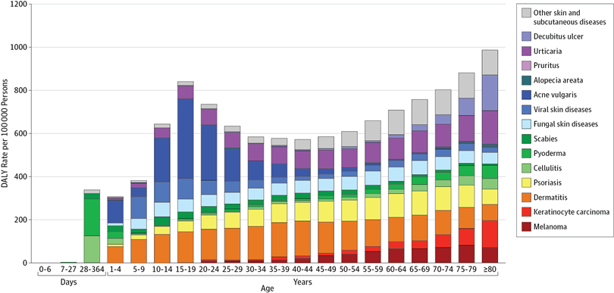
Unpacking DALY cost of skin diseases by age
Karimkhani et al 2017

Slide 23
Discussion Question
What causes the most deaths?

Slide 24
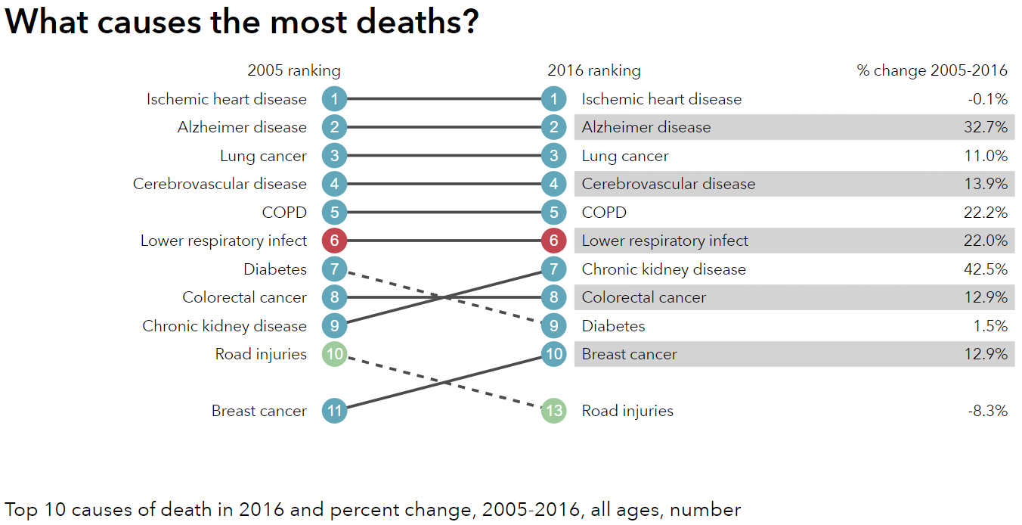
http://healthdata.org/us-health

Slide 25
Visualizing US Health and Health Expenditure
Health:
  https://vizhub.healthdata.org/gbd-compare/
Health Expenditure:
  https://vizhub.healthdata.org/dex/

Slide 26
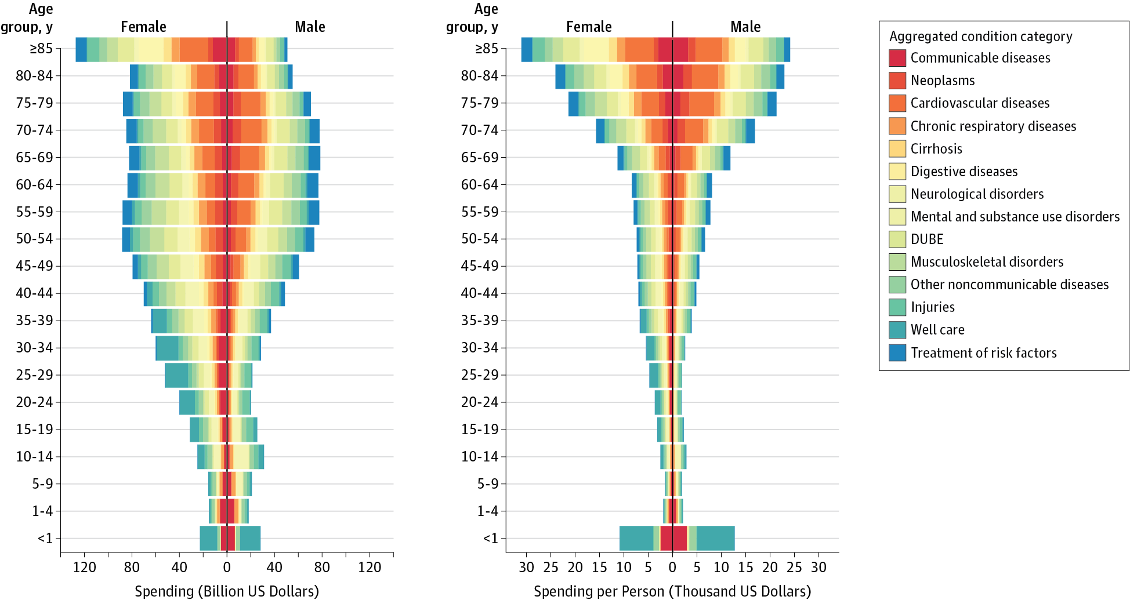
Health Care Costs by Age, Sex, and Disease
Dielman et al 2016

Slide 27
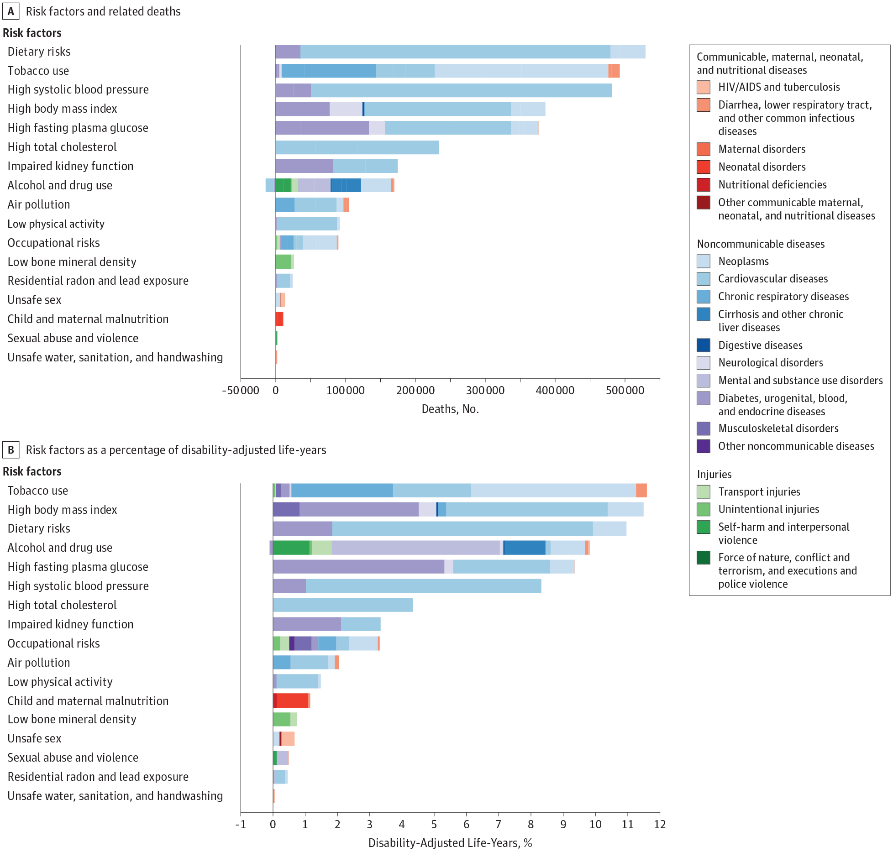
Risk Factors

Slide 28
Risk Factors

Slide 29
Unresolved Question?
Is the problem Big Pharma? Is it too many hospital administrators? Is it predatory nursing facilities?
In a broad sense, who is driving health care costs?
How should insurance premiums be structured given the distribution of costs across age and sex?
Does Medicare cause Health Care Costs to grow among people aged 65 and up or does increasing illness cause Health Care Costs to grow in this population?

Slide 30
Discussion question
Why do some say that health care in the united states is the best in the world?

Slide 31
Discussion question
Why do some say that health care in the united states is the best in the world?
  For those who can afford care, quality is often very high
  US is leader in innovation and development
  Inequality in disease risk is higher in US than other wealthy countries
  US leads in some statistics such as cancer survival rates
  About 40 percent of the world’s medical travelers—people who go abroad to obtain acute elective care—come to the United States

Slide 32
Hospital care in the US is (mostly) excellent
Five-Year Survival Rates for Patients Diagnosed with Five Common Cancers in Seven Countries, 2005–2009
Country | Female Breast | Colon | Lung | Prostate | Childhood Leukemia
Canada* | 85.8 | 62.8 | 17.3 | 91.7 | 90.6
France** | 86.9 | 59.8 | 13.6 | 90.5 | 89.2
Germany | 85.3 | 64.6 | 16.2 | 91.2 | 91.8
Italy | 86.2 | 63.2 | 14.7 | 89.7 | 87.7
Japan | 84.7 | 64.4 | 30.1 | 86.8 | 81.1
United Kingdom* | 81.1 | 53.8 | 9.6 | 83.2 | 89.1
United States | 88.6 | 64.7 | 18.7 | 97.2 | 87.7

Slide 33

Other epidemics in art
Opium/drugs
  John Prine – Sam Stone (1971)
  https://www.youtube.com/watch?v=OLVWEYUqGew
Spanish Flu
  Edward Munch
  Self-Portrait with the Spanish Flu
  Self-Portrait after the Spanish Flu
Obesity

Slide 34
The Man with Night Sweats
BY THOM GUNN
I wake up cold, I who
Prospered through dreams of heat
Wake to their residue,
Sweat, and a clinging sheet.
My flesh was its own shield:
Where it was gashed, it healed.
I grew as I explored
The body I could trust
Even while I adored
The risk that made robust,
A world of wonders in
Each challenge to the skin.
I cannot but be sorry
The given shield was cracked,
My mind reduced to hurry,
My flesh reduced and wrecked.
I have to change the bed,
But catch myself instead
Stopped upright where I am
Hugging my body to me
As if to shield it from
The pains that will go through me,
As if hands were enough
To hold an avalanche off.

Slide 35
Sources:
Fuchs, Victor R. "Major trends in the US health economy since 1950." New England Journal of Medicine 366, no. 11 (2012): 973-977.
Dieleman, Joseph L., et al. "US spending on personal health care and public health, 1996-2013." Jama 316.24 (2016): 2627-2646.
Indicators, O. E. C. D. "Health at a Glance 2017." OECD Indicators, OECD Publishing, Paris. https://read.oecd-ilibrary.org/social-issues-migration-health/health-at-a-glance-2017_health_glance-2017-en#page1
Karimkhani, Chante, Robert P. Dellavalle, Luc E. Coffeng, Carsten Flohr, Roderick J. Hay, Sinéad M. Langan, Elaine O. Nsoesie et al. "Global skin disease morbidity and mortality: an update from the global burden of disease study 2013." JAMA dermatology 153, no. 5 (2017): 406-412.
IHME Data Visualizations: https://vizhub.healthdata.org

