Slide 1
HCMI 4225: Welfare in the US
BUSN 202: Mon/Wed 12:30 AM – 1:45 PM
Shane Murphy – shane@uconn.edu
Notes:
https://www.youtube.com/watch?v=mr_8B1IzFFY&ab_channel=PBSNewsHour

Slide 2
Welfare as insurance
Social risk of economic downturns
Welfare programs finance needs of low income individuals
Multiplier effect
  By how much does the economy grow for a dollar of new government spending
    In models depends on many factors
    Multiplier for spending by giving money to consumers depends on savings rate of consumer
      Marginal propensity to consume

Slide 3
Multipliers and marginal propensity to consume
Marginal Propensity to Consume
  If you get a dollar how much will you spend on consumption (vs savings)
Higher MPC -> higher multiplier
  MPC higher for low income individuals
  MPC higher for aid in kind (ie aid that must be spent on certain types of goods like food (SNAP), health (Medicaid) or housing (Section 8))
Focusing government programs on people who need it is called Means Testing
  Pro – cheaper, intuitively effective
  Con – broader programs can be more popular, broader programs often found to be more empirically effective

Slide 4
Recession Ready - Hamilton Project of Brookings and Equitable Growth
Every chapter was on a different automatic stabilizer
Currently existing
  unemployment insurance
  extended benefits
  Programs:
    TANF (welfare), Unemployment Insurance, Medicaid (health insurance for low income individuals), SNAP (food stamps), the Earned Income Tax Credit (EITS), Medicare (health insurance for older individuals), housing assistance (such as Section 8), and Social Security (pensions for older individuals)
New proposals
  Infrastructure
  Direct payments to individuals

Slide 5
How to increase spending more quickly: Sahm Index/Sahm Rule
Three-month average of monthly unemployment rate
  current rate and the two prior.
  monthly data's noisy, so you don't want to overreact to little ups and downs
Compare current month to prior 12 months.
If the difference is half a percentage point or more, we're in a recession

Slide 6
Claudia Sahm
Macroeconomist focusing on weaknesses in the economy
Worked at the Federal Reserve Bank from 2007-2019
Currently at think tank – Washington Center for Economic Growth

Slide 7
Welfare works?
We already noted this about Medicaid

Slide 8
Additional effects of the ACA
There has been a lot of research on the health and coverage outcomes of the Affordable Care Act
  KFF summary for Medicaid expansion (Antonisse as lead author) - https://www.kff.org/medicaid/report/the-effects-of-medicaid-expansion-under-the-aca-updated-findings-from-a-literature-review/
  Mazurenko, Olena, Casey P. Balio, Rajender Agarwal, Aaron E. Carroll, and Nir Menachemi. "The effects of Medicaid expansion under the ACA: a systematic review." Health Affairs 37, no. 6 (2018): 944-950.
  Courtemanche, Charles, James Marton, Benjamin Ukert, Aaron Yelowitz, Daniela Zapata, and Ishtiaque Fazlul. "The three‐year impact of the Affordable Care Act on disparities in insurance coverage." Health services research 54 (2019): 307-316.
  Soni, Aparna, Laura R. Wherry, and Kosali I. Simon. "How Have ACA Insurance Expansions Affected Health Outcomes? Findings From The Literature: A literature review of the Affordable Care Act's effects on health outcomes for non-elderly adults." Health Affairs 39, no. 3 (2020): 371-378.
  Courtemanche, Charles, James Marton, Benjamin Ukert, Aaron Yelowitz, and Daniela Zapata. "Early effects of the Affordable Care Act on health care access, risky health behaviors, and self‐assessed health." Southern Economic Journal 84, no. 3 (2018): 660-691.
  …

Slide 9
Access, Utilization
Many studies find improvements in access to care
  Increases in cancer diagnosis rates (especially early stage)
  Earlier presentation for common surgical conditions – lowering complications
  Increase listing for heart transplants among African Americans
  Increased access for treatment of behavioral and mental health conditions
  Increase in prescriptions for opioid use disorder and overdose
  Increase in prescriptions for smoking cessation drugs

Slide 10
Access, Utilization
Many studies find improvements in access to care
  Reduction in disparities by race, income, education, and employment status in access and affordability
  Increased rates of optimal care for patients with common surgical conditions
  Improved quality of care for common community health care treated conditions:
    Asthma, Pap testing, BMI assessment, hypertension control
  Declines in uninsured ED visits, but mixed evidence and no significant change in total ED volume
  Reduced LOS for Medicaid patients
  Improvements in care and quality in areas with primary care shortages

Slide 11
Access, Utilization: Criticism
Confusion in non-waiver states
Failures to follow up with new patients
Longer wait times

Slide 12
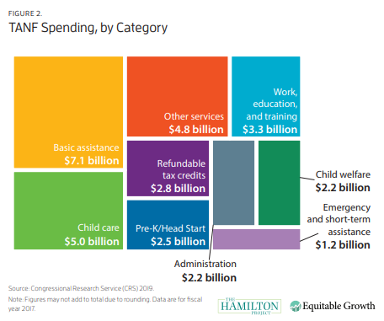
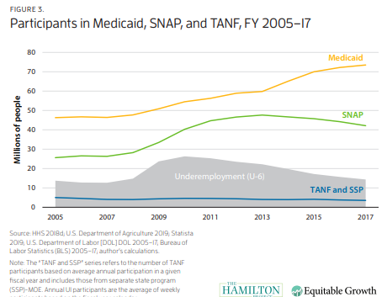
Temporary Assistance for Needy Families (TANF)
Block grants to states
  Downsides of block grants
  Under pre-existing Aid to Families with Dependent Children, states had access to unlimited matched federal funds for eligible families
Under 25% of families in poverty receive TANF
Maximum benefit between $170 and $923 /month

Slide 13
TANF – Temporary Assistance to Needy Families
Temporary Assistance to Needy Families (TANF) which is what Aid to Families with Dependent Children (AFDC) became after welfare reform in 1997.
Major components of the reform were that welfare became temporary (offering up to two years only) and require recipients to work or look for work (with some exceptions).
Welfare has positive effects, especially for lower income recipients
  Child education and health outcomes
  Household earnings and savings
Reform reduced these, but has lowered cost of programs
  Cost effective?

Slide 14
Welfare and marriage
Welfare programs often give higher benefits to single parents (usually single mothers)
TANF
  TANF has been shown to lead to a decline in marriage rates for recipients while receiving TANF, but this decline does not continue when recipients leave TANF
  People who are or will be eligible for TANF at some point in their life are generally more skeptical of marriage than people who are not, but the receipt of TANF does not influence these beliefs, as they are more correlated with factors like income and education
  In 2003, due to efforts of the Heritage Foundation, Brookings, and others, HHS implemented the Healthy Marriage Initiative and the Supporting Healthy Marriage Project to help reduce the negative effect of TANF on marriage rates and to reduce absentee parenting
The ACA and Medicaid expansion
  Expanding Medicaid has been shown to decrease the number of marriages, possibly because people no longer need to get health coverage from their spouse
  Requiring plans to cover children until the age of 26 have shown similar effects
  However, Medicaid expansion is shown to be overwhelmingly good for children and other recipients (Guth et al 2020).

Slide 15
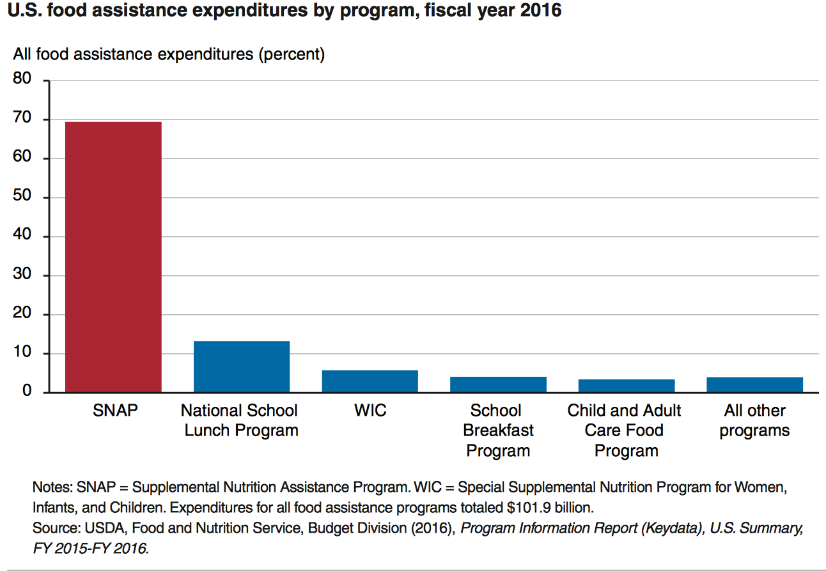
State Grants: Food Assistance Programs

Slide 16
SNAP
SNAP
  central goal is to alleviate food insecurity and it succeeds
  also improves well-being over other dimensions
High benefits for families
  maximum of almost $700 per month for a family of 4
  average benefit of about $250 per month for a family of 4
Has a profound effect on the family food economy

Slide 17
EITC – Earned Income Tax Credit
Low income individuals get a cash subsidy based on how much they work, up to $5610 dollars for someone earning $14,000 (40% raise)
Always incentivizes work
Administered by IRS
Popular and effective

Slide 18
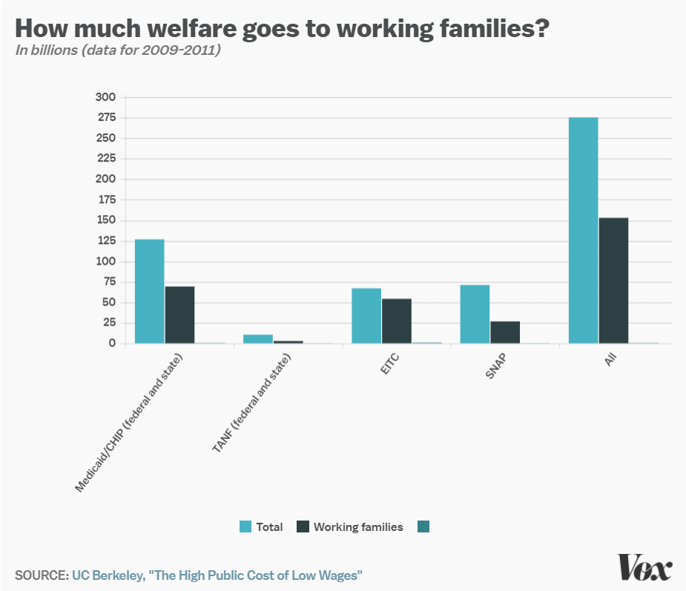
Work requirements
Federal: SNAP (food stamps)
  Requires able-bodied recipients without dependents to work 80 hours a month
  Part of 1996 Welfare Reform
State: TANF (welfare)
  Kansas and elsewhere
  Limited improvements on unemployment and poverty
State: Medicaid
Earned Income Tax Credit!
Notes:
http://laborcenter.berkeley.edu/the-high-public-cost-of-low-wages/

Slide 19
1996 Welfare reform
Changed Aid to Families with Dependent Children (AFDC) to TANF
States had more leeway to who gets benefits
  Block Grants to states
Assistance cut to recent immigrants
Work requirements

Slide 20
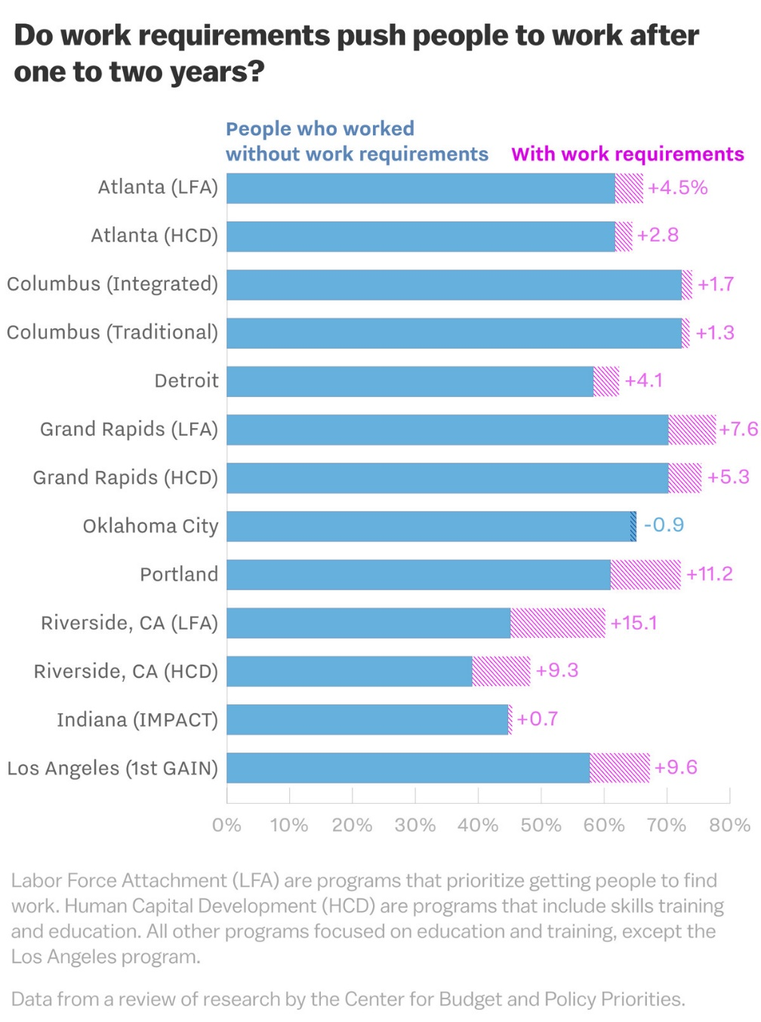
Effect of 1996 work requirements on TANF
13 cities participated in an experiment before requirement was implemented
  The proportion of TANF recipients who worked without requirements was about 60% before the experiment
  Increased by about 4% on average in the following years
  Gains disappeared by 5 years
  Stable work saw small increase by 5 years
  Small effect on poverty – on average increasing poverty
  Decrease the ability to attend training programs, deal with health issues
  Targets foreign born and ESL

Slide 21
Pros and Cons of TANF work requirements
Pro
  Work requirement increases amount people work
Con
  Work requirement increases poverty

Slide 22
However
80% of adults on Medicaid are in working families
  60% work themselves
  Of those that don’t:
    35% are unable to due to disability
    28% are caretakers for family members
    18% are students
    8% are actively looking for work
    8% are retired
  Leaving 3% of nonworking adult Medicaid population who could work but don’t
Notes:
JAMA Dec 2017

Slide 23
Barriers to employment
Low income individuals facing Medicaid work requirements struggle to find work
  20% have less than a high school degree
  25% have multiple chronic conditions
  More likely to live in areas with high unemployment and poverty
Notes:
Urban Institute 2019

Slide 24
Labor Market Effects
Increased jobs
Did not reduce employment for low-income workers
Enrollees looking for work reported Medicaid enrollment made it easier to seek employment, those employed reported it made it easier to continue working
Increase volunteering

Slide 25
Additional Social Support/Welfare Programs
Programs we’ve discussed
  TANF
  Social Security
  Unemployment
  SNAP/WIC
Others:
Section 8 of the Housing Act of 1937
  Rental assistance for low income households
Supplemental Security Income
  Replace Aid to the Blind, Aid to the Permanently and Totally Disabled, and Aid to the Elderly from 1935 SSA
  Once an individual qualifies for Supplemental Security Income they automatically become eligible for several other assistance programs (Medicaid, SNAP, Sectuon 8, others)
Head Start
  1965 program – Early Childhood Education
High Ed programs
  Pell, SMART, FSEOG, and subsidized loans
Other…

Slide 26
More sources
Abramowitz, Joelle. "Saying,“I don’t”: The effect of the affordable care act young adult provision on marriage." Journal of Human Resources 51, no. 4 (2016): 933-960.
Cancian, Maria, Robert H. Haveman, Daniel R. Meyer, and Barbara Wolfe. "Before and after TANF: The economic well-being of women leaving welfare." Social Service Review 76, no. 4 (2002): 603-641.
Chetty, Raj. "Moral hazard versus liquidity and optimal unemployment insurance." Journal of political Economy 116, no. 2 (2008): 173-234.
Guth, Garfield and Rudowitz. The Effects of Medicaid Expansion under the ACA: Studies from January 2014 to January 2020, KFF Report, March 17 2020
Hampton, Matt, and Otto Lenhart. "The effect of the Affordable Care Act Medicaid expansion on marriage." Economic Inquiry 60, no. 2 (2022): 568-591.
Hawkins, Alan J., Paul R. Amato, and Andrea Kinghorn. "Are government‐supported healthy marriage initiatives affecting family demographics? A state‐level analysis." Family Relations 62, no. 3 (2013): 501-513.
Kroft, Kory, and Matthew J. Notowidigdo. "Should unemployment insurance vary with the unemployment rate? Theory and evidence." The Review of Economic Studies 83, no. 3 (2016): 1092-1124.
Muennig, Peter, Rishi Caleyachetty, Zohn Rosen, and Andrew Korotzer. "More money, fewer lives: the cost effectiveness of welfare reform in the United States." American Journal of Public Health 105, no. 2 (2015): 324-328.
Taylor, Mary Jane, and Mary Beth Vogel-Ferguson. "Attitudes toward traditional marriage: A comparison of TANF recipients and a general population of adults." Families in Society 92, no. 2 (2011): 225-229.
Teitler, Julien O., Nancy E. Reichman, Lenna Nepomnyaschy, and Irwin Garfinkel. "Effects of welfare participation on marriage." Journal of Marriage and Family 71, no. 4 (2009): 878-891.
Wood, Robert G., Quinn Moore, and Anu Rangarajan. "Two steps forward, one step back: The uneven economic progress of TANF recipients." Social Service Review 82, no. 1 (2008): 3-28.

