Slide 1
HCMI 4225: Comparing Health Systems
Shane Murphy – shane@uconn.edu

Slide 2
Understanding major health systems indicators
Beds per capita
  World average – 2.9 per 1000
  US average – 2.9 per 1000
Physicians per capita
  World average – 1.8 per 1000
  US average – 2.6 per 1000
Nurses per capita
  World average – 4 per 1000
  US average – 15.7 per 1000
Universal Health Coverage
  The proportion of a population that can access essential quality health services
    Measures?
  The proportion of the population that spends a large amount of household income on health
    Measures?
Notes:
https://data.worldbank.org/indicator/

Slide 3
Two issues: Financing and Governance
Focus is often on financing
Provision depends on both financing and governance

Slide 4
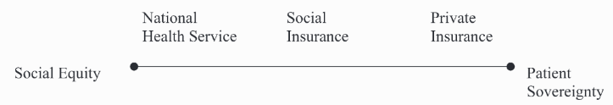
Types of health care systems by provision and funding

Slide 5
Governance issues
Governance of Consumption
  Extent of public access to care
  Extent of public control of costs
Governance of provision
  Extent of control of hospitals
  Extent of constraints on private interests and doctors
Governance of Production
  Extent of public constraints on medical innovation

Slide 6
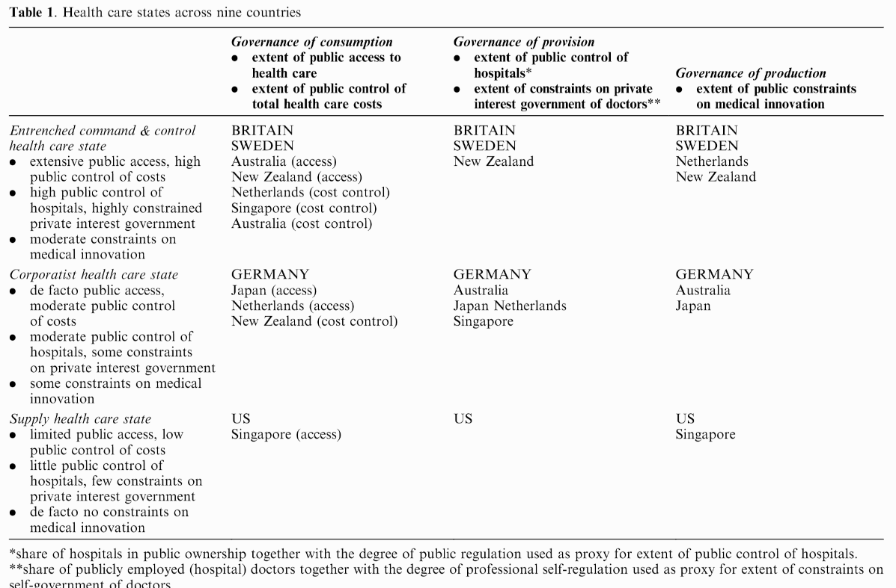

Slide 7
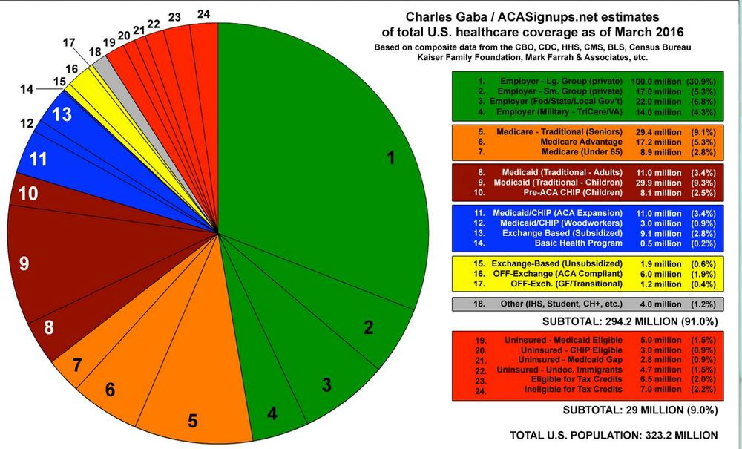
United States Health System
Approximate coverage (2016)
  47% employer
  17% Medicare
  23% Medicaid
  3% Self
  1% Other
  9% Uninsured

Slide 8
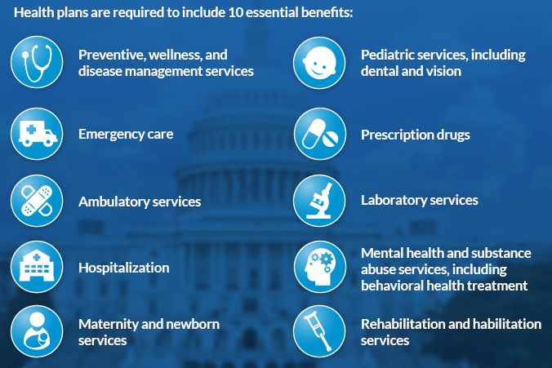
Essential benefits
Essential Health Benefits
  Conflict over cost to plans and religious objections
Major holes include: pharmaceutical coverage, dental, and vision care

Slide 9
Health provider management
Primary Care mostly private, registration not required
56% of hospitals are private non-profit, rest are mixed public and for profit
  Non-profit vs profit
  Consortiums
Medical education is through mostly public institutions but high tuition (average about $40,000 per year)

Slide 10
Major health indicators
Life Expectancy
  World – 73, US – 77
Child Mortality
  World – 37 per 1,000, US – 6 per 1,000
Maternal Mortality
  World – 211 per 100,000 births, US – 19 per 100,000 births
Obesity Rate
  World – 13% of population aged over 20, US – 36.2%
Diabetes Rate
  World – 9.8% of population aged 20-79, US – 10.7%
Notes:
https://data.worldbank.org/indicator
Obesity: https://www.thelancet.com/journals/lancet/article/PIIS0140-6736(17)32129-3/fulltext

Slide 11
State-level single payer
2011 Vermont passed a law that in theory would lead to single payer insurance in the state
Cost estimated to be $2.5 billion on top of current spending
  Vermont’s total tax revenue in 2014 was $2.7 billion
    So state taxes would nearly double, payroll taxes increase 11.5%, income tax increase 9%
  Vermont’s population is about 623,900 people
    $2.5 billion / 623,900 = $4000 tax per person
Medicare and Medicaid would reimburse Vermont for qualified individuals
  $2.5 billion needed to pay for non-reimbursed care
Vermont’s governor Shumlin was politically weak

Slide 12
All payer-systems
AKA State Hospital Rate Setting
Goal (same as single payer):
  Increase efficiency and reduce insurer overhead in the health care system.
Sets one price that every health insurer pays for any given medical procedure.
  Removes job of billing clerk, among others
Currently, bigger plans tend to negotiate deeper discounts.
  Private insurance plans pay the most, Medicare pays slightly less, and Medicaid pays the lowest rates.
Con: may lower incentive for innovation and lower provider profits which could be used for experiments.

Slide 13
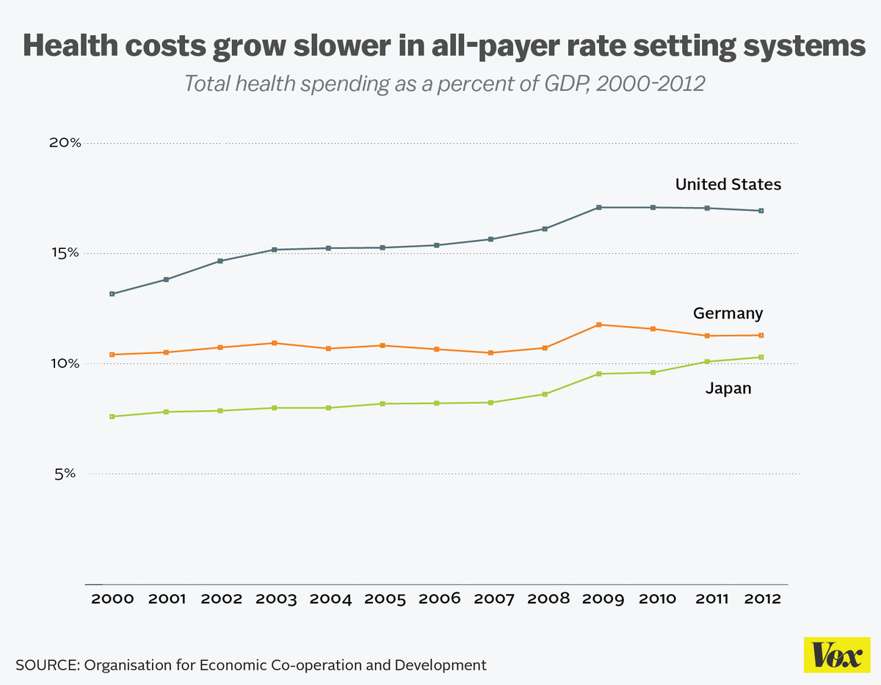
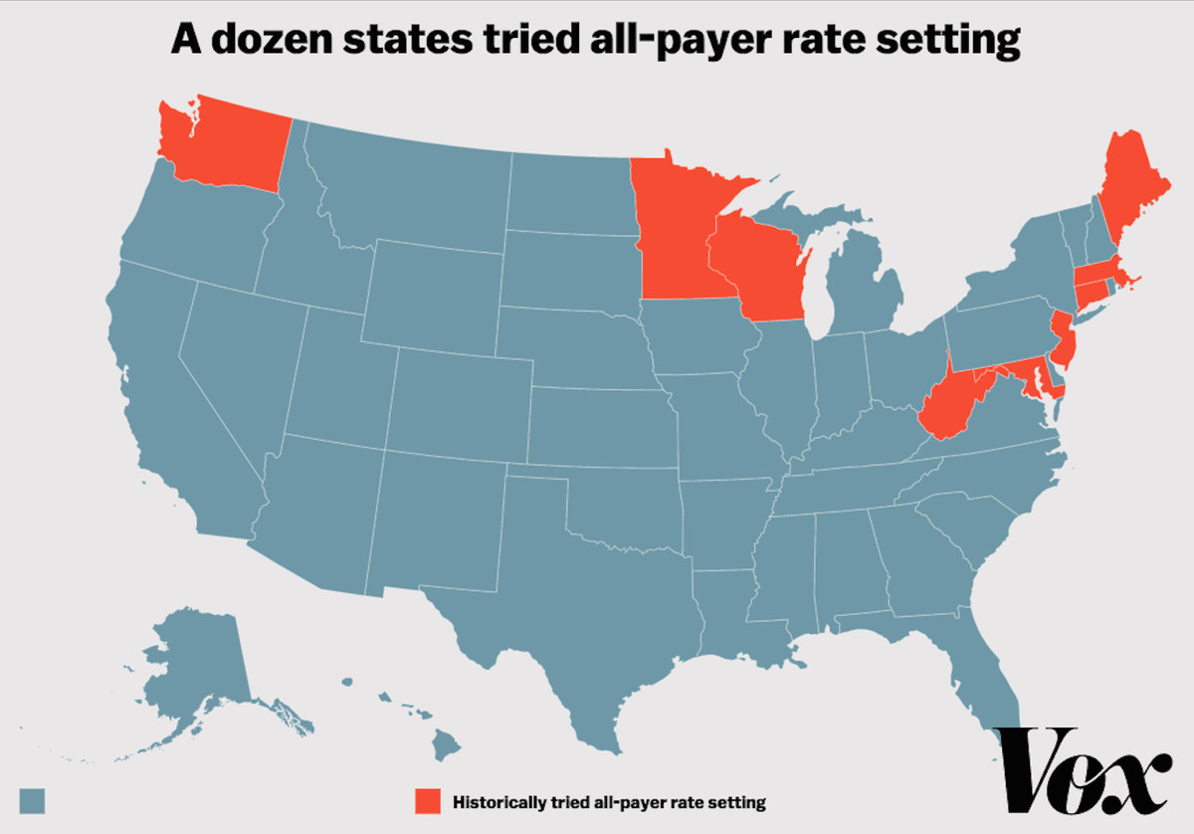
All payer-systems
France, Germany, Japan, the Netherlands, and Switzerland
12 States in the 1970s and 1980s
  Killed by HMOs
  Only Maryland still uses all-payer
Maryland
  Not success story (but not a failure)
  Prices have come down substantially
  But utilization has increased
  Added spending cap in 2014

Slide 14
Stories and myths in the US
Nursing Shortage/physician shortage
  Google scholar search for term
    Compare to teacher shortage, “no one wants to work anymore” (https://twitter.com/paulisci/status/1549527748950892544)
Nation of uninsured
  9%
Private system
  Majority public finance, majority of hospitals non-profit or public
    Non-profit does not mean altruism first
Socialist
  1/3 Medicare are Medicare advantage and 2/3 Medicaid are Medicaid Managed Care
Republicans oppose universal coverage
  3:30 of https://www.youtube.com/watch?v=_A0O7IVsVhY
  Reagan at https://www.youtube.com/watch?v=56gbHNtd4Is

Slide 15
Problems facing any health care system
1. How does one reconcile the need for regional or national coordination with the ability to respond to local needs?
2. How does one reconcile urban with rural needs and the problems of maldistribution?
3. How does one devise a national health care system and yet honor and foster the energies, creativity, and resources of the voluntary sector?
4. How does one reconcile public accountability with professional autonomy and expertise?
5. How shall primary care be integrated with specialty and hospital care?
6. How shall individualistic principles and patterns of practice be reconciled with national standards and a national system?
7. How is a system to reconcile a focus on the patient with a focus on community and population health?

Slide 16
Canada
Federal single payer system – health under provincial jurisdiction
Public administration, private provision
  Providers required to be non-profit
Comprehensive coverage, Universal, Portable, Accessible

Slide 17
Canada: Issues
Financing crisis since the 1980s
Lead to cost controls – cost of care lower in 1997 than 1989
Some support for moving to a privatized single payer system

Slide 18
United Kingdom
National Health Services
Health care should be “free at the point of service,” a founding principle of the NHS.
Funded through income taxes
Focus on:
  Primary care
  Reducing inequalities
  Incentivizing prevention
  Uniform salary scale across subspecialists
  Cost control, especially for drugs

Slide 19
UK: Managed Competition
Under Thatcher, the UK experimented with reducing regulations and cost controls, allowing providers to control funds, especially for elective services
Experiment failed, largely because providers did not build up the administrative structure to successfully bargaining between providers and provider groups called GP fundholers.
Ended in 1997

Slide 20
France
Fee-for-service private provision reimbursed by the NHI (liberalism)
Famously #1 in 2000 WHO ranking
Slightly over half funded by payroll taxes
Funding system is complex
  Some care is paid out of pocket and then reimbursed
  Some is fee-for-service
  Some is based on estimated annual budgets

Slide 21
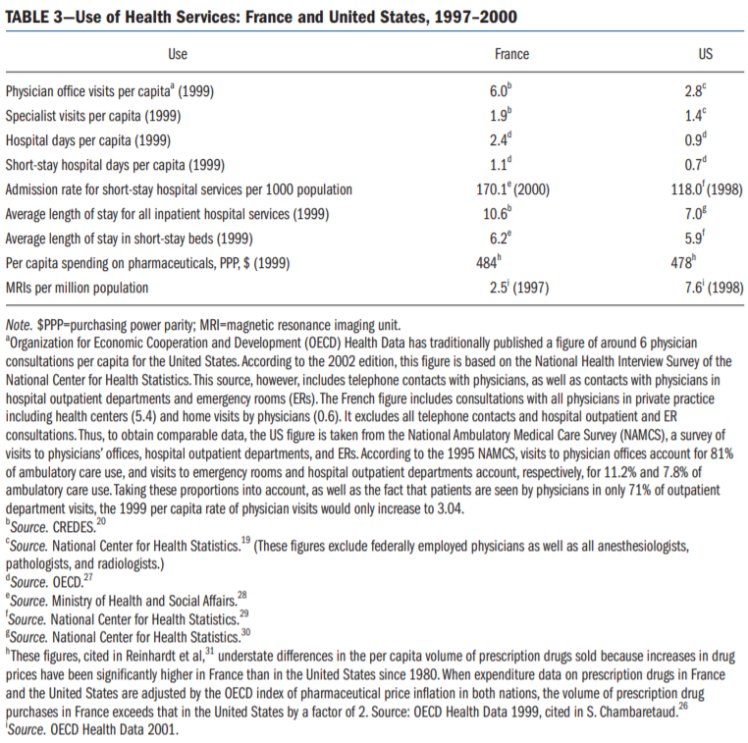

Slide 22
France: Issues
Significant inequalities of resources, outcomes, and quality
Relatively high spending

Slide 23
Germany
Statutory Health Insurance – 92% coverage, rest private or wealthy
Professional autonomy for providers with self-governing bodies
Financed with payroll taxes and regional or occupation based funds

Slide 24
Four Models
Beveridge
  Socialized Medicine
  UK, Italy, Spain, Norway, Denmark, Finland, Sweden, New Zealand, Cuba
Bismarck
  Employer based universal mandated heavily regulated or government controlled insurance
  Germany, France, Switzerland, the Netherlands, Japan
National Health Insurance
  Public financing, private provision
  Canada, Taiwan, South Korea
Other: Out of Pocket, Private Insurance, Mixed Models
  US

Slide 25
Visualization
Who pays?
  https://vizhub.healthdata.org/fgh/
Videos:
  Taiwan - https://www.youtube.com/watch?v=MCDiFIyW0tQ
  France - https://www.youtube.com/watch?v=_yF69KVbUaQ
  UK - https://www.youtube.com/watch?v=qMNuxPByEW0
Notes:
https://www.youtube.com/playlist?list=PLkfBg8ML-gIngk82SUbTp6Og_KkYfJ6oF

Slide 26
Readings and Sources
January 2003 edition of the American Journal of Public Health
Burau, Viola, and Robert H. Blank. "Comparing health policy: an assessment of typologies of health systems." Journal of comparative policy analysis 8, no. 01 (2006): 63-76.
McDonough, John E. "Tracking the demise of state hospital rate setting." Health Affairs 16, no. 1 (1997): 142-149.
Pauly, Mark, and Robert Town. "Maryland exceptionalism? All-payers regulation and health care system efficiency." Journal of health politics, policy and law 37, no. 4 (2012): 697-707.

