Slide 1
HCMI 4225: Effects of Health Insurance
Shane Murphy – shane@uconn.edu

Slide 2
Experiment design: randomization
Randomized evaluations can provide clear answers
Without knowing why two groups differ, hard to know what to attribute the differences to
Can get perverse “findings” (e.g. health insurance makes you sicker)
Randomly assign individuals to different treatments (programs) or control (status quo continues)
By construction, the treatment group and the control group will have the same characteristics, on average
Observable: age, income, measured health…
Unobservable: motivation, social networks, unmeasured health…

Slide 3
Experiments in Health Insurance
RAND Health Insurance Experiment
Ran from 1971-1982
Oregon Health Study
Medicaid Expansion

Slide 4
Rand Health Insurance Experiment (HEI)
Research questions:
How does cost sharing affect demand for personal health care services?
How does cost sharing affect demand for particular services, e.g., hospital care, dental services?
Does use of personal health care services improve health?
How does a change from fee-for-service payment to capitation affect demand for personal health care services?

Slide 5
Study design
Enrolled 2,750 non-elderly (<=61) families, 7,700 individuals for from 3-5 years across 6 sites throughout the US
Families randomly assigned to 1 of 14 insurance plans differing in cost sharing rates and in maximum dollar expenditures per year (MDE or stop loss)
Five basic types:
Free care, 25% cost sharing, 75% cost sharing, and 95% cost sharing, HMO-style
Income adjusted for poor families
OOP capped at $1,000 ($3,000 at 2005 US$)
At enrollment, families exchanged their existing health insurance policy for HIE plan—held harmless for medical expenditure higher than they would have experienced if they had not enrolled in HIE
Some participants randomly assigned to capitation plan
Participation in HIE voluntary for families
Ran from 1971-1982

Slide 6
Results
More cost sharing -> less utilization and les cost

Slide 7
Results
Utilization rates decreased for cost sharing individuals across illness type

Slide 8
Health Outcomes
The poorest and sickest 6 percent of the sample at the start of the experiment had better outcomes under the free plan for 4 of the 30 conditions measured.
Serious symptoms were less prevalent for poorer people on the free plan.
Free care improved the control of hypertension.
Free care marginally improved vision for the poorest patients.
Free care also increased the likelihood among the poorest patients of receiving needed dental care.
Cost sharing also had some beneficial effects. Participants in cost sharing plans worried less about their health and had fewer restricted-activity days (including time spent in seeking medical care).

Slide 9
Key Result
For 94 percent of persons in HIE, not with low income and not in poor health at baseline, having health insurance coverage had no effect on health.
In a large-scale, multiyear experiment, participants who paid for a share of their health care used fewer health services than a comparison group given free care.
Cost sharing reduced the use of both highly effective and less effective services in roughly equal proportions. Cost sharing did not significantly affect the quality of care received by participants.
Cost sharing in general had no adverse effects on participant health, but there were exceptions: free care led to improvements in hypertension, dental health, vision, and selected serious symptoms. These improvements were concentrated among the sickest and poorest patients.

Slide 10
Oregon Medical Experiment
Research Question: What are the effects of expanding access to public health insurance for low income adults?
Oregon’s Medicaid expansion program covers those financially but not categorically eligible for Medicaid
Low-income (below 100% of federal poverty line), uninsured, able-bodied adults
Covers doctors, hospitals, drugs, mental health, etc. with no consumer cost sharing and low or no premiums
In 2008: Oregon had money to cover some but not all of those eligible… so chose to run a lottery for fairness
Asked interested individuals to sign up
Randomly assigned ~30,000 out of 75,000 ability to apply for Medicaid
After about 2 years, find money to offer the remainder coverage.

Slide 12
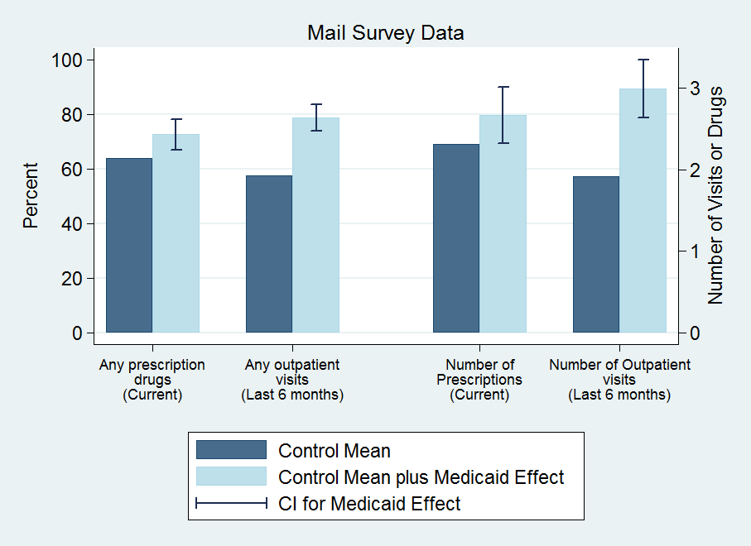
Results: Utilization

Slide 13
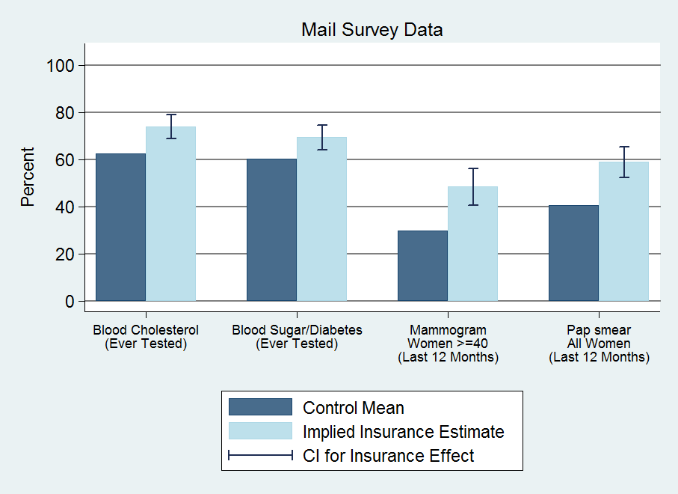
Results: Preventive Care

Slide 14
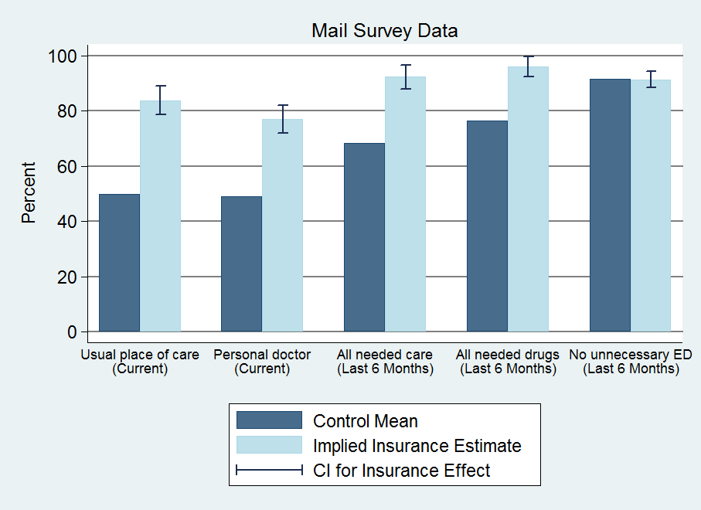
Results: Access

Slide 15
Hospitalizations (discharge data)
30%↑probability of hospital admission
40% ↑number of ER visits
Substantial (but imprecise) increase in total resource use
By condition: increase in heart disease use (not shown)
No change in mix of private/public use; no power to detect change in quality of hospitals used
Other use (self-reports)
35% ↑ probability of outpatient visit
15% ↑ probability of taking prescription drugs
0.3 standard dev ↑ in compliance with recommended preventive care
No discernable change in ER use (imprecise)
Implied $777 increase in spending for insured
25% increase

Slide 16
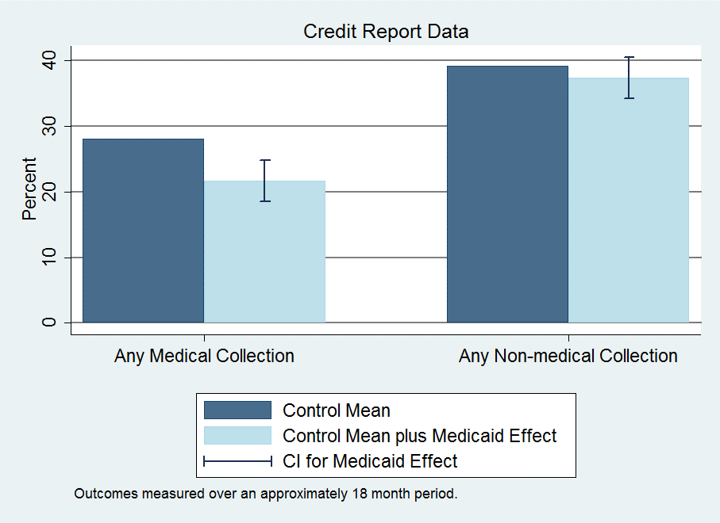
Results: Financial

Slide 17
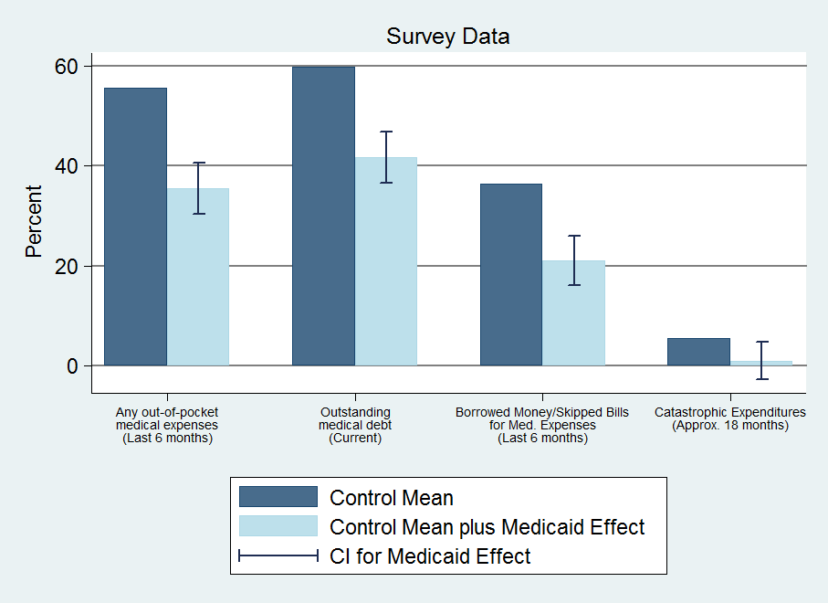
Results: Financial

Slide 18
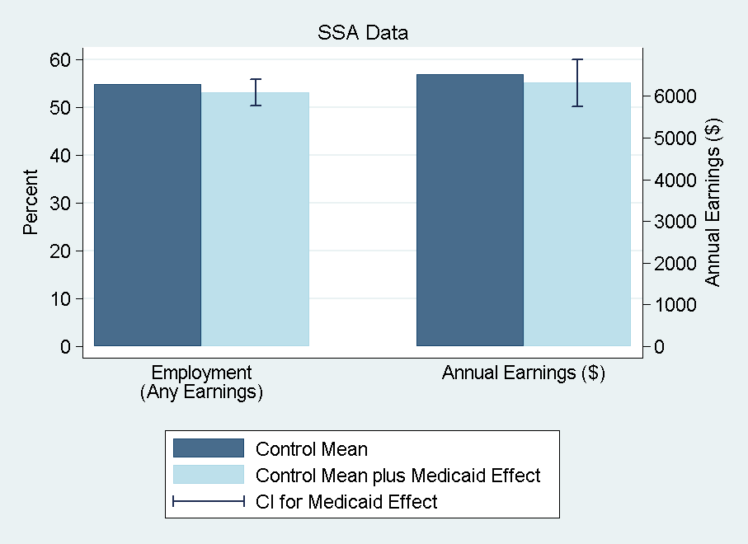
Results: Financial

Slide 19
Results: Financial
Reduction in collections (credit reports)
25% ↓ probability of unpaid medical bills sent to collection
No observed effects on other measures
Limitations: time lags, extreme events, lack of data on informal channels (more heavily used by poor)
Reduction in strain, OOP, money owed (self-reports)
Substantial reduction across measures
Captures additional channels
Implications for distribution of burden/benefits
Some borne by patients, some by providers (or those to whom passed through) – only 2% of bills sent to collection ever paid

Slide 20
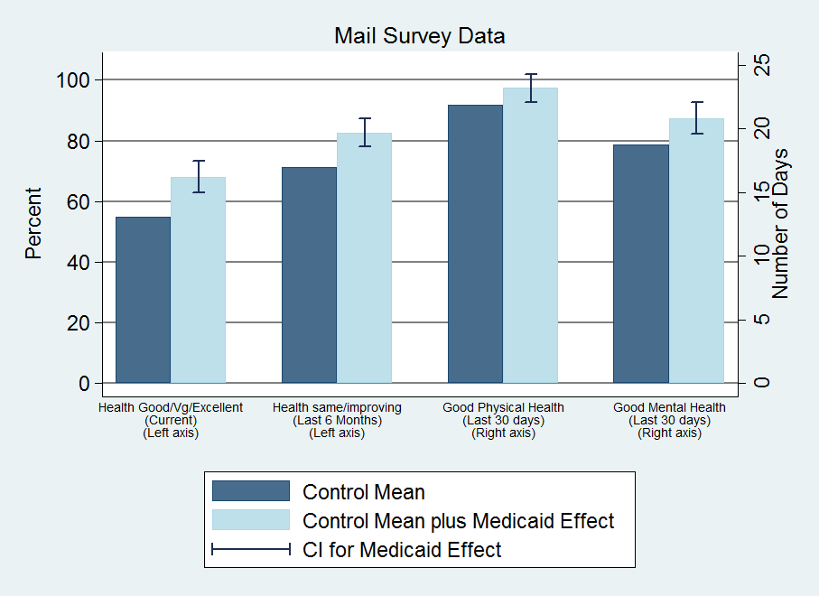
Results: Health

Slide 21
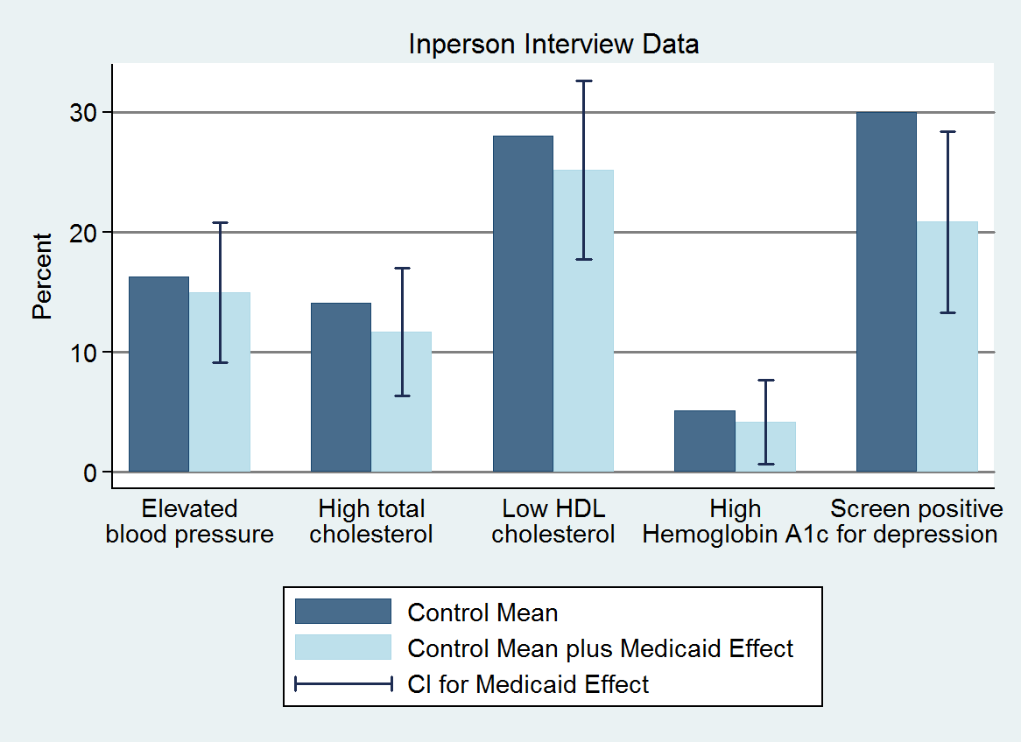
Results: Health

Slide 22
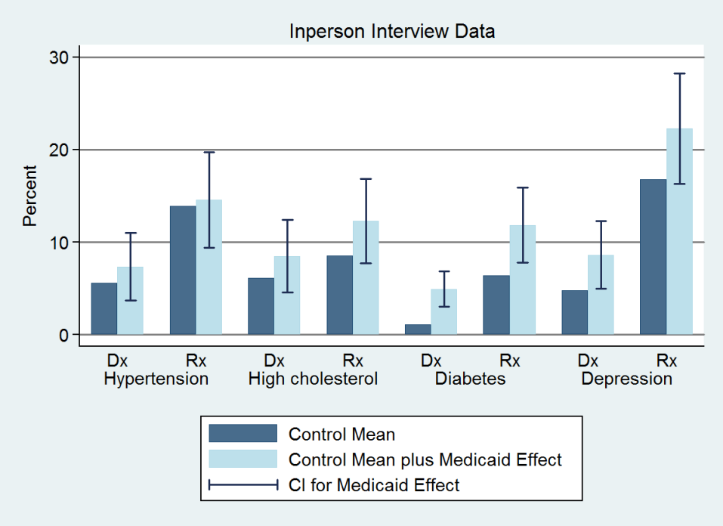
Results: Health

Slide 23
Results: Health
Health benefits from Medicaid
Improves self-reported health
Reduces depression (by ~9 pctg pts or 30%)
No detectable impact on blood pressure, cholesterol, or blood sugar
Chosen because they are important, measurable health problems in this population and have been shown in clinical trials to be modifiable with effective treatment within our time frame
Cannot reject decline in blood sugar predicted by the effect we see on diabetes medication + clinical trials of effects of such medication
Can reject declines in blood pressure found in quasi-experimental Medicaid studies

Slide 24
Large improvements in self-reported physical and mental health
Mental health indices correlate well with clinical diagnoses
Reduces depression (by ~9 pctg pts or 30%)
Physical health measures open to several interpretations
Improvements consistent with increased utilization
Also see reports of improved quality and access
Usual place of care; reported quality of care
But these results appear shortly after insurance coverage
~2/3 magnitude, in advance of changes in utilization
Although lottery selection “glow” may be stronger earlier
Suggestive of increase in perceived overall well-being
Also substantial improvements in reported happiness
Possible decline in blood sugar for individuals with diabetes
Unlikely that it had an effect on blood pressure for people with hypertension

Slide 25
Results: Summary
Increased health care use across the board
Hosp, ER, primary care, drugs, preventive care
~25% ↑ total, annual spending (hospital, outpatient, drugs)
Reduced out-of-pocket costs and financial strain
Virtually eliminated “catastrophic” out-of-pocket spending
No detectable effect on earnings and employment
Health
Improved self-reported health
Reduced depression
No/Limited detectable effects on measured physical health

Slide 26
Criticism: Power and effect size in the Oregon Healthcare experiment
The Oregon study was aimed at expanding coverage for roughly half of the 75,000 newly eligible individuals for Medicaid
But 12,229 people responded to the surveys and were analyzed, about half in treatment and control
And most of the treatment group (all of whom were offered Medicaid in the experiment) didn’t even sign up for Medicaid
So the treatment group actually was about 1,500 people!!!!
The majority of whom did not have any given chronic condition
There are claims that the Oregon Healthcare experiment was too small and therefore was underpowered
The power of an experiment expresses whether an experiment has enough subjects to estimate with statistical significance an effect size of interest to the researchers

Slide 27
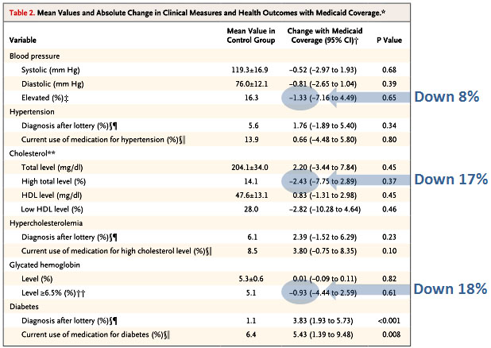
Total health effect sizes estimated by the Oregon Experiement
Notes:
https://www.motherjones.com/kevin-drum/2013/05/what-we-know-oregon-medicaid-study/

Slide 28
Power and effect size in the Oregon Healthcare experiment
5.1% of the control group had elevated glycated hemoglobin levels (common marker for diabetes)
5.1% of 1,500 is roughly 80 people
Assume the treatment group has the same numbers.
The reduction in people with elevated GH was roughly 20%, about 16 people.
Any experiment on a treatment group of 80 people that shows success in 16 (and no success in the other 64 or in the 80 people in the control group) is underpowered
The power of an experiment expresses whether an experiment has enough subjects to estimate with statistical significance an effect size of interest to the researchers
But a 20% reduction in the number of people with elevated GH would be a great success!!
Notes:
https://www.motherjones.com/kevin-drum/2013/05/what-we-know-oregon-medicaid-study/

Slide 29
Power and effect size in the Oregon Healthcare experiment
Before randomization, there were 2225 people with hypertension. If we assume that half got randomized to each arm, and then take the 24.1 percentage point increase in coverage the study reports, that means there were only 280 people with hypertension who got Medicaid, and who could be studied for this outcome. Further, those people had a baseline average blood pressure of 130/83. That’s remarkably well controlled! So there’s not nearly the room for improvement that you might assume.
Before randomization, there were 872 patients with diabetes. Half to each group, and then the 24.1% who actually got new Medicaid, and you’ve got about 110 patients with diabetes in the Medicaid group. And again, their average baseline A1c was 6.7%, which is pretty well controlled. How much could the Medicaid do? With respect to the percentage of patients with a A1C>=6.5, there appears to be so much imprecision in the measurement that it’s in the 95% confidence interval that they got every single person in Medicaid with diabetes under control: the baseline percentage of A1C>=6.5 was 54.0, and the reduction in the Medicaid group was -27.0 (95% CI -71.91 to 17.92).
Notes:
https://theincidentaleconomist.com/wordpress/oregon-medicaid-power-problems-are-important/

Slide 30
Average health outcomes and the Oregon Experiment
“Average blood pressure was a bizarre thing to measure. You have to remember that most people who get health insurance are healthy. They’re not going to get “healthier”. The average blood pressure in the control group was 119/76. That’s normal! You would only expect that it might improve in those with a high blood pressure. So I might have looked for an effect in those patients with hypertension. 16.3% of people in the control group had a systolic over 140 or a diastolic over 90. In the Medicaid group, that dropped to 15%. If they wanted to look at average pressures, why didn’t they single out the hypertensive people?”
Notes:
https://theincidentaleconomist.com/wordpress/additional-thoughts-on-the-new-oregon-medicaid-results/

Slide 31
Myth vs reality
“Insurance/Medicaid is worthless or worse than no insurance”
Not true: Increases in utilization, perceived access and quality, reductions in financial strain, and improvement in self-reported health
“Covering the uninsured will get them out of the Emergency Room”
Not true: Medicaid increases use of ER (overall and for a broad range of visit types)
“Health insurance expansion saves money”
Not true in short run: increases in health care use
In long run, remains to be seen: increases in preventive care and improvements in self-reported health

Slide 32
Effects of the ACA
There has been a lot of research on the health and coverage outcomes of the Affordable Care Act
KFF summary for Medicaid expansion (Antonisse as lead author) - https://www.kff.org/medicaid/report/the-effects-of-medicaid-expansion-under-the-aca-updated-findings-from-a-literature-review/
Mazurenko, Olena, Casey P. Balio, Rajender Agarwal, Aaron E. Carroll, and Nir Menachemi. "The effects of Medicaid expansion under the ACA: a systematic review." Health Affairs 37, no. 6 (2018): 944-950.
Courtemanche, Charles, James Marton, Benjamin Ukert, Aaron Yelowitz, Daniela Zapata, and Ishtiaque Fazlul. "The three‐year impact of the Affordable Care Act on disparities in insurance coverage." Health services research 54 (2019): 307-316.
Soni, Aparna, Laura R. Wherry, and Kosali I. Simon. "How Have ACA Insurance Expansions Affected Health Outcomes? Findings From The Literature: A literature review of the Affordable Care Act's effects on health outcomes for non-elderly adults." Health Affairs 39, no. 3 (2020): 371-378.
Courtemanche, Charles, James Marton, Benjamin Ukert, Aaron Yelowitz, and Daniela Zapata. "Early effects of the Affordable Care Act on health care access, risky health behaviors, and self‐assessed health." Southern Economic Journal 84, no. 3 (2018): 660-691.
…

Slide 33
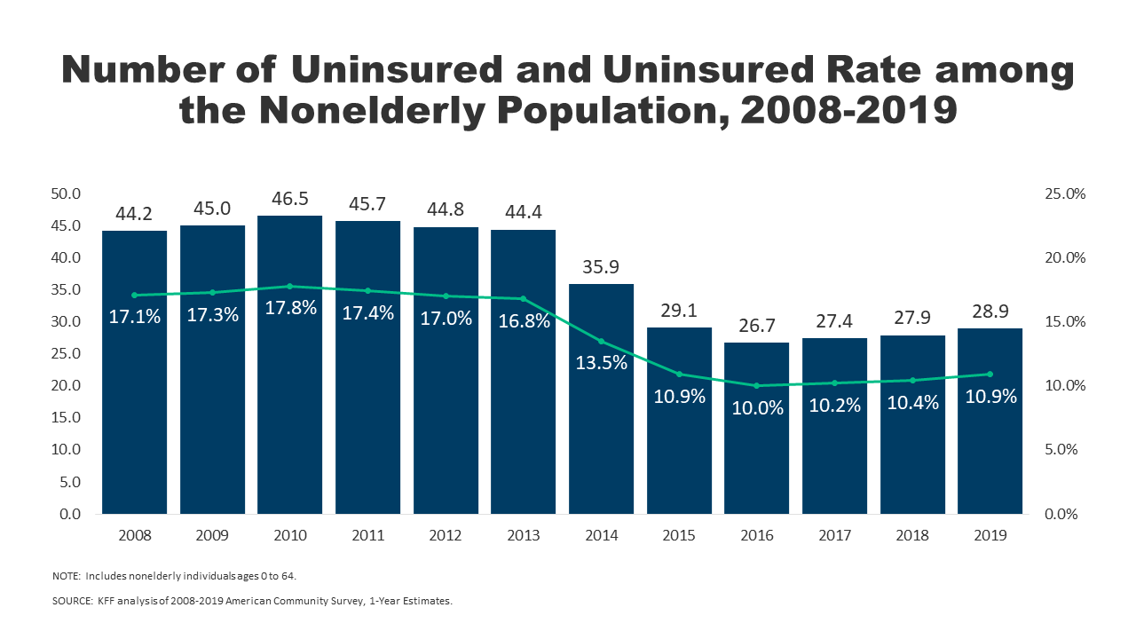
Effects on health and coverage
Largest effect on coverage was due to Medicaid expansion, not the exchanges
Largest effect on health comes from self-perceived health, mental health, financial stability
These three factors are all closely interrelated
Benefits of wellness visits are difficult to measure
Health benefits for chronic conditions require large samples sizes, studies are hard to perform

Slide 34
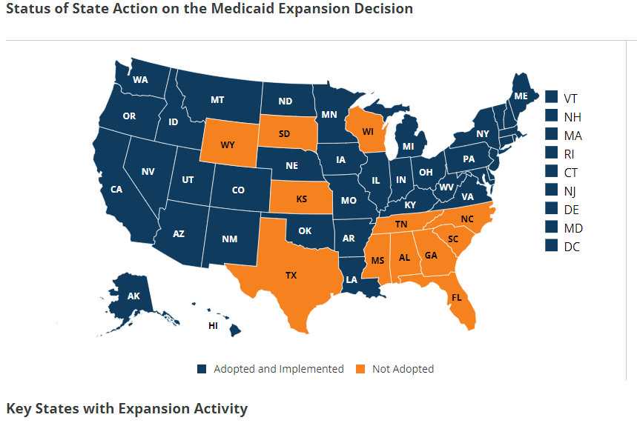
Coverage: Medicaid expansion
All US citizens and legal residents with income up to 138% FPL qualify for coverage in participating states
Led to large growth in enrollment in participating states, smaller growth in non-participating states
Reduction in uninsured rates, especially among low-income individuals
Partial Woodwork effect/welcome mat effect
Growth among individuals who were previously eligible

Slide 35
Coverage: Medicaid expansion: subgroups
Coverage gains in expansion versus non-expansion states for specific vulnerable populations:
young adults, prescription drug users, people with HIV, veterans, parents, mothers, women of reproductive age (with and without children), children, lesbian, gay, and bisexual adults, newly diagnosed cancer patients, women diagnosed with a gynecologic malignancy, low-income workers, low-educated adults, early retirees, and childless adults with incomes under 100% FPL
Disproportionately positive impact in rural areas in expansion states
Gains can be found across racial/ethnic categories
Reduced disparities by income and age
Possibly reducing disparities by race/ethnicity

Slide 36
Coverage: Medicaid expansion: Alternative approaches
Section 1115 gave states the option of expanding Medicaid in alternative ways
These states (especially Arkansas, Michigan, and Indiana) have shown similar gains in coverage rates
Indiana instituted monthly contributions which have created enrollment and continuing coverage issues

Slide 37
Coverage: Medicaid expansion: criticism
Crowding out of private insurance
Mixed results, although there has been some decline in private coverage in participating states

Slide 38
Access, Utilization
Many studies find improvements in access to care
Increases in cancer diagnosis rates (especially early stage)
Earlier presentation for common surgical conditions – lowering complications
Increase listing for heart transplants among African Americans
Increased access for treatment of behavioral and mental health conditions
Increase in prescriptions for opioid use disorder and overdose
Increase in prescriptions for smoking cessation drugs

Slide 39
Access, Utilization
Many studies find improvements in access to care
Reduction in disparities by race, income, education, and employment status in access and affordability
Increased rates of optimal care for patients with common surgical conditions
Improved quality of care for common community health care treated conditions:
Asthma, Pap testing, BMI assessment, hypertension control
Declines in uninsured ED visits, but mixed evidence and no significant change in total ED volume
Reduced LOS for Medicaid patients
Improvements in care and quality in areas with primary care shortages

Slide 40
Access, Utilization: Criticism
Confusion in non-waiver states
Failures to follow up with new patients
Longer wait times

Slide 41
Affordability and Financial Security
Possible reduced patients with unmet medical need because of cost
Reduction in OOP
Average reduction in 2014 of about $205
Greater reductions among Medicaid expansion covered individuals than subsidized marketplace coverage individuals
Declines in unpaid bills and financial stress over future bills
In Ohio, percentage of expansion enrollees with medical debt fell by nearly half since enrolling in Medicaid (55.8% had debt prior to enrollment, 30.8% had debt at the time of the study)

Slide 42
Health Outcomes
Possible improvements in self-reported health
Improved outcomes for cardiac patients
Infant Mortality Rate Reductions for expansion states between 2014 and 2016, a period where the rate rose slightly for non-expansion states
Effect largest among African Americans
Limited of no effect on drug overdoses or alcohol poisonings

Slide 43
Economic effects
Federal matching for expansion population provided large spending savings for expansion states
No significant increase in state spending on Medicaid, including savings in some states
Possible reduction in overall spending due to spillovers
State costs related to behavioral health services, crime and the criminal justice system, and Supplemental Security Income program costs.
Lower Medicaid spending per enrollee
New enrollees generally less expensive than existing enrollees
First year of enrollment generally more expensive than subsequent years
Medicaid expansion lowers marketplace premiums
Marketplace enrollees younger and healthier in expansion states

Slide 44
Impacts on providers
Reduction in uninsured visits and uncompensated care costs
Decline in uninsured ED visits and increase in Medicaid-covered ED visits
Increase in Medicaid-covered substance use disorder treatment facility visits
Reduced disparity in uninsured visits between hospitals that treat a disproportionate share of low-income patients (DSH hospitals/safety net hospitals) and those that do not
Improved overall hospital financial performance, reduced probability of closure
Especially in rural areas

Slide 45
Labor Market Effects
Increased jobs
Did not reduce employment for low-income workers
Enrollees looking for work reported Medicaid enrollment made it easier to seek employment, those employed reported it made it easier to continue working
Increase volunteering

Slide 46
Readings:
Brook, Robert H., Emmett B. Keeler, Kathleen N. Lohr, Joseph P. Newhouse, John E. Ware, William H. Rogers, A. Ross Davies et al. "The health insurance experiment: A classic RAND study speaks to the current health care reform debate." Santa Monica. RAND Corporation (2006). (https://www.rand.org/content/dam/rand/pubs/research_briefs/2006/RAND_RB9174.pdf)
“The Oregon Health Insurance Experiment, " Health Affairs Health Policy Brief, July 16, 2015. (https://www.healthaffairs.org/do/10.1377/hpb20150716.236899/full/)

Slide 47
Covid talk
Increase in Covid mortality risk is much higher among older people than younger:
In fact 65-74 year olds are 65 times more likely to die from COVID than are 18-29 year olds
The comparable risk increases for 75-84 year olds and people 85 and older compared to 18-29 year olds are 140 times and 340 times, respectively.
Note that people in all age cohorts from five years old and up are equally likely to contract COVID, or at least to be recorded as having contracted it
Notes:
https://www.cdc.gov/nchs/nvss/vsrr/mortality-dashboard.htm#

Slide 48
Covid talk
All-cause mortality has increased much more than the number of estimated Covid deaths
Covid’s mortality effect by age group depends on if you estimate all-cause mortality or official Covid mortality - between the third quarter of 2019 and the second quarter of 2021:
Among Americans between the ages of 15 and 44, official COVID deaths account for 22.6% of the increase in the all-cause mortality rate over the course of the pandemic.
Among Americans between the ages of 45 and 64, official COVID deaths account for 63% of the increase in the all-cause mortality rate over the course of the pandemic.
Among Americans 65 and older, official COVID deaths account for 112% of the increase in the all-cause mortality rate over the course of the pandemic.
While
Among 15-44 year old Americans all-cause mortality has increased by 31.7% over the course of the pandemic.
Among 45-64 year old Americans all-cause mortality has increased by 24.3% over the course of the pandemic.
Among Americans 65 year and older all-cause mortality has increased by 15.7% over the course of the pandemic.
Notes:
https://www.cdc.gov/nchs/nvss/vsrr/mortality-dashboard.htm#

Slide 49
Covid talk
How far back in the nation’s medical history do we have to go to find the same mortality rate among people 65 or older that we saw during the first year of the pandemic? The answer is: 2006.
How far back do we have to go to find the same mortality rate among people 25 to 34 years old that we saw during the first year of the pandemic? The answer is: 1952.
Notes:
https://www.cdc.gov/nchs/nvss/vsrr/mortality-dashboard.htm#

Slide 50
Covid talk
Total burden might be estimated by life years lost – for the period from spring 2020 to spring 2021:
110,080 excess deaths among 75-84 year olds.
1,012,737 years of life lost among 75-84 year olds.
110,670 excess deaths among 65-74 year olds.
1,715,340 years of life lost among 65-74 year olds.
75,460 excess deaths among 55-64 year olds.
1,754,445 years of life lost among people 55-64.
41,715 excess deaths among 45-54 year olds
1,334,880 years of life lost among 45-54 year olds
28,006 excess deaths among 35-44 year olds.
1,148,246 years of life lost among 35-44 year olds.
8,744 excess deaths among 15-24 year olds.
524,610 years of life lost among 15-24 year olds.

Slide 51
Covid Talk
All-cause mortality among 25-34 year olds crept up gradually between 2003 and 2019, rising by a total of 23% over this time, before the massive leap last year
Here’s the breakdown of the official causes of the increase over the last year:
COVID: 0 to 6.4. (15.8% of increase)
Drug overdose: 34.8 to 47.3 (31% of the increase)
Firearm injury: 17.9 to 23.6 (14.1% of the increase)
Homicide: 11.4 to 16.3 (12.1% of the increase)
Unintentional injuries: 52.7 to 71.3 (46% of the increase)

Slide 52
Other major causes of death where there was any statistical change:
Cancer 7.9 to 7.6
Chronic liver disease and cirrhosis: 2.4 to 4.0
Chronic lower respiratory disease: 0.7 to 0.8
Diabetes: 2.0 to 2.7
Heart disease: 7.6 to 8.7
HIV: 1.0 to 1.1
Hypertension: 0.2 to 0.4
Influenza and pneumonia: 1.0 to 0.7
Kidney disease: 0.6 to 0.7
Suicide: 17.5 to 18.3
4.1 total increase, i.e. these account for 10.1% of the total rise in all-cause mortality.

