Slide 1
HCMI 4225: Public Health Reform
Shane Murphy – shane@uconn.edu

Slide 2
Discussion
List 3 arguments for universal, single payer health insurance in the US.
  What are counterarguments for these?
List 3 arguments against.
  What are counterarguments for these?
Most arguments revolve around who is helped and who is hurt. In each case, think about who are the stakeholders affected and how are they affected.

Slide 3
Arguments for single payer health insurance in the US

Slide 4
Arguments against single payer health insurance in the US

Slide 5
Great unknowns if single payer health insurance is implemented in the US
How would interest group involvement change

Slide 6
The problem in two graphs
Costs are growing, particularly administrative costs, prices, and overutilization
  I prefer to focus on administrative costs
Health isn’t improving and for many it is getting worse
  This may not be the fault of the medical health system, but rather the behavioral health system

Slide 7
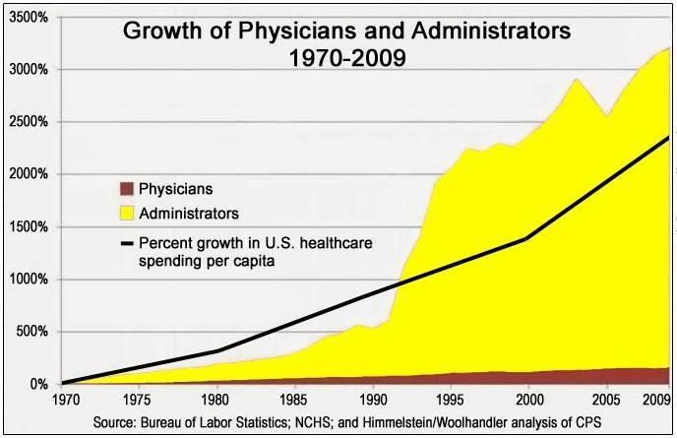
A famous & misleading graph
Notes:
https://www.motherjones.com/kevin-drum/2019/06/join-me-on-a-dive-down-the-rabbit-hole-of-health-care-admin-costs/
https://marginalrevolution.com/marginalrevolution/2019/08/are-health-administrators-to-blame.html

Slide 8
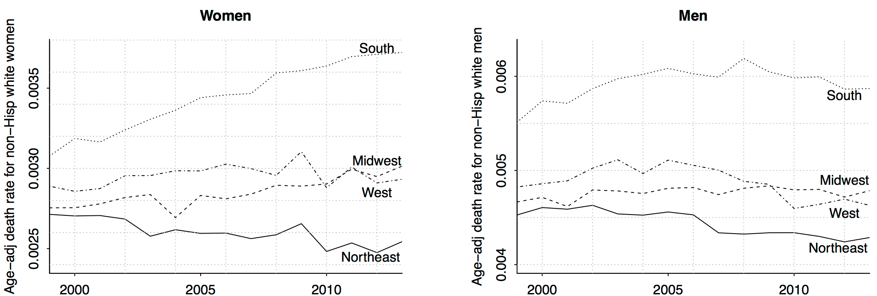
Deaton and Case 2015 (corrected by Gelman 2016)

Slide 9
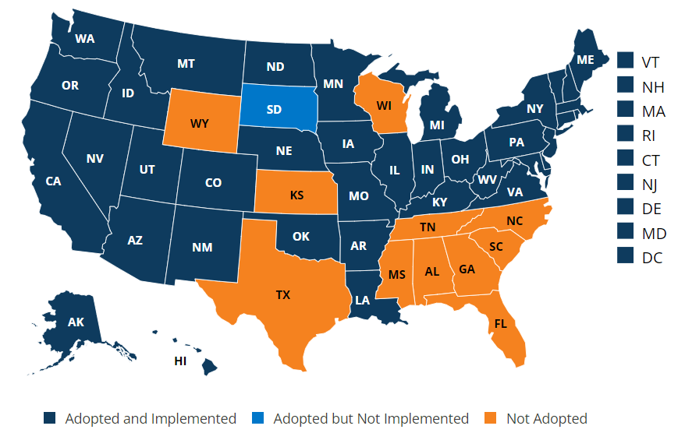
State of Medicaid Expansion

Slide 10
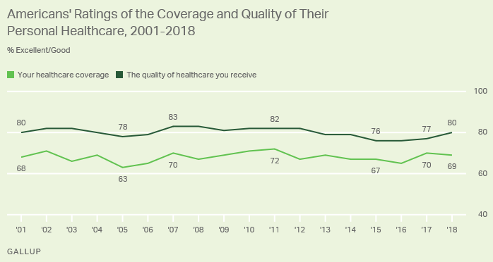
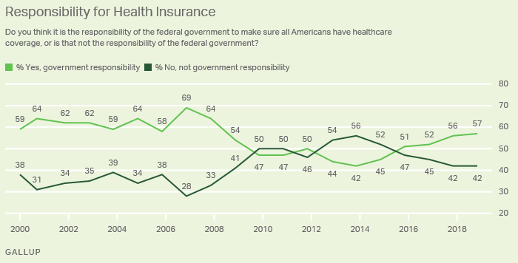
Some Polls
People like their insurance
  But not as much as they like their coverage
  And they don’t like the healthcare industry
People think the government should play a role
  But aren’t sure what that role should be
Notes:
https://news.gallup.com/poll/4708/healthcare-system.aspx
https://news.gallup.com/poll/245195/americans-rate-healthcare-quite-positively.aspx

Slide 11
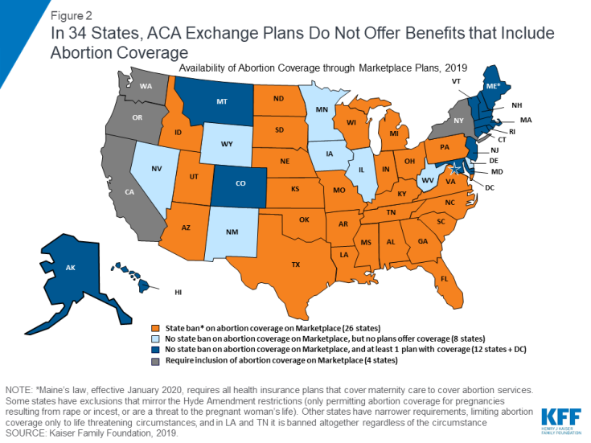
Abortion Coverage Regulations
Hyde Amendment
  Applies to subsidies for plans bought on exchange
  Does not apply to abortions in cases of rape, incest, or endangerment of life of woman
  States may fund abortion care for Medicaid recipients

Slide 12
Inflation Reduction Act of 2022
Medicare may negotiate the cost of prescription drugs.
Caps the amount seniors pay at $2,000 annually, and the cost of insulin at $35 a month
Penalizes companies that unfairly hike prices by requiring them to pay a rebate to Medicare.
Expanding premium and co-pay assistance for low-income seniors in the Medicare Part D drug program
Extending enhanced Affordable Care Act Marketplace premium subsidies, which were set to expire at the end of this year, through the end of 2025
Making all vaccines free for Medicare beneficiaries
Not an inflation reducing bill, its just a name for a budget bill
  Recent budget reconciliation bills include Tax Cuts and Jobs Act of 2017 and the American Rescue Plan of 2021.
  Inflation is a lagging indicator of problems and the lag is long
  So while this act does little or nothing to address inflation in 2022, its effect on long-term inflation is not necessarily zero

Slide 13
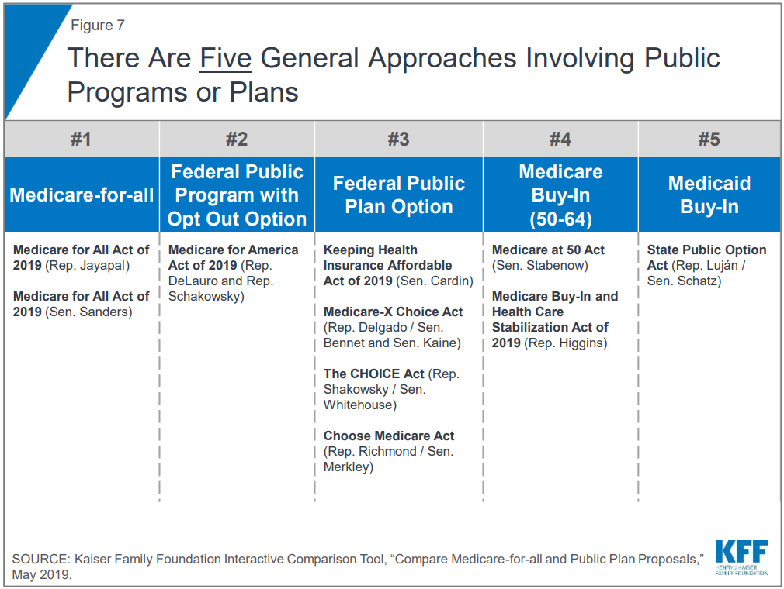

Slide 14
Democratic proposals focus on:
Coverage for all
  The ACA cut uninsured rates in half, but no further
  And purchase of bronze plans and interest in high deductible plans suggests markets are going to lead to less complete coverage
  Most democratic plans propose a single payer without copayments or deductible available for everyone
Notes:
Based on the Kip Sullivan plan

Slide 15
Democratic proposals focus on:
Costs
  ACA cost control measures have little or no evidence behind them
  HMOs create possibly only short term cost improvements
  Gaming the system has increased
    Gaming measurement
    Gaming caase-mix
    Gaming costs
  Single payer would shrink administrative costs and reduce corruption/gaming
  Single payer would negotiate with pharmaceutical companies

Slide 16
Democratic proposals focus on:
Payment
  Less emphasis or detail on payment, similar proposals to Medicare Part A and B
    Physicians: FFS
    Hospitals: Capitation
Choice
  Removal of networks used by HMOs/PPOs/POSs

Slide 17
Republican criticisms of Democratic plans
Complexity
  The ACA was 2,300 pages long and now entails 16,000 pages of regulations
Cost
  Government organizations are known for waste
Physician incentives
  Physician pay will have to go down
Insuree choice
  People prefer the public option, so that they could keep their current plan

Slide 18
Republican proposals focus on
Liberalize Health Savings Accounts
  Increase tax deductible contribution maximums
  Permit broader usage
  Allow tax-free rollover to survivors
Notes:
Based on the Scott Atlas plan

Slide 19
Republican proposals focus on
Tax Treatment and Incentives
  Either remove tax deduction for employer sponsored care or allow deduction for non-employer sponsored care
  Remove tax deductions for non-high deductible plans
    Ie treat most plans as Cadillac plans

Slide 20
Republican proposals focus on
Reduce regulations on insurance
  Allow high-deductible plans with fewer coverage mandates
  Reduce or remove use of employer sponsored health insurance
  Permit insurers to adjust premiums for obesity and other health risks and pre-existing conditions

Slide 21
Republican proposals focus on
Increase Medicare privatization
  Add private options for Medicare enrollees
    Include drug benefits in plans
    Regulate private plans to ensure out-of-pocket limits
  Combine A, B, and D into one, simplified Medicare public option
  Promote HSAs for Medicare recipients
  Increase eligibility age

Slide 22
Republican proposals focus on
Increase Medicaid privatization
  Allow high-deductible private Medicaid plans
  Seed fund HSAs for Medicaid recipients
  Use federal funds incentives to push states to encourage enrollees onto high-deductible plans

Slide 23
Republican proposals focus on
Reduce regulatory burden
  Allow nurse practitioners and physician assistants to take a higher role
  Reduce the power of medical specialty societies restricting supply of doctors
  Repeal taxes on medical devices and brand-name drugs
  Reduce bureaucracy in the FDA for device and drug approvals

Slide 24
Texas v Azar -> Texas v US
Notes:
https://www.kff.org/health-reform/fact-sheet/potential-impact-of-texas-v-u-s-decision-on-key-provisions-of-the-affordable-care-act/?utm_source=hs_email&utm_medium=email&utm_content=2&_hsenc=p2ANqtz-_037l8tBxCjsxUijA0INwupseSA0XA0fYwXLCVUgAn08z0nBGg2egu9vDkAhM8FxmmRzkRaJKdRDb5v-4XisZ7tNXt_g

Slide 25
Democratic criticism of Republican plans
Introducing low cost high deductible plans won’t lead to universal coverage and will reduce necessary utilization
Health Savings Accounts, depending on implementation, will be a regressive tax break
Regulations improve care and are necessary
Privatizing Medicare and Medicaid is unpopular and may not lead to improvements

Slide 26
Proposals with broad appeal include:
Limited Medicaid expansion
  To 100% FPL rather than 138%
People eligible for no-cost Medicaid or ACA no-cost plans should be automatically enrolled
Encourage state reinsurance risk pools to expand the size of pools
Increase transparency in prices
Limit monopoly power, including patent-based monopoly
Notes:
http://www.aei.org/publication/the-health-reforms-the-g-o-p-should-embrace-but-probably-wont/

Slide 27
Proposals with broad appeal include:
Limit the tax exclusion of employer-sponsored insurance
Ensure effective anti-trust enforcement
Encourage all-payer claims databases – reversing Gobeille v. Liberty Mutual and ERISA rules against these
Expand site-neutral payments where clinically feasible – hospital outpatient departments shouldn’t receive higher payments than stand-alone clinics
Balancing incentives in Medicare Physician Fee Schedule to incentivize med students to become PCPs
Notes:
http://www.aei.org/publication/cost-reducing-health-policies/

Slide 28
Proposals with broad appeal include:
Limit the tax exclusion of employer-sponsored insurance
Ensure effective anti-trust enforcement
Encourage all-payer claims databases – reversing Gobeille v. Liberty Mutual and ERISA rules against these
Expand site-neutral payments where clinically feasible – hospital outpatient departments shouldn’t receive higher payments than stand-alone clinics
Balancing incentives in Medicare Physician Fee Schedule to incentivize med students to become PCPs
Reforming Medigap cost sharing and Medicare benefit design
Reforming protected classes in Medicare Part D
Remove incentive to prescribe higher cost drugs in Medicare Part B
Remove regulations that restrict generic drugs
Notes:
http://www.aei.org/publication/cost-reducing-health-policies/

Slide 29
Other proposals
Repeal any willing provider laws – insurance plans don’t need to offer so generous out-of-network coverage

Slide 30
4 more classes
Three topics from the following:
  Covid, various aspects of Medicare/mediciad, Crises, retirement/social security/private retirement financing, ….
Apr 19: ??? - Financing of Medicare and Medicaid
Apr 21: ??? – Biden, O’Connor, and the next 5 years
Apr 26: ? – Covid
Apr 28: Review/wrap up

Slide 31
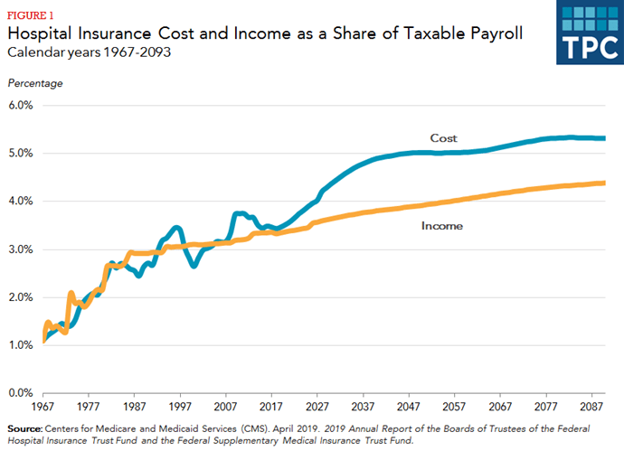
Medicare solvency

Slide 32
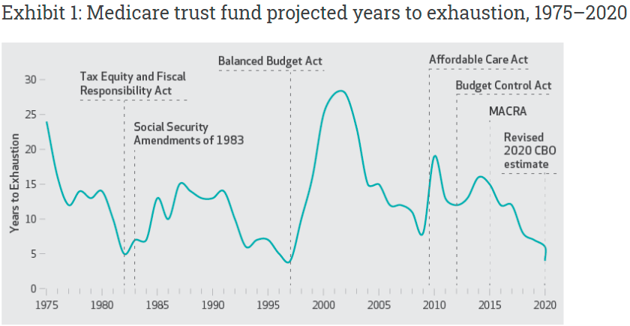
Never the first time, not the last(?)

Slide 33
Timeline
Recessions reduce payroll tax revenue: Nov 1973–Mar 1975 Oil Crisis, Jan 1980–July 1980 double dip, July 1981–Nov 1982 Iran revolution, July 1990–Mar 1991 ending Bush’s presidency, Mar 2001–Nov 2001 dot-com bubble, Dec 2007–June 2009 great recession, Feb 2020–June 2020 Covid recession
The Tax Equity and Fiscal Responsibility Act of 1982: The prospective payment system required Medicare to pay for most inpatient care using diagnosis-related groups. This significantly reduced federal outlays, quickly leading to an increase in the life span of the trust fund, which remained relatively stable through the end of the 1980s.
Balanced Budget Act of 1997: various measures including reductions in the growth of payments to providers, expansion of prospective payments to post acute care facilities, and increased cost sharing for beneficiaries.
Reduced revenues from the dot-com bubble triggered the Sustainable Growth Rate (SGR) provisions of the 1997 Balanced Budget Act, requiring a significant cut in Medicare payments. These cuts were canceled by legislation, leading to continued reduction in Trust Fund balance.
Expected revenue generators such as the “Cadillac Tax,” medical device tax, and other parts of the ACA did not end up becoming reality. A year after the ACA went into effect, a fiscal crisis led to the Budget Control Act of 2011, which cut Medicare payments by 2 percent.
The Medicare Access and CHIP Reauthorization Act of 2015 permanently repealed the SGR and provided temporary increases in payments for a variety of providers, including ambulance services and home health services in rural areas. The effect has been a depletion of the trust fund at faster than expected rates. Over the past five years, the expected year of exhaustion shortened from 2030 to 2026.

Slide 34
Future
Current Law if Fund runs out
  Payments may be delayed
  Or reduced
New legislation likely
  Revenue enhancing
  Cost cutting
Radical changes
  Medicare buy-in with ACA subsidies
  Push generics
  Increase payroll tax
Cost cutting legislation
Policy Option | Potential Savings
Expand Bundled Payments and Promote New Payment Models | $5 to $50 billion
Reduce Preventable Readmissions and Unnecessary Complications | Up to $10 billion
Reduce Payments to Post-Acute Providers | $25 to $50 billion
Reform and Reduce Payments for Graduate Medical Education | $15 to $40 billion
Reduce Medicare's Coverage of Bad Debts | $15 to $50 billion
Expand Medicare and Medicaid Drug Rebates | $50 to $150 billion
Reduce the Price and Use of High-Cost Drugs | Up to $30 billion
Adopt Competitive Bidding for Medicare Advantage | $25 to $75 billion
Limit Medicare Cost-Sharing Rules | Up to $20 billion
Restrict Supplemental Coverage | $50 to $125 billion
Limit Medical Malpractice Claims | $50 to $70 billion

Slide 35
Discussion
Consider three possibilities, each group will focus on one outcome:
  1) Democratic proposals
  2) Republican proposals
  3) Status quo/centrist
Three groups, in your group, consider some of the proposals (5-10) you read about.
  Who are the stakeholders that advocate for your outcome? Why?
  Take the position assigned to your group, what would someone advocating for that position say about this proposal?
  Imaging the country decides to pursue a grand compromise. Would a version of this proposal be something your group would be willing to accept in such a compromise?

Slide 36
Discussion
Who are the stakeholders that advocate for your outcome? Why?
  Low-income families (rural/urban), private insurance companies (large/small), middle/high income families (rural/suburban/urban), employers (large/small)
Take the position assigned to your group, what would someone advocating for that position say about this proposal?
Imaging the country decides to pursue a grand compromise. Would a version of this proposal be something your group would be willing to accept in such a compromise?

Slide 37
Discussion - proposals
Independent Payment Advisory Board (IPAB) – Control costs for Medicare (and maybe Medicaid) by limiting reimbursement for high cost-low effectiveness treatments
  Democratic response – In favor of limited cuts, but afraid this would shift more burden to the sick
  Republican response – In favor of cutting spending, proposed caps are often state-administered
  Which stakeholders are less concerned that this would shift more burden to the sick?
    Higher income individuals (generally older), less sick individuals (generally younger)
  What about providers?
    Could limit ability to provide high cost (and high margin) care. Don’t want their autonomy reduced
  What about private insurance companies?
    Could result in shift of high-cost care from medicare to private insurer, could also justify private insurers not covering high cost care

Slide 38
Discussion - proposals
More limited Medicaid expansion (to 100% FPL)
  Republican response – spending on Medicaid is already to high, but more limited is better than a larger
  Democratic response – spending on Medicaid is already to limited, but more expansion is better than none

Slide 39
Muhlestein, David. "The Coming Crisis For The Medicare Trust Fund" Health Affairs Blog, December 15, 2020

