Slide 1

HCMI 4225: Economics of Insurance
BUSN 203: Mon/Wed 9:30 PM – 10:45 AM
Shane Murphy – shane@uconn.edu

Slide 2
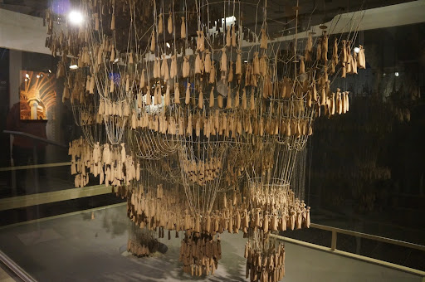
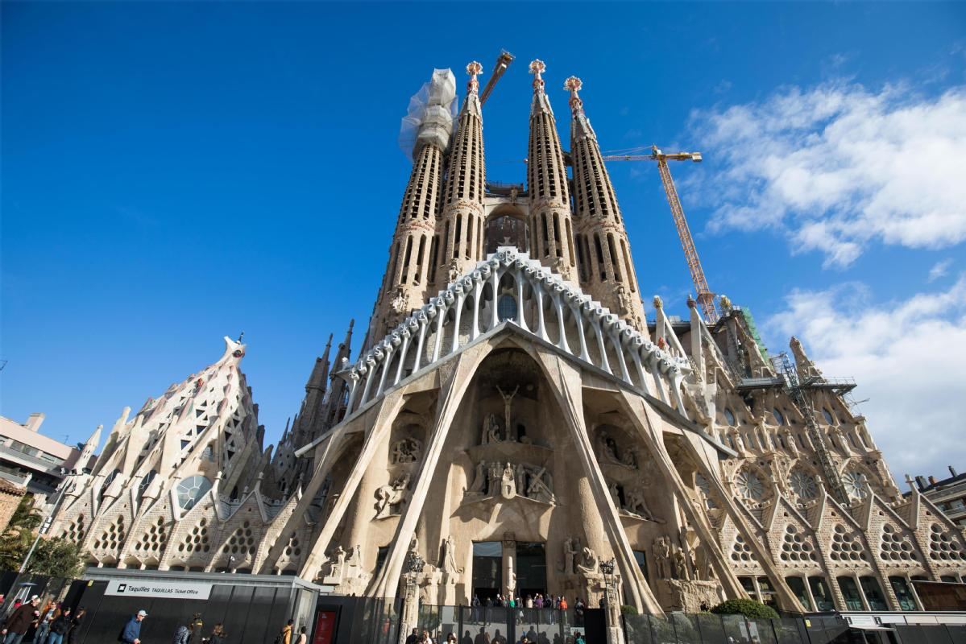
Math in art
Math Rock?
  Odd time signatures and complicated scales
  Such as my favorite band when I was in High School: The Dismemberment Plan
  D-Plan – The City
    https://www.youtube.com/watch?v=cMLiFpecgVg
Antoni Gaudi
  It was long known that an optimal arch follows an inverted catenary curve, i.e., an upside-down hanging chain. Gaudí's upside-down physical models took him years to build but gave him more flexibility to explore organic designs, since every adjustment would immediately trigger the "physical recomputation" of optimal arches. He would turn the model upright by the way of a mirror placed underneath or by taking photographs.

Slide 3
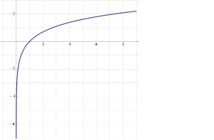
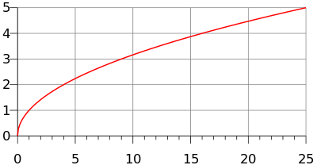
Utility
y=U(x)
  Utility is generally increasing in x
    (So U’(x)>0)
  Utility is generally concave
    U(E(x))>E(U(x))
    (also U’’(x)<0)
Examples
  y=ln(x)
  y=√x

Slide 4
Marginal utility
Marginal utility the change in utility from a change in input (wealth) given the current level of the input
  What is change in utility if someone's wealth changes by a dollar
Diminishing marginal utility
  In general, the wealthier someone is, the less utility they gain from earning an extra dollar
    The less utility they lose from losing an extra dollar
  The utility lost if someone loses $1000 is greater if they are poor

Slide 5
Risk aversion and Loss aversion
Risk aversion comes about because marginal utility is diminishing
  Imagine you are in a coin flip scenario, heads you win $10,000, tails you lose, call that scenario A
  Scenario B is a situation where you don’t have to flip a coin
    Expected value of the two scenarios is equal (on average, you end up with no change)
  Diminishing marginal utility can be used to show people prefer scenario B
  People prefer a risk free situation to a risky situation
Loss aversion is based on a psychological approach called Prospect theory
  Different from risk aversion, people have a greater aversion to loss than might be expected from the marginal utility approach
  So they have two utility functions, a positive one that seeks gains and a negative one that avoids losses
    And the negative one is maybe a bit larger in magnitude

Slide 6
Risk Premium
Risk Premium is the maximum amount of money a risk-averse person would pay to avoid taking a risk
Risk Premium is the difference between the expected value of a gamble and the value of a sure outcome such that the utility of that outcome equals the expected utility of the gamble
  We won’t use this precise definition in this class, but it is important in an economics class
The risk premium is a function of risk aversion – more risk averse people are willing to pay a greater premium
The risk premium is not a function of loss aversion

Slide 7
Insurance premiums
  Insurance capitalizes on this
  Under this theory the maximum a person is willing to pay for insurance is the expected loss plus the risk premium (so expected revenue equals expected loss for the insure plus an additional premium)
  On average, an insurance company pays out the expected loss (so expected cost equals expected loss)
  So the expected profit is the expected revenue minus expected cost
  If a persons insurance premium is as large as possible, then profit equals the risk premium!

Slide 8
Demand for Insurance
Factors of Demand:
  Risk Aversion
  Perception of Risk
  Peer Behavior
  Wealth and Income
  Ability to Externalize Risk
    Moral Hazard

Slide 9
Diversification and Pooling and the Role of the Standard Deviation
In a sense, Insurance is a mechanism by which the cost of risks are mediated through pooling
  The insured are willing to pay a risk premium to cover administrative and transaction costs of the pool in return for the reduction in risk
  Members of a pool do not necessarily make equal contributions
    Contributions may be increasing in level of risk and exposure

Slide 10
Diversification and Pooling and the Role of the Standard Deviation
Why are there very few private flood insurance plans?

Slide 11
Practice expected value problem 1
Lottery L has two outcomes A, B, U(x) = √X
A gives you $25, B gives you $10
P(A) = 0.1, P(B) = 0.9
What is E(X), the expected value of the lottery?
What is U(E(X)), the utility of the expected value?

Slide 12
Practice expected value problem 1 (with Solution)
Lottery L has two outcomes A, B, U(x) = √X
A gives you $25, B gives you $10
P(A) = 0.1, P(B) = 0.9
What is E(X), the expected value of the lottery?
E(X) = A*P(A)+B*P(B) = 0.1*25+0.9*10 = 2.5+9=11.5
What is U(E(X)), the utility of the expected value?
U(x) = √X = U(11.5) = √11.5 = 3.39

Slide 13
Practice expected value problem 1
Lottery L has two outcomes A, B, U(x) = √X
A gives you $25, B gives you $10
P(A) = 0.1, P(B) = 0.9
What is U(A), U(B)?
What is E(U(X)), the expected utility of the lottery?

Slide 14
Practice expected value problem 1 (with Solution)
Lottery L has two outcomes A, B, U(x) = √X
A gives you $25, B gives you $10
P(A) = 0.1, P(B) = 0.9
What is U(A), U(B)?
U(A) = U(25) = √25 = 5 U(B) = U(10) = √10 = 3.16
What is E(U(X)), the expected utility of the lottery?
E(U(X)) = U(A)*P(A)+U(B)*P(B) = 5*0.1+3.16*0.9 = 0.5 + 2.85 = 2.9

Slide 15
Practice expected value problem 1 (with Solution)
Lottery L has two outcomes A, B, U(x) = √X
A gives you $25, B gives you $10
P(A) = 0.1, P(B) = 0.9
What is E(X), the expected value of the lottery?
E(X) = A*P(A)+B*P(B) = 0.1*25+0.9*10 = 2.5+9=11.5
What is U(E(X)), the utility of the expected value?
U(x) = √X = U(11.5) = √11.5 = 3.39
What is U(A), U(B)?
U(A) = U(25) = √25 = 5 U(B) = U(10) = √10 = 3.16
What is E(U(X)), the expected utility of the lottery?
E(U(X)) = U(A)*P(A)+U(B)*P(B) = 5*0.1+3.16*0.9 = 0.5 + 2.85 = 2.9

Slide 16
Practice expected value problem 2
Lottery L has two outcomes A, B, U(x) = √X
A gives you $0, B gives you $16
P(A) = 0.75, P(B) = 0.25
What is E(X), the expected value of the lottery?
What is U(E(X)), the utility of the expected value?
What is U(A), U(B)?
What is E(U(X)), the expected utility of the lottery?

Slide 17
Practice expected value problem 2 (with solution)
Lottery L has two outcomes A, B, U(x) = √X
A gives you $0, B gives you $16
P(A) = 0.75, P(B) = 0.25
What is E(X), the expected value of the lottery?
E(X) = A*P(A)+B*P(B) = .75*0+0.25*16 = 0+4=4
What is U(E(X)), the utility of the expected value?
U(x) = √X = U(4) = √4 = 2
What is U(A), U(B)?
U(A) = U(0) = √0 = 0 U(B) = U(4) = √4 = 2
What is E(U(X)), the expected utility of the lottery?
E(U(X)) = U(A)*P(A)+U(B)*P(B) = 0*0.75+2*0.25 = 0 + 0.5 = 0.5

Slide 18
Practice expected value problem 3
Lottery L has two outcomes A, B, U(x) = √X
A gives you $25, B gives you $81
P(A) = 0.6, P(B) = 0.4
What is E(X), the expected value of the lottery?
What is U(E(X)), the utility of the expected value?
What is U(A), U(B)?
What is E(U(X)), the expected utility of the lottery?

Slide 19
Practice expected value problem 3 (with solution)
Lottery L has two outcomes A, B, U(x) = √X
A gives you $25, B gives you $81
P(A) = 0.6, P(B) = 0.4
What is E(X), the expected value of the lottery?
E(X) = A*P(A)+B*P(B) = 0.6*25+0.4*81 = 15+32.4 = 47.4
What is U(E(X)), the utility of the expected value?
U(x) = √X = U(47.4) = √47.4 = 6.88
What is U(A), U(B)?
U(A) = U(25) = √25 = 5 U(B) = U(81) = √81 = 9
What is E(U(X)), the expected utility of the lottery?
E(U(X)) = U(A)*P(A)+U(B)*P(B) = 5*0.6+9*0.4 = 3 + 3.6 = 6.6

Slide 20
Practice expected value problem 4
Lottery L has three outcomes A, B, C, U(x) = √X
A gives you $0, B gives you $9, C gives you $100
P(A) = 0.7, P(B) = 0.2, P(C) =0.1
What is E(X), the expected value of the lottery?
What is U(E(X)), the utility of the expected value?
What is U(A), U(B), U(C)?
What is E(U(X)), the expected utility of the lottery?

Slide 21
Practice expected value problem 4
Lottery L has three outcomes A, B, C, U(x) = √X
A gives you $0, B gives you $9, C gives you $100
P(A) = 0.7, P(B) = 0.2, P(C) =0.1
What is E(X), the expected value of the lottery?
E(X) = A*P(A)+B*P(B)+C*P(C) = 0*0.7+9*0.2+100*0.1 = 0+1.8+10=11.8
What is U(E(X)), the utility of the expected value?
U(E(X)) = √E(X) = √11.8 = 3.44
What is U(A), U(B), U(C)?
U(A) = √0 = 0, U(B) = √9 = 3, U(C) = √100 = 10
What is E(U(X)), the expected utility of the lottery?
E(U(X)) = U(A)*P(A)+U(B)*P(B)+U(C)*P(C) = 0*0.7+3*0.2+10*0.1 = 0+0.6+1 = 1.6

Slide 22
Law of Large Numbers
Given a fair experiment, the average or mean value of the results obtained from a large number of trials should be close to the expected value. As more trials are performed, the mean will tend to become closer to the expected value.
  If X is a random variable and (x1, x2, x3, x4, x5) are random draws from X
  Average(x1, x2, x3, x4, x5) ≠ Expected Value (X)
  And Average (x1, x2, …, x999, x1000) ≠ Expected Value (X)
  But the Average(x1, x2, …, x999, x1000) will usually be closer to E(X)
Risk for an insurance company is that the average loss for its portfolio in a given year will be larger than expected
  So what does the Law of Large Numbers suggest an insurance company should do to reduce this risk?

Slide 23
Pooling in Insurance
Efficiency (maximized social welfare) vs Equity (“fairness”)
How do you think Efficiency and Equity could be managed in designing an insurance program?
Pooling equilibrium – all risk types buy the same policy
  High risk individuals pay lower rate, low risk individuals pay higher rate
  Low risk individuals less likely to buy insurance
  High risk individuals more likely to buy insurance
Separating equilibrium – Risk types buy different insurance policies
  Low risk individuals pay lower rate, become more likely to buy policy
  High risk individuals pay higher rate, become less likely to buy policy

Slide 24
Adverse Selection
Adverse selection occurs when market participation is affected by asymmetric information
Adverse selection occurs when high-risk individuals are more likely to purchase insurance than low-risk individuals

Slide 25
Mitigating Adverse Selection
Individual Mandate in the ACA
Waiting Period before Coverage Takes Effect
Premiums Tied to Risk

Slide 26
Moral Hazard
When there is a lack of incentive to guard against risks because an individual is protected from the consequences of those risks

Slide 27
Mitigating Moral Hazard
Co-payments and Deductibles

Slide 28
Separating and pooling equilibria
Consider an insurance market with two types of customers (heterogeneous)
  H – high risk
  L – low risk
The expected cost of high risk customers is higher than low risk
Costumers know their risk, but insurance companies do not (private information, asymmetric information)

Slide 29
Insurance plans
In a simple model, insurance plans vary on premiums and amount of coverage
Insurance companies need premiums large enough to cover expected medical costs
High risk types have higher expected medical costs
For a simple model, consider insurance plans that have a limit on annual coverage
High risk types want a higher limit

Slide 30
Pooling equilibrium
In a pooling equilibrium, both risk types buy the same insurance plans and pay the same premiums
High risk types want more generous coverage (higher limit)
Pooling equilibria are unstable
  Low risk types will be willing to get plans with less coverage If they cost less
  High risk types may find less coverage plans to not be worth it
Even if insurance companies don’t know customer types

Slide 31
Separating equilibrium
But if two plans are offered:
  low risk types will buy the low premium, low coverage plans
  High risk types will buy the higher premium, higher coverage plans
  Now insurance companies know who is who
  This will drive up cost of high coverage plans!
Low risk types will only be partially insured
In a market where most of the population is healthy, separating equilibria may also be unstable!
  It is possible to offer plans that attract both types away from separating equilibria
  But these plans will still be unstable – there is no stable plan!

Slide 32
Demand for insurance: Risk avoidance vs access
In the late 1990s, John Nyman made an argument against excessive concern for moral hazard
His argument is that risk avoidance and the demand for certainty is not the reason people buy insurance, especially health insurance
Instead, people demand health insurance in order to increase their access to health care in time of need (the access motive)

Slide 33
Demand for Insurance: Access effect
More importantly, consider an example:
  Elizabeth purchases an insurance policy (for $4,000) that directly writes a check for $40,000 upon a diagnosis with breast cancer
  Without the insurance, she would purchase a $20,000 mastectomy
  With the insurance, she also buys a $20,000 breast reconstruction procedure
Now consider a separate example:
  Elizabeth purchases an insurance policy (for $4,000) that pays up to $40,000 upon a diagnosis with breast cancer
  In this case, what would Elizabeth buy?
  What if the policy pays up to $80,000?

Slide 34
Demand for Insurance: Access effect
In the first example, Elizabeth’s purchases represent her demand for care when sick and provided with $40,000.
  Her spending represents the purchase which provides her with the most welfare
  So the moral hazard is, in a sense, efficient.
In the second and third cases, we don’t know how much of her purchases represent what she would do if she had a check or $40,000 and how much of her purchases represent the fact that medical care has an effective price of $0 for the first $40,000 of spending.

Slide 35
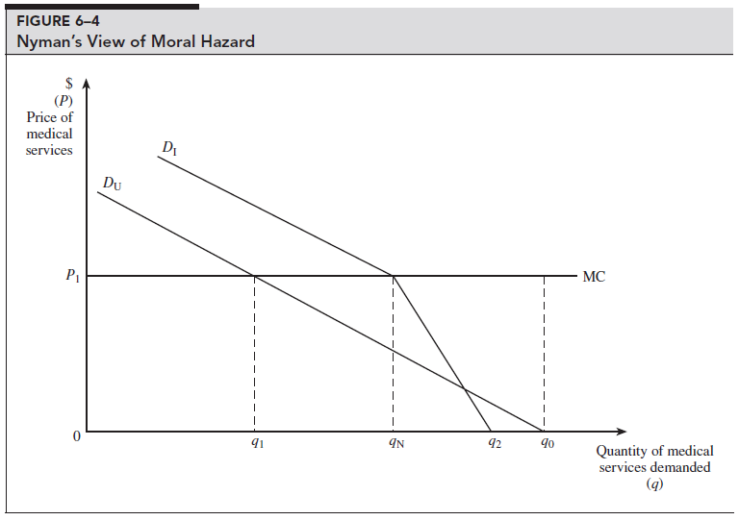
In fact, the uninsured may have less price elasticity for medical care than the insured
The uninsured
  Have higher rates of preventable and/or untreated illness
  Are less likely to receive care that they feel they need
  Have more preventable hospitalizations
  Have shorter hospital stays for the same conditions
  Are hospitalized sicker and have poorer health outcomes (including death)…

Slide 36
In fact, the uninsured may have less price elasticity for medical care than the insured
The uninsured
  Have higher rates of preventable and/or untreated illness
  Are less likely to receive care that they feel they need
  Have more preventable hospitalizations
  Have shorter hospital stays for the same conditions
  Are hospitalized sicker and have poorer health outcomes (including death)…

Slide 37
Note about utility
In most models of insurance, there are 4 different possible states of the world with 4 different values of Wealth:
The insurance companies average cost is:
Probability get sick * Cost of Illness
The insurance companies average revenue is:
Insurance Premium
If profits were zero then Insurance Premium = Probability get sick * Cost of Illness
 | Uninsured | Insured
Healthy | Initial Wealth | Initial Wealth – Insurance Premium
Sick | Initial Wealth – Cost of Illness | Initial Wealth – Insurance Premium – Cost of Illness + Insurance Payout

Slide 38
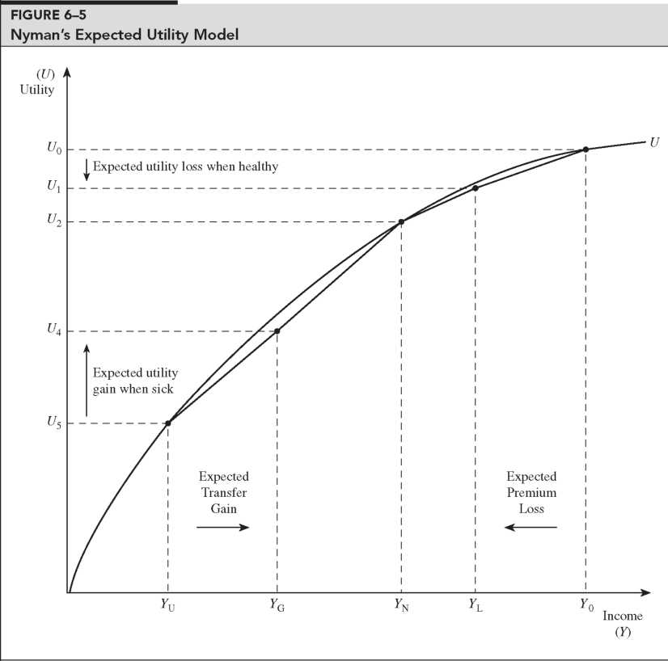
Transfer of wealth from the healthy to the sick has a different utility interpretation than a simple gamble

Slide 39
Implication for cost sharing
Remember our methods of mitigation moral hazard:
  Higher deductibles and coinsurance, Care management, Prepayment, Gatekeeping, Utilization review, Voluntary and mandatory second opinions, Chronic disease management
If the negative cost of moral hazard is overestimated, then mitigation will be overzealous
  “Cost sharing policies are directed at problems that largely do not exist”
  Insurance subsidies are socially optimal (providing access value to those who couldn’t afford it)

Slide 40
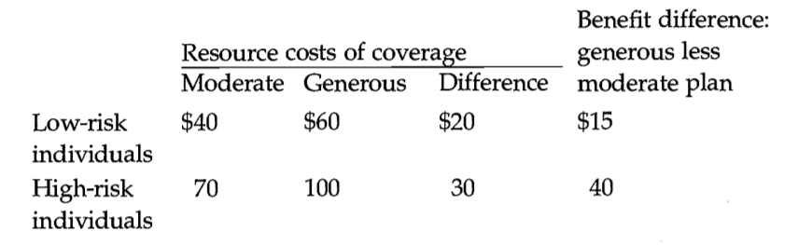
Adverse selection example
High risks are more expensive than low risks, and spending is greater under the generous plan for each risk type.
The last column shows the posited gain in benefits the different types of individuals receive from the generous as opposed to the moderate plan.
The efficient outcome in this example is for high-risk people to be in the more generous plan and low risk people to be in the moderate plan.
High risks should be in the generous plan because the incremental value of that plan to them ($40) is greater than its additional cost ($30).
For low risks, the opposite is true ($15 <$20).

Slide 41
Adverse selection example
We suppose that insurers charge the same premium for everyone enrolled in the plan
  possibly because individuals are indistinguishable to the insurer, equal premiums are required by law, or employers adopt this policy to help spread risks.
Starting at the efficient equilibrium, the premiums that would cover costs in this case are $40 for the moderate plan and $100 for the generous plan.
If these premiums were offered, however, all of the high-risk people would switch to the low-risk plan:
  the additional cost to high risks of the more generous plan ($60) is not worth the additional benefit ($40).
Thus, everyone would wind up in the moderate plan. The reason is simple: A person who switches from the generous to moderate plan benefits by mixing in with lower-risk individuals, and since premiums reflect risk mixes, this distorts choices towards the moderate plan.
This leads to higher costs for the low risk individuals or higher losses for the insurance provider

Slide 42
Readings:
(optional) Klein, Robert (2014) A Primer on The Economics of Insurance (https://www.researchgate.net/publication/270500085_A_Primer_on_The_Economics_of_Insurance)

Slide 43
Class structure
Quizzes
  6=3+3
Next few lectures
  history1

Slide 44
Paper discussion
5-10 pages (aim for 7)
  Topics: “Health and Social Insurance”
    Health – Public Health
    Social Health
    Health Insurance
    Social Insurance
    Health and Society
  Insurance means payment/payers (and payees)
Discussion of topics
  Extended office hour appointments (week of October 4 or 11)
Groups are allowed (1-4)
Formats – paper, video (20-40 min), podcast (30-60 min), other?
Sources – academic (peer reviewed), At least 5

