Slide 1
HCMI 4225: Public Goods and Health
Mon/Wed 9:30 AM – 10:45 AM
Shane Murphy – shane@uconn.edu
Office Hours:

Slide 2
Overview
Discuss class organization
Discuss next week’s discussion
What is a public good?
Is health a public good?
Importance of public goods for health

Slide 3
Course Organization
Office Hours
Suite is closed on Wednesdays and some Fridays
So how about TR? What time?
Readings
Optional
I post most readings that I use for making lectures at end of slides
Some of them are particularly good, I often add those to the course list as optional
Required
About half of “required readings” will have a homework assignment associated with them
All will be covered in lecture
There will usually be two or one required reading per week – one per class
Readings can be found at lib.uconn.edu
Politics
Social Insurance and Public Health Insurance are cornerstones of progressive domestic politics. Part of this class will be to outline the history of these in the US (and beyond). Part of this class will be discussing the pros and cons of these policies, how they succeed and fail, what could change, etc.

Slide 4
Next Week’s discussion
Political philosophy and ethical philosophy
What do we owe each other?
What is the role of the state?
What does the state owe us?
Is there such a thing as human rights?
Sign up for a two podcasts at the google docs link
For one of those, do the homework. Listen to the second to get a broader understanding of the issues at hand
Some podcasts have an optional second and third podcast
Two or three students are allowed to sign up for each one

Slide 5
Public goods
Goods which the market will not provide as:
non-excludable (non-exclusive)
benefits of good freely available to all or prohibitively costly to provide good only to people who pay for it and prevent or exclude other people from obtaining it
non-rival in consumption (inexhaustible)
quantity available for other people does not fall when someone consumes it, such that the total cost of production does not increase as the number of consumers increases (MC of additional user = $0)
Public goods are NOT necessarilly goods provided by the state (e.g. NOT public health systems!)

Slide 6
Examples
Defence
Given size of armed forces may protect population of 10, 20, 50 or 100 million people
Law & order
Foreign visitor benefits from crime-free streets as much as local residents
Information
Discovery of food additive that causes cancer – cost borne once, then cost of dissemination so that all can benefit is (virtually) zero
Infectious disease surveillance (prevent epidemics)

Slide 7
Public-private spectrum
Place these goods in their proper category:
Clothing
Beef
Fish
TV Shows
Wikipedia
Theme Parks
Nature Parks
Club
goods
Public
goods
Rivalry
High Low
Private
goods
Common
pool goods
High Low
Excludability

Slide 8
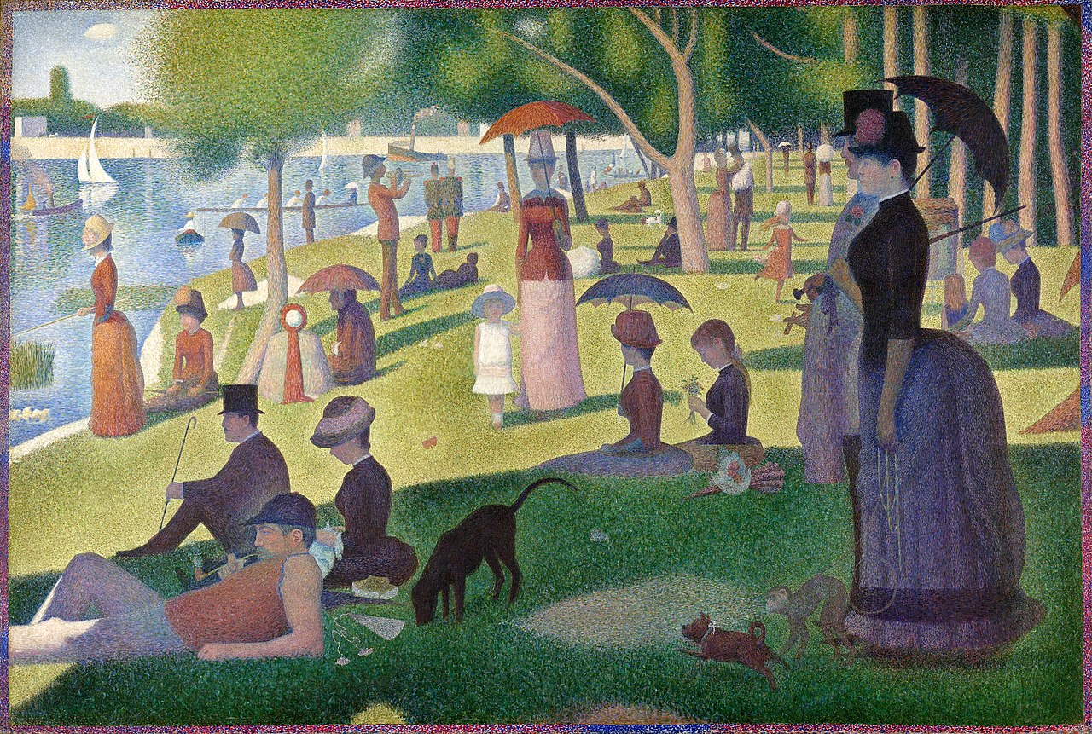
A Sunday on La Grande Jatte, Georges Seurat, 1884
Public Goods in NYC: Jane Jacobs vs Robert Moses
Motherless Brooklyn (2019)
Citizen Jane (2016)

Slide 9
Classifications are contested
Even Private Goods
Music samples
DJ Cutkiller - https://www.youtube.com/watch?v=1ip5dv14wYE
Girl Talk - https://www.youtube.com/watch?v=lKJd0RzmadQ

Slide 10
Is health a public good
Health does NOT fit the definition of a public good:
one person’s health status primarily benefits them
goods and services necessary to provide and sustain health are predominantly rival and excludable
BUT: are aspects that have PG aspects (e.g. communicable disease control – Public Health Campaigns)

Slide 11
Quasi-public goods
Public goods are rarely ‘pure’ – often:
non-excludable but rival – ‘common pool goods’
Beach on a holiday
non-rival but excludable – ‘club goods’
Satellite television signals, polio vaccination
Technology & geography determine the degree of publicness (e.g. television & radio signals, street lights)

Slide 12
Access goods
Private goods are often required to access public goods (e.g. computer to access internet)
This restricts scope of the benefits from public goods and may lead to perverse targeting
To secure provision of some public goods required access goods may thus be considered as if they were public goods
Health infrastructure possibly including health insurance

Slide 13
Importance of public goods
Free markets under-supply public goods because:
non-excludability leads to ‘free-riding’
non-rivalry leads to lower than socially optimal consumption

Slide 14
Non-excludability & ‘free-riding’
A free-rider is someone willing (hoping) to let others pay for a public good they will consume (e.g. cure for cancer)
If everyone tries to be a free-rider, no one pays for the good to be produced
Leads to societal loss of welfare – everyone worse off = ‘prisoner’s dilemma’

Slide 15
Non-rivalry
Private good – rivalry means each unit only consumed by 1 consumer (↑ demand = ↑ quantity)
Market demand = horizontal sum of demand curves (sum of all quantities demanded at given price)
Public good – nonrivalry means each unit is consumed by all consumers (↑demand = ↔quantity)
Market demand = vertical sum of demand curves (sum of price each consumer WTP for single unit)

Slide 16
Private individual demand curve

Slide 17
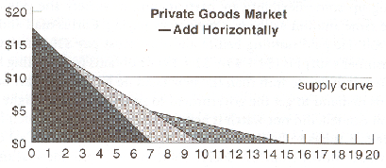
Private market demand curve

Slide 18
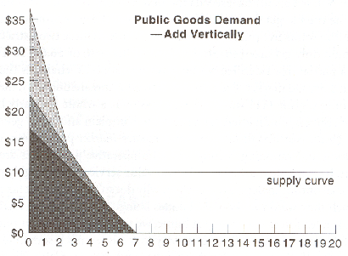
Public quasi-demand curve

Slide 19
Example PG in Health: medical research
Discovery of bacteria in 1850s and 1860s by Louis Pasteur began revolution in treatment of disease, saved wool industry from anthrax, improved brewing and dairy products
No single beneficiary (firm or consumer) obtains benefits sufficient to cover costs
Cost of research supported by (French) government
Underinvestment if beneficiaries do not pay

Slide 20
Related Issue: Natural Monopoly
A natural monopoly is a monopoly in an industry in which high infrastructural costs and other barriers to entry relative to the size of the market give the largest supplier in an industry, often the first supplier in a market, an overwhelming advantage over potential competitors.
Examples: Sports Leagues, Information Technology Standards, Water and Sewage
Natural monopolies can be unregulated, regulated, or government controlled

Slide 21
Related Issue: Social Benefit
In economic models, price is set by finding where marginal cost equals marginal benefit
In competitive markets, this is approximately true!
The marginal social benefit may be above the marginal benefit
So while the price might be too high for me to be willing to buy, it is better for society if I do, and society may find it worthwhile to subsidize my purchase
The marginal social benefit may increase as the number of customers increases
Goods with marginal social benefit will see under-provision in a free market

Slide 22
Central problem
Core policy issue is therefore one of ensuring collective action to facilitate production of, and access to, goods which are largely non-excludable and non-rival in consumption
Role usually assigned to government (although not exclusively - peer pressure, social responsibility, community, fairness)

Slide 23
Role for government
Public good aspects are often a rationale for government finance through:
Fees (e.g. prescription, dental). Still loss welfare as leads to inefficient exclusion where people excluded even though benefit>cost
‘Privatizing’ (excluding) a public good through establishing property rights - patent system
Direct finance, funded through general taxation
Other financial incentives/compensation - permits

Slide 24
Role for government
There are drawbacks associated with governmentally provided public goods
There may still be welfare loss from ’free’ goods (depending on actual cost)
Level of provision may be hard to determine - problems in obtaining ‘social value’ (incentive to over/under state value – CBA replaces market pricing)
Government programs may reflect political pressure to benefit special-interest groups

Slide 25
Public Health Decision Making: Driven by Science and Evidence
Value the prevention of premature death and disability, improvements in health status, and improving quality of life.
Public health training emphasizes these imperatives over other factors that impact public decision making.
Public health officials may advocate interventions that demonstrate positive outcomes on mortality, but are less likely to assess the broader economic and social impacts of interventions.

Slide 26
Political Decision Making: Driven by Multiple Factors
What is in a politicians Utility function?

Slide 27
Political Decision Making: Driven by Multiple Factors
Elected officials have strong incentives to incorporate:
business perspectives
economic impact,
Political relationships,
maintaining coalitions beyond an immediate issue,
other factors in beyond to public health evidence.
Differences in time horizons can also result in different imperatives
Public health agencies and advocacy organizations typically have continuity that transcends a single leader,
elected officials have defined (and typically shorter) terms.

Slide 28
Implementing Public Health Recomendations
Public health specifically, more than most policy areas, is an inherently intergovernmental enterprise - roles are built on:
police powers of state and local governments;
interstate regulatory authority provided constitutionally to the federal government;
Particularly over federally funded programs
federal responsibilities to protect borders (and thereby address cross-national disease threats);
the more ill-defined federal mandate to promote the general welfare.

Slide 29
Examples of conflict between politicians and public health
Former Surgeons General have noted interference from political officials in their efforts to highlight health issues. Although the most visible of these involved Surgeon General C. Everett Koop and the AIDS epidemic, a 2007 hearing of the House Committee on Oversight and Government Affairs featured other examples from Surgeon General David Satcher, who noted the Clinton Administration's decision to oppose Federal funding for syringe exchange programs; and Richard Carmona, who cited restrictions placed on his funding and communications that limited his independence in speaking to the public about health issues.1
Recent episodes of gun violence and calls for Federal response have highlighted long-standing Congressional constraints on Centers for Disease Control and Prevention research initiatives in this area, including a freeze on direct funding for gun violence research and a prohibition on using funds for gun control advocacy.
Reproductive health issues (including guidance for sex education in schools, HIV prevention programs, and abortion-related issues) have been hot-button topics across administrations and congresses, reflecting deep differences regarding the role of government, religion, and privacy. Even collection of data bearing on these issues has been hotly contested at all levels of government.
There is strong evidence that needle exchange programs are effective in preventing the spread of HIV, hepatitis, and other infectious diseases. However, philosophical differences over risk reduction initiatives have inhibited the widespread implementation of these programs. Federal funding for such programs is currently barred by conditions placed on appropriations bills.
Corporate interests often engage in the political process to block public policies that are contrary to their business interests, or use campaign contributions to gain access to lawmakers. For example, the beverage industry mounted costly campaigns to defeat soda tax referenda in multiple jurisdictions, and there was significant opposition to federal programs that tackled obesity and tobacco.
Climate change science continues to be challenged by both industry and political figures who oppose government interventions in markets.

Slide 30
Examples of cooperation between politicians and public health
Many deadly childhood diseases have been virtually eliminated, and race differentials eliminated, through vaccination requirements for school-age children set by states and school districts, and public funding of vaccines for uninsured and underinsured children (the federal Vaccines for Children Program).
Second-hand tobacco smoke exposure has been significantly reduced as a health threat through action at the federal level (eg, banning cigarette machines in schools and banning smoking on commercial airplanes) and local level (smoke-free policies in bars, restaurants, and other indoor spaces), and more recently by public housing authorities and other entities
Lead has been removed from paint and gasoline, resulting in a precipitous drop in blood lead levels in children. This has been accomplished using the interlocking authorities of all levels of government. The recent crisis in the Flint, Michigan, water system is at once a reminder of how much work remains to be done in this area, and also the extent to which public health science must inform policy decision making.
Public mandates for seat belts and other motor vehicle safety and highway construction standards, based on injury prevention research, have resulted in significant declines in deaths from motor vehicle collisions.
Federal clean air, clean water, and toxic substances legislation in the 1970s and a subsequent generation of implementing regulations have reduced the burden of environmental toxins and their impact on human health.
Food safety standards, and federal standardized labeling of food content and menu offerings have protected the public from foodborne illness and allowed more informed consumer dietary choices.
Fluoridation of water supplies in jurisdictions across the United States has reduced tooth decay by 25% in children and adults.

Slide 31
Recommendations for public health advocacy
Understand nonscientific factors in public policy decision making.
Avoid partisanship. .
Present the evidence fairly.
Be forthcoming about value judgments.
Choose the right battles.
Choose the right messengers.
Sharpen policy-relevant analytic skills.
Make public health relevant to real-world decisions.

Slide 32
Sources:
Health care as a public good
*Karsten, Siegfried G. "Health care: private good vs. public good." American Journal of Economics and Sociology 54, no. 2 (1995): 129-144.
*Galea, Sandro. “Public health as a public good.” Boston University School of Public Health, January 10, 2016, https://www.bu.edu/sph/2016/01/10/public-health-as-a-public-good
*Hunter, Edward L. "Politics and public health—engaging the third rail." Journal of public health management and practice 22, no. 5 (2016): 436.

