Slide 1
HCMI 4225: Welfare in the US
BUSN 203: Mon/Wed 9:30 AM – 10:45 AM
Shane Murphy – shane@uconn.edu
Notes:
https://www.youtube.com/watch?v=mr_8B1IzFFY&ab_channel=PBSNewsHour

Slide 2
Welfare as insurance
Social risk of economic downturns
Welfare programs finance needs of low income individuals
Multiplier effect
By how much does the economy grow for a dollar of new government spending
In models depends on many factors
Multiplier for spending by giving money to consumers depends on savings rate of consumer
Marginal propensity to consume

Slide 3
Multipliers and marginal propensity to consume
Marginal Propensity to Consume
If you get a dollar how much will you spend on consumption (vs savings)
Higher MPC -> higher multiplier
MPC higher for low income individuals
MPC higher for aid in kind (ie aid that must be spent on certain types of goods like food (SNAP), health (Medicaid) or housing (Section 8))
Focusing government programs on people who need it is called Means Testing
Pro – cheaper, intuitively effective
Con – broader programs can be more popular, broader programs often found to be more empirically effective

Slide 4
Recession Ready - Hamilton Project of Brookings and Equitable Growth
Every chapter was on a different automatic stabilizer
Currently existing
unemployment insurance
extended benefits
Programs:
TANF (welfare), Unemployment Insurance, Medicaid (health insurance for low income individuals), SNAP (food stamps), the Earned Income Tax Credit (EITS), Medicare (health insurance for older individuals), housing assistance (such as Section 8), and Social Security (pensions for older individuals)
New proposals
Infrastructure
Direct payments to individuals

Slide 5
Welfare works?
We already noted this about Medicaid

Slide 6
Additional effects of the ACA
There has been a lot of research on the health and coverage outcomes of the Affordable Care Act
KFF summary for Medicaid expansion (Antonisse as lead author) - https://www.kff.org/medicaid/report/the-effects-of-medicaid-expansion-under-the-aca-updated-findings-from-a-literature-review/
Mazurenko, Olena, Casey P. Balio, Rajender Agarwal, Aaron E. Carroll, and Nir Menachemi. "The effects of Medicaid expansion under the ACA: a systematic review." Health Affairs 37, no. 6 (2018): 944-950.
Courtemanche, Charles, James Marton, Benjamin Ukert, Aaron Yelowitz, Daniela Zapata, and Ishtiaque Fazlul. "The three‐year impact of the Affordable Care Act on disparities in insurance coverage." Health services research 54 (2019): 307-316.
Soni, Aparna, Laura R. Wherry, and Kosali I. Simon. "How Have ACA Insurance Expansions Affected Health Outcomes? Findings From The Literature: A literature review of the Affordable Care Act's effects on health outcomes for non-elderly adults." Health Affairs 39, no. 3 (2020): 371-378.
Courtemanche, Charles, James Marton, Benjamin Ukert, Aaron Yelowitz, and Daniela Zapata. "Early effects of the Affordable Care Act on health care access, risky health behaviors, and self‐assessed health." Southern Economic Journal 84, no. 3 (2018): 660-691.
…

Slide 7
Access, Utilization
Many studies find improvements in access to care
Increases in cancer diagnosis rates (especially early stage)
Earlier presentation for common surgical conditions – lowering complications
Increase listing for heart transplants among African Americans
Increased access for treatment of behavioral and mental health conditions
Increase in prescriptions for opioid use disorder and overdose
Increase in prescriptions for smoking cessation drugs

Slide 8
Access, Utilization
Many studies find improvements in access to care
Reduction in disparities by race, income, education, and employment status in access and affordability
Increased rates of optimal care for patients with common surgical conditions
Improved quality of care for common community health care treated conditions:
Asthma, Pap testing, BMI assessment, hypertension control
Declines in uninsured ED visits, but mixed evidence and no significant change in total ED volume
Reduced LOS for Medicaid patients
Improvements in care and quality in areas with primary care shortages

Slide 9
Access, Utilization: Criticism
Confusion in non-waiver states
Failures to follow up with new patients
Longer wait times

Slide 10
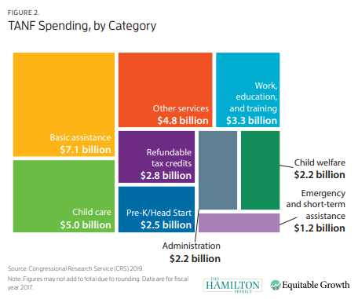
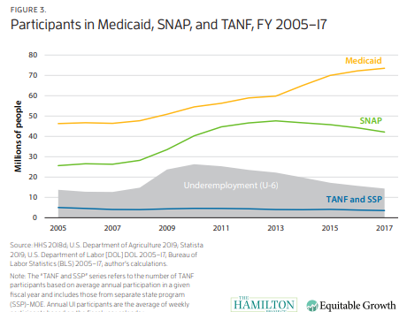
Temporary Assistance for Needy Families (TANF)
Block grants to states
Downsides of block grants
Under pre-existing Aid to Families with Dependent Children, states had access to unlimited matched federal funds for eligible families
Under 25% of families in poverty receive TANF
Maximum benefit between $170 and $923 /month

Slide 11
TANF – Temporary Assistance to Needy Families
Temporary Assistance to Needy Families (TANF) which is what Aid to Families with Dependent Children (AFDC) became after welfare reform in 1997.
Major components of the reform were that welfare became temporary (offering up to two years only) and require recipients to work or look for work (with some exceptions).
Welfare has positive effects, especially for lower income recipients
Child education and health outcomes
Household earnings and savings
Reform reduced these, but has lowered cost of programs
Cost effective?

Slide 12
Welfare and marriage
Welfare programs often give higher benefits to single parents (usually single mothers)
TANF
TANF has been shown to lead to a decline in marriage rates for recipients while receiving TANF, but this decline does not continue when recipients leave TANF
People who are or will be eligible for TANF at some point in their life are generally more skeptical of marriage than people who are not, but the receipt of TANF does not influence these beliefs, as they are more correlated with factors like income and education
In 2003, due to efforts of the Heritage Foundation, Brookings, and others, HHS implemented the Healthy Marriage Initiative and the Supporting Healthy Marriage Project to help reduce the negative effect of TANF on marriage rates and to reduce absentee parenting
The ACA and Medicaid expansion
Expanding Medicaid has been shown to decrease the number of marriages, possibly because people no longer need to get health coverage from their spouse
Requiring plans to cover children until the age of 26 have shown similar effects
However, Medicaid expansion is shown to be overwhelmingly good for children and other recipients (Guth et al 2020).

Slide 13
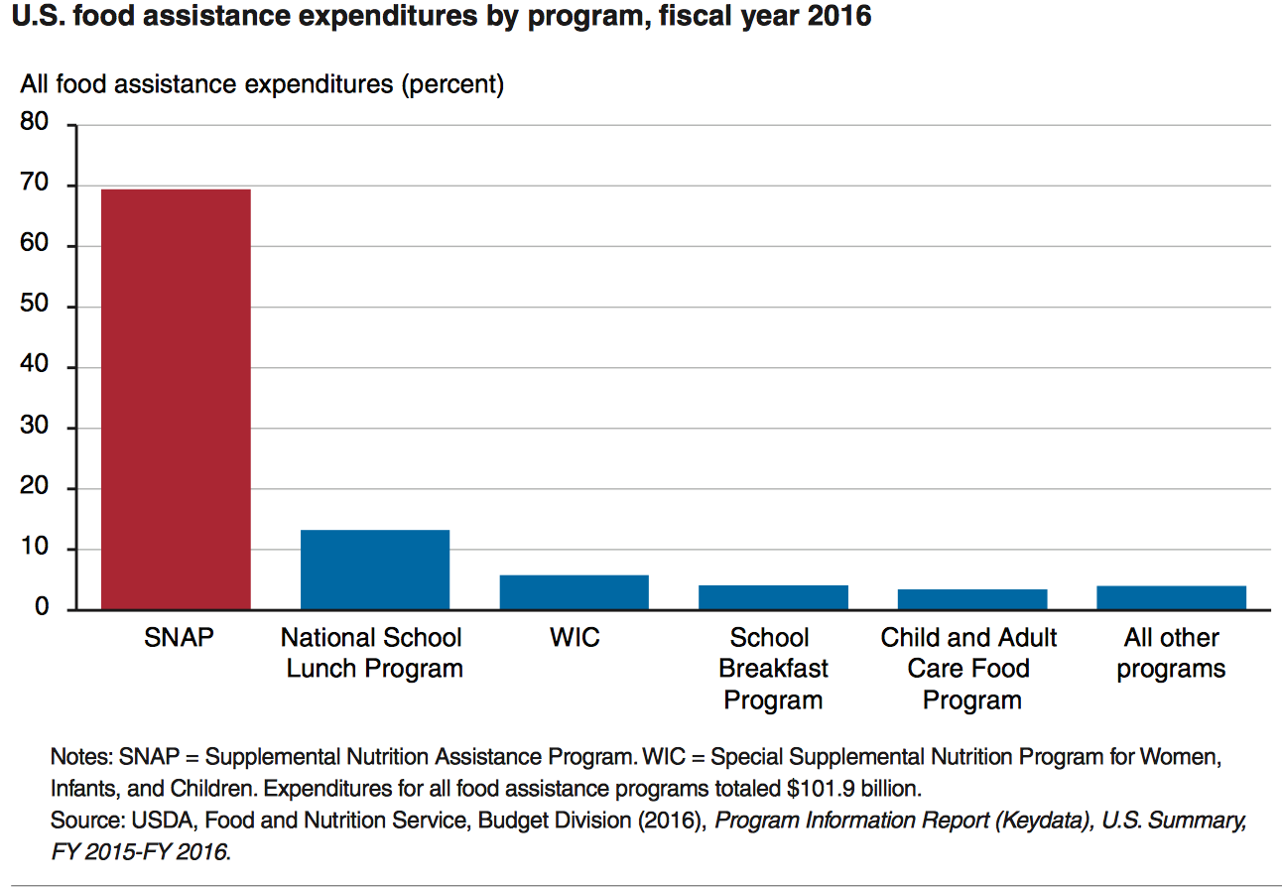
State Grants: Food Assistance Programs

Slide 14
SNAP
SNAP
central goal is to alleviate food insecurity and it succeeds
also improves well-being over other dimensions
High benefits for families
maximum of almost $700 per month for a family of 4
average benefit of about $250 per month for a family of 4
Has a profound effect on the family food economy

Slide 15
EITC – Earned Income Tax Credit
Low income individuals get a cash subsidy based on how much they work, up to $5610 dollars for someone earning $14,000 (40% raise)
Always incentivizes work
Administered by IRS
Popular and effective

Slide 16
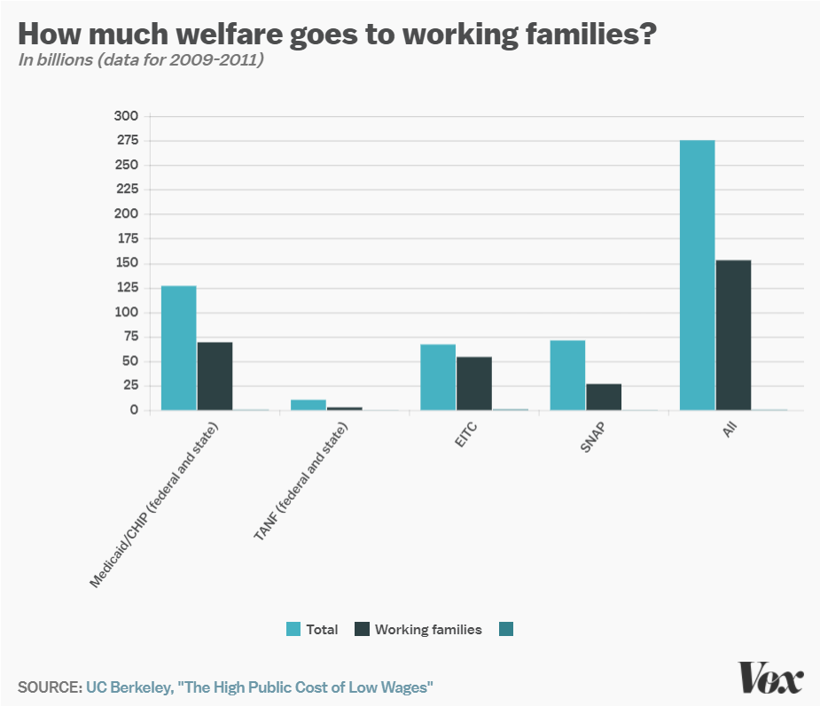
Work requirements
Federal: SNAP (food stamps)
Requires able-bodied recipients without dependents to work 80 hours a month
Part of 1996 Welfare Reform
State: TANF (welfare)
Kansas and elsewhere
Limited improvements on unemployment and poverty
State: Medicaid
Earned Income Tax Credit!
Notes:
http://laborcenter.berkeley.edu/the-high-public-cost-of-low-wages/

Slide 17
1996 Welfare reform
Changed Aid to Families with Dependent Children (AFDC) to TANF
States had more leeway to who gets benefits
Block Grants to states
Assistance cut to recent immigrants
Work requirements

Slide 18
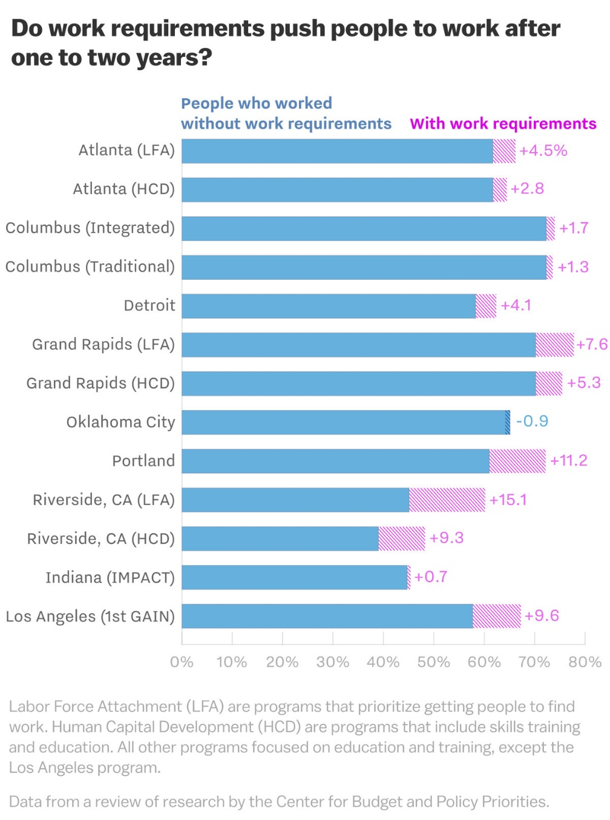
Effect of 1996 work requirements on TANF
13 cities participated in an experiment before requirement was implemented
The proportion of TANF recipients who worked without requirements was about 60% before the experiment
Increased by about 4% on average in the following years
Gains disappeared by 5 years
Stable work saw small increase by 5 years
Small effect on poverty – on average increasing poverty
Decrease the ability to attend training programs, deal with health issues
Targets foreign born and ESL

Slide 19
Pros and Cons of TANF work requirements
Pro
Con

Slide 20
Pros and Cons of TANF work requirements
Pro
Work requirement increases amount people work
Con
Work requirement increases poverty

Slide 21
However
80% of adults on Medicaid are in working families
60% work themselves
Of those that don’t:
35% are unable to due to disability
28% are caretakers for family members
18% are students
8% are actively looking for work
8% are retired
Leaving 3% of nonworking adult Medicaid population who could work but don’t
Notes:
JAMA Dec 2017

Slide 22
Barriers to employment
Low income individuals facing Medicaid work requirements struggle to find work
20% have less than a high school degree
25% have multiple chronic conditions
More likely to live in areas with high unemployment and poverty
Notes:
Urban Institute 2019

Slide 23
Labor Market Effects
Increased jobs
Did not reduce employment for low-income workers
Enrollees looking for work reported Medicaid enrollment made it easier to seek employment, those employed reported it made it easier to continue working
Increase volunteering

Slide 24
Additional Social Support/Welfare Programs
Programs we’ve discussed
TANF
Social Security
Unemployment
SNAP/WIC
Others:
Section 8 of the Housing Act of 1937
Rental assistance for low income households
Supplemental Security Income
Replace Aid to the Blind, Aid to the Permanently and Totally Disabled, and Aid to the Elderly from 1935 SSA
Once an individual qualifies for Supplemental Security Income they automatically become eligible for several other assistance programs (Medicaid, SNAP, Sectuon 8, others)
Head Start
1965 program – Early Childhood Education
High Ed programs
Pell, SMART, FSEOG, and subsidized loans
Other…

Slide 25
More sources
Abramowitz, Joelle. "Saying,“I don’t”: The effect of the affordable care act young adult provision on marriage." Journal of Human Resources 51, no. 4 (2016): 933-960.
Cancian, Maria, Robert H. Haveman, Daniel R. Meyer, and Barbara Wolfe. "Before and after TANF: The economic well-being of women leaving welfare." Social Service Review 76, no. 4 (2002): 603-641.
Chetty, Raj. "Moral hazard versus liquidity and optimal unemployment insurance." Journal of political Economy 116, no. 2 (2008): 173-234.
Guth, Garfield and Rudowitz. The Effects of Medicaid Expansion under the ACA: Studies from January 2014 to January 2020, KFF Report, March 17 2020
Hampton, Matt, and Otto Lenhart. "The effect of the Affordable Care Act Medicaid expansion on marriage." Economic Inquiry 60, no. 2 (2022): 568-591.
Hawkins, Alan J., Paul R. Amato, and Andrea Kinghorn. "Are government‐supported healthy marriage initiatives affecting family demographics? A state‐level analysis." Family Relations 62, no. 3 (2013): 501-513.
Kroft, Kory, and Matthew J. Notowidigdo. "Should unemployment insurance vary with the unemployment rate? Theory and evidence." The Review of Economic Studies 83, no. 3 (2016): 1092-1124.
Muennig, Peter, Rishi Caleyachetty, Zohn Rosen, and Andrew Korotzer. "More money, fewer lives: the cost effectiveness of welfare reform in the United States." American Journal of Public Health 105, no. 2 (2015): 324-328.
Taylor, Mary Jane, and Mary Beth Vogel-Ferguson. "Attitudes toward traditional marriage: A comparison of TANF recipients and a general population of adults." Families in Society 92, no. 2 (2011): 225-229.
Teitler, Julien O., Nancy E. Reichman, Lenna Nepomnyaschy, and Irwin Garfinkel. "Effects of welfare participation on marriage." Journal of Marriage and Family 71, no. 4 (2009): 878-891.
Wood, Robert G., Quinn Moore, and Anu Rangarajan. "Two steps forward, one step back: The uneven economic progress of TANF recipients." Social Service Review 82, no. 1 (2008): 3-28.

