Slide 1
HCMI 4225: Societal Stability and Financial Stabilizers
BUSN 202
Shane Murphy – shane@uconn.edu

Slide 2
Midterm discussion

Slide 3
Overview of first half of semester
Between 1600s and 1900s, governments became more democratic, republican, and populist
Democracy = participation of more of the population
Republic = rule by citizens rather than monarchs or dictators
Populist = use government programs to appeal to interests of large groups of voters (rather than only small groups like elites or nobles)
Welfare, Social Insurance, and Public Health Insurance increased legitimacy of governments struggling with changing dynamics
Increased size and scope of governments
Thus:
What is the appropriate size and scope of government?

Slide 4
Some things we skipped

Slide 5
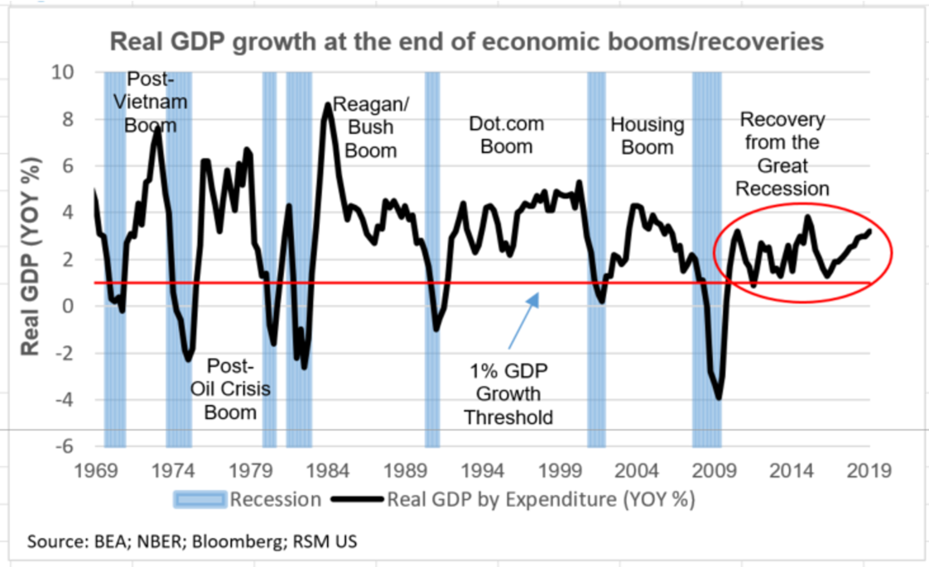
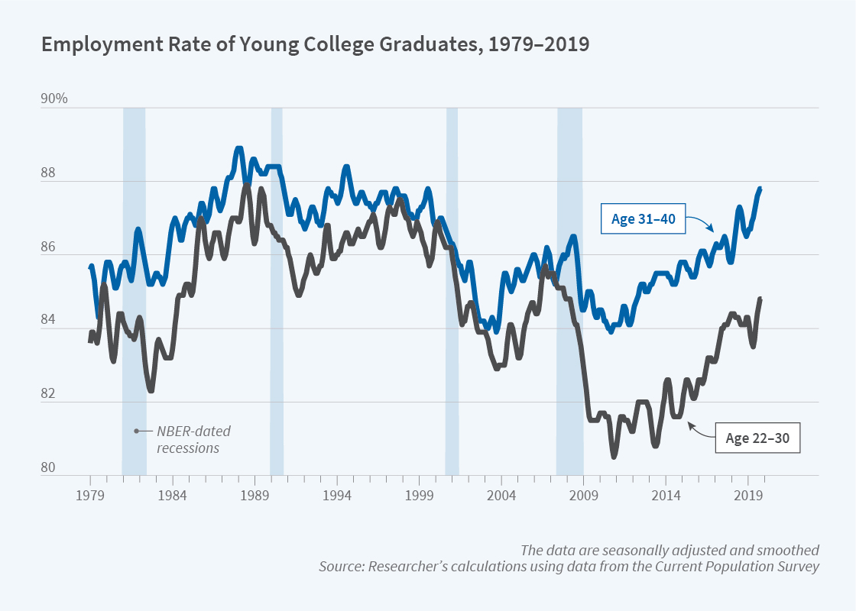
Recessions – GDP and Employment
Economists define as fall in GDP over two quarters
GDP is measured by NBER, an independent, Boston-based economics research group
Measures come out with about six months delay
NBER recession announcement is more complicated
Comes out with 12 month delay

Slide 6
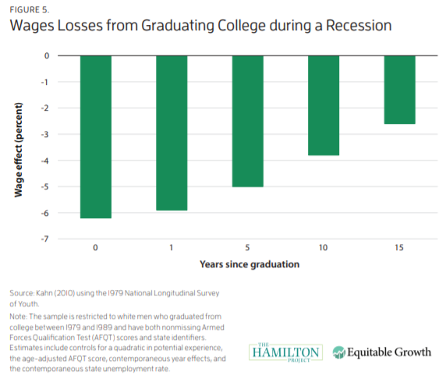
Cost not born equally across components of the economy

Slide 7
How do economists suggest we get out of recessions
Monetary Policy
Cut interest rates to increase investment
Ensure monetary predictability to avoid swings
Fiscal Policy
Increase economic activity by
Cutting taxes so consumers and business have more to spend
Spend money on social programs so lower income people have more to spend
Spend money on public goods like infrastructure so people have jobs and can spend their wages

Slide 8
Direct payments to individuals
Common - small
2001 – Tech bubble crash
Tax rebate - $500
2008 – Housing bubble crash
Economic stimulus payment - $1000
2019 – Covid-19 crisis
CARES check - $1200

Slide 9
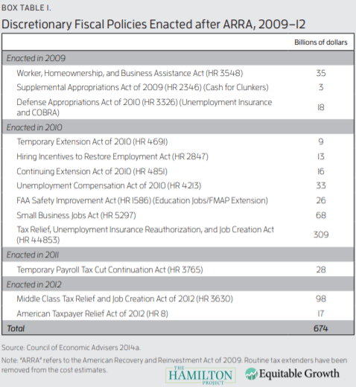
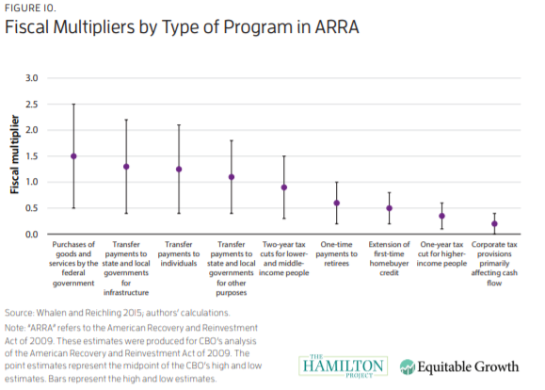
Fiscal Policy

Slide 10
Coronavirus recession
¾ of US spending is consumer spending
Retail spending collapsed
Fed already in March 2020 set interest rates to zero
Fed represents opinion of top US macroeconomists
Made many more efforts to prop up economy
Lending expansion helped wall street – also expanded loan access to smaller businesses
But individuals and small businesses need money more than loans

Slide 11
A note on Modern Monetary Theory
Related to Keynesian principle that the limit to the economy shouldn’t be money, it should be capacity
Basically, print money to finance increasing spending until unemployment is as low as possible
Money supply is not fixed by the amount of gold in the world
Key figures:
Stephanie Kelton (Bernie Sanders advisor), L. Randall Wray, Bill Mitchell, Warren Mosler
Widely criticized by most economists
MMT are unconvincing about policy effects on interest rates, investment environment, and open economy macro/international trade

Slide 12
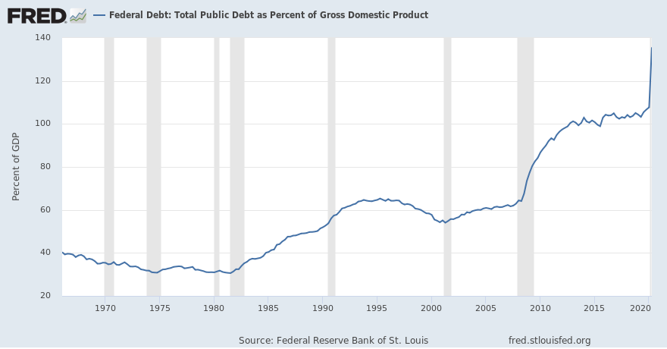
In the meantime: Debt financing
Debt represents future taxes
Who holds out debt?
17% of US debt is held by investors, much of it is held by Americans expecting to retire on its returns
23% of US debt is held by other branches of the government
25% of US debt is held by foreign governments
Japan and China together hold a little over half of foreign owned debt, under 10% of US Debt
Holding US debt helps strengthen foreign currency, lowering prices of foreign exports purchased in the US
What’s going to happen?
Nothing much! The worst case scenario is really bad though!

Slide 13
Lessons learned from 2008-2009 crisis and 2020-2021 crisis
Quantitative Easing
Central bank purchases government bonds or other financial assets (i.e. municipal bonds, corporate bonds, stocks, etc.) in order to inject money into the economy to expand economic activity
Moral Hazard
Governments do not blame large holders of capital for not managing their own risk
Long-term spending maintaining socio-economic order easier to pass

Slide 14
US Response
Health Response
Medicaid
Pressure on insurance companies to cover Covid generously
Fiscal Response
2020 CARES Act
PPP
2021 ARP
Social Response

Slide 15
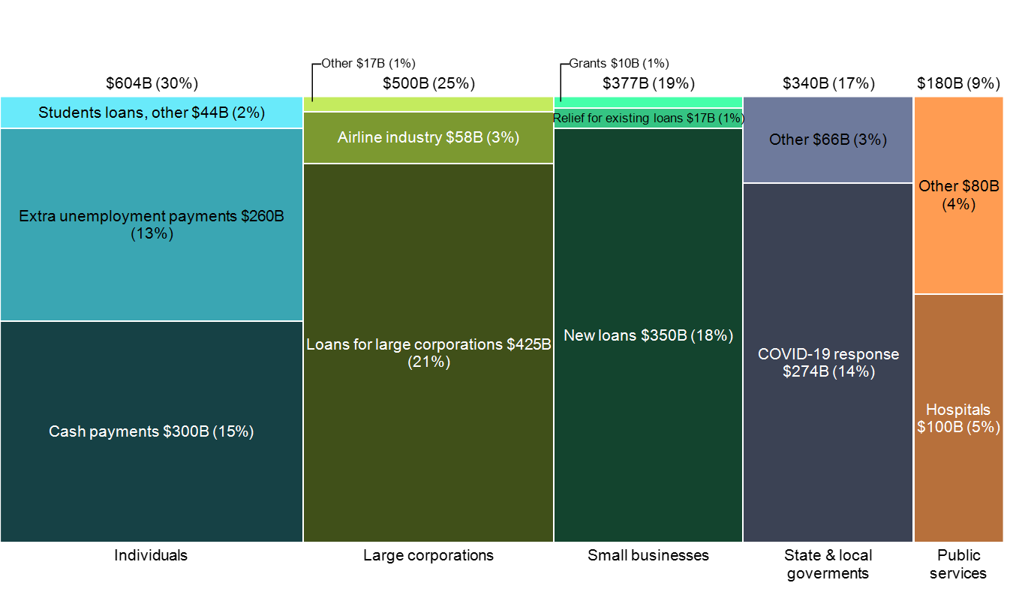
2020 Cares Act ($2.2 trillion)

Slide 16
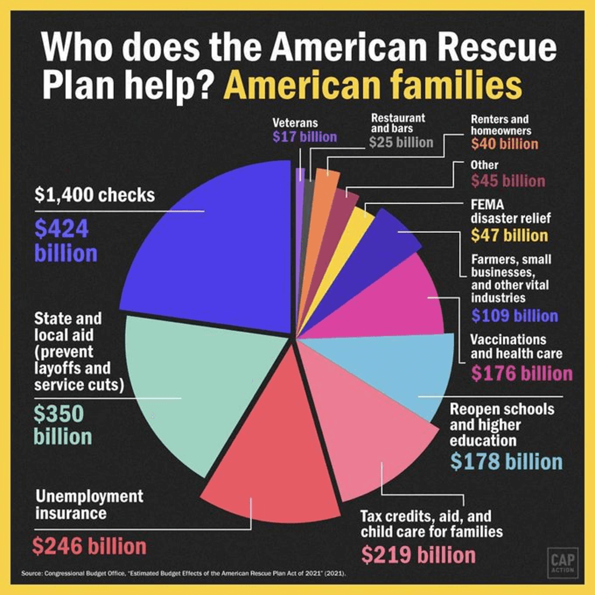
2021 American Rescue Plan ($1.9 trillion)
No provision equivalent to the Paycheck protection program loans
https://projects.propublica.org/coronavirus/bailouts/

Slide 17
World Response
IMF – Financing and debt relief
World Bank – Financing
Development assistance
NGOs
The Global Fund to Fight AIDS, Tuberculosis and Malaria
BMGF
GAVI
IGOs
Development Banks
European Union/European Commission
UN Agencies
UNDP, UNHCR, UNICEF, WFP
Countries
US, Japan UK, Germany, France, Canada, Australia
https://vizhub.healthdata.org/fgh/

Slide 18
Recession Ready - Hamilton Project of Brookings and Equitable Growth
Every chapter was on a different automatic stabilizer
Currently existing
unemployment insurance
extended benefits
New proposals
Infrastructure
Direct payments to individuals

Slide 19
Claudia Sahm
Macroeconomist focusing on weaknesses in the economy
Worked at the Federal Reserve Bank from 2007-2019
Currently at think tank – Washington Center for Economic Growth

Slide 20
Sahm Index/Sahm Rule
Three-month average of monthly unemployment rate
current rate and the two prior.
monthly data's noisy, so you don't want to overreact to little ups and downs
Compare current month to prior 12 months.
If the difference is half a percentage point or more, we're in a recession

