Slide 1
HCMI 4225: Post Acute and Long Term Care
Mon/Wed 9:30 AM – 10:45 AM
Shane Murphy – shane@uconn.edu

Slide 2
Facilities
Post-acute and long-term care services were provided by
4,200 adult day services centers,
11,500 home health agencies,
4,700 hospices,
15,600 nursing homes,
31,400 assisted living and similar residential care communities,
1,200 inpatient rehabilitation facilities,
400 long-term care hospitals
Most for-profit; chain-affiliation common
1.6 million nurses (RN, LN, LVN, nursing aids) and 35k social workers

Slide 3
Distributions
Geographic
Uneven, fewer providers in the West, especially for nursing homes
More rural nursing homes
More urban long term care hospitals
Profit status
Home health more likely to be for-profit, inpatient and adult day services non-profit, inpatient government
Chain status
Residential care and nursing home most likely to be chain affiliated
Medicare certification near universal
Medicaid certification near universal for inpatient rehab and nursing homes, about 75% for adult day, home health, and long-term care, 50% for residential care communities

Slide 4
Patients (2017/2018 estimates)
251,100 current participants were enrolled in adult day services centers;
1,321,200 people were current residents in nursing homes; and
918,700 current residents were living in residential care communities.
4,940,300 patients were discharged from home health agencies;
1,562,500 patients received services from hospices;
380,400 patients received services from inpatient rehabilitation facilities;
115,800 patients received services from long-term care hospitals
Women over 50% more likely to use long term care centers

Slide 5
Long-term care services
Long-term care services include assistance with
activities of daily living (ADLs; dressing, bathing, and toileting),
Instrumental activities of daily living (IADLs; medication management and housework),
health maintenance tasks
Medicaid spending on long-term care services totaled $129 billion in 2018, accounting for 32% of total Medicaid expenditures
Of the 10.9 million older adults who reported receiving help with daily activities in a given month in 2011, about 3 in 10 received paid help
About one-half of Americans reaching age 65 will need long-term care services and will incur, on average, $138,000 in long-term care costs
Average projected length of needing long-term care services is 2 years, including an average length of 1 year of paid long-term care services
About one-third of people turning age 65 are projected to need long-term care services for more than 2 years

Slide 6
Post-acute care services
Common conditions include: traumatic brain injury, spinal cord injury, amputation, congenital deformity, major burns, major trauma, orthopedic or arthritic conditions, joint replacement, hip fracture, and other neurological conditions
Received at home health agencies, skilled nursing facilities, inpatient rehabilitation facilities, and long-term care hospitals
In 2018, post-acute care fee-for-service spending was $58.6 billion
Home health care common, reimbursed by Medicare
Inpatient (and outpatient) physical, occupational, and speech therapies and nursing services common
75% of rehabilitation facilities were located within an acute care hospital and about 25% were freestanding

Slide 7
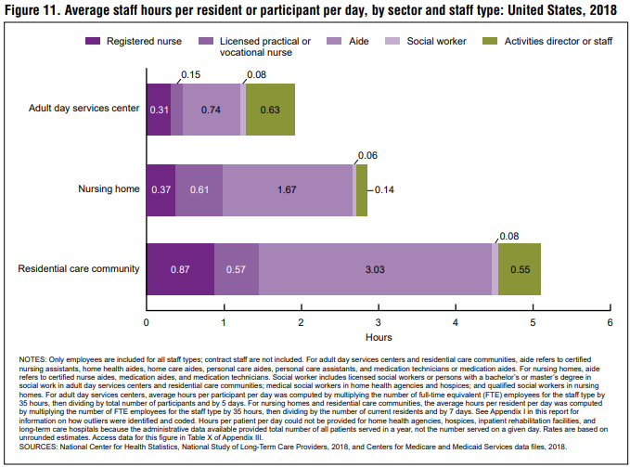

Slide 8
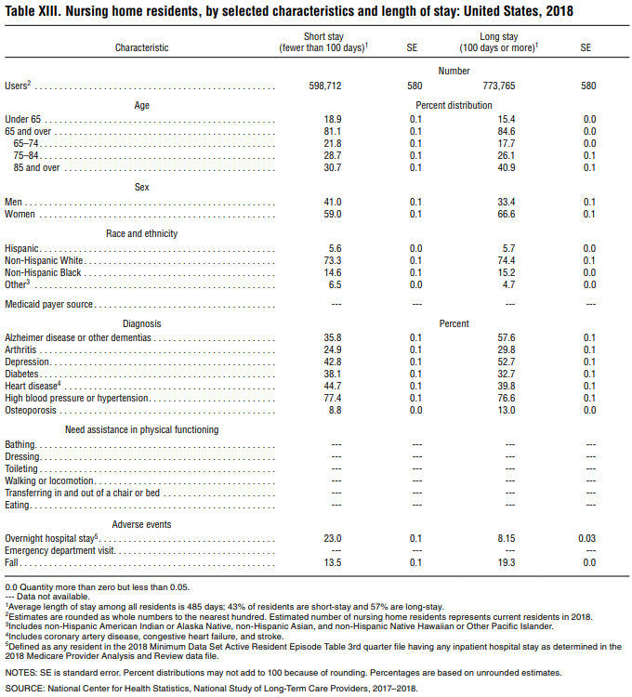

Slide 9
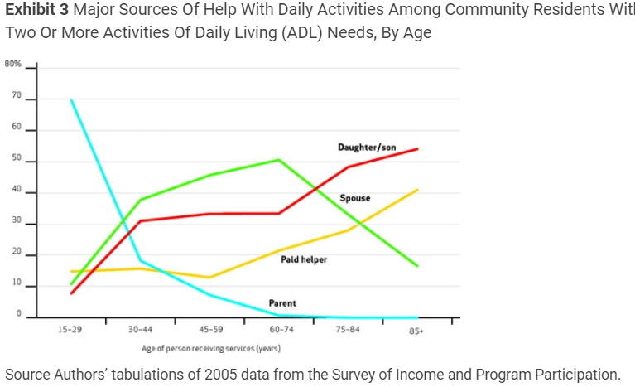
Sources of care for community residents

Slide 10
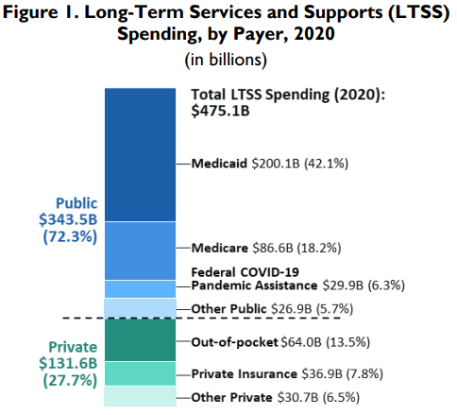
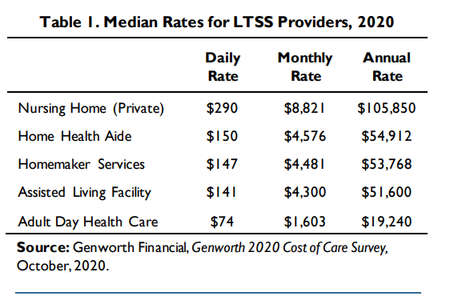
Cost and financing

Slide 11
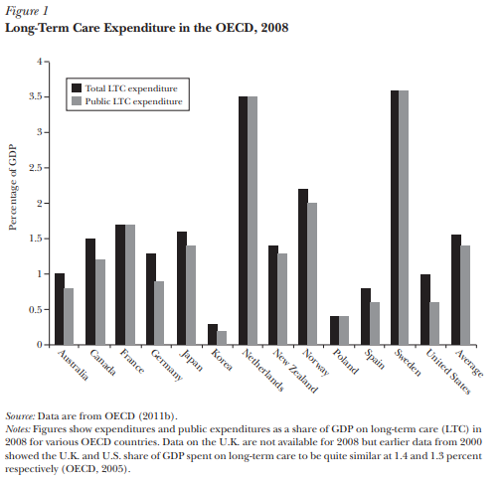
Long-Term Care
About 9% of all healthcare expenditure and 2% of GDP
Growth in expenditure faster than rest of health expenditure
Due to aging, not technology

Slide 12
Medicare
Medicare covers nursing care for no more than 100 days; only if this care is in a skilled nursing facility, not in custodial nursing homes more typical of long-term care; and only if this care follows a hospital stay of more than three consecutive days.

Slide 13
Medicaid
Second payer by law – private insurance and Medicare pay first
For nursing home Medicaid and HCBS Medicaid waivers, in 2022, the income limit for an individual is often $2,523 / month. This equates to 300% of the Federal Benefit Rate for an individual. The asset limit is $2,000.
For regular state Medicaid, or specific to seniors, Aged, Blind and Disabled Medicaid, in 2022, the income limit is generally $841 / month (100% of the Federal Benefit Rate for an individual) or $1,133 / month (100% of the Federal Poverty Level for a household of 1) for single applicants and the asset limit is generally $2,000.
Spousal income exempt, spousal assets not exempt.
Primary home value up to $600k to $900k exempt from asset limit

Slide 14
Medicaid look back penalty
Gifts in the previous five years are considered in asset limits
If asset limit would have been exceeded except for gifts in the look back period, Medicaid eligibility is delayed.
For every $14,060 gifted or sold under fair market value, recipient will be penalized with a month of Medicaid ineligibility

Slide 15
Medicaid incentivizes against private insurance
Public expenditure is “crowding out” private expenditure
Low income and low asset individuals who will likely qualify for Medicaid should they need long term care are unlikely to buy private long term care insurance
buying private insurance is spending money that they could otherwise spend on other goods

Slide 16
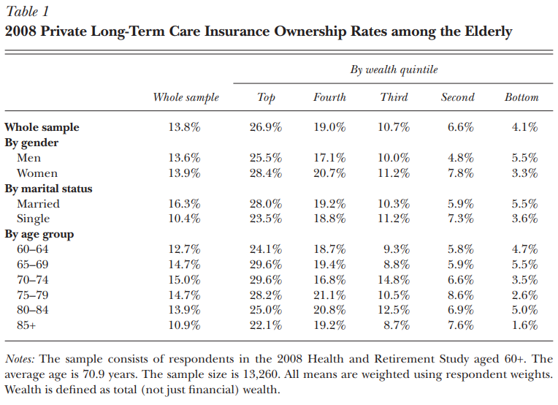
Private Insurance

Slide 17
Virtually all (90 percent) of policies sold in the individual market cover home care and nursing home care
Deductables are usually 30-90 days
Maximum benefits are 1-8 years, sometimes unlimited
Maximum daily benefit often lower than average daily cost
Annual premiums depend on age policy begun
If started at 55, cost is over $2,000 for men, $3,000 for women
Load = ratio of premiums to benefit
Loads range from 30% to 60%

Slide 18
Reform possibility
Hard to implement
Remove asset limit?
Remove Medicaid coverage?
CLASS act of the ACA was abandoned – would have created federal government market for private long-term care insurance
Implement tax incentives for private long-term care insurance

Slide 19
Connecticut Long-Term Care Partnership Programs
For every dollar that a Partnership insurance policy pays out in benefits, a dollar of assets can be protected from Medicaid spend down rules. When determining Medicaid eligibility, any assets you have up to the amount the Partnership insurance policy lifetime maximum in benefits will be disregarded. For example, if your Partnership insurance policy paid up to $200,000 in benefits, Connecticut’s Medicaid program would allow you to keep $200,000 in assets and still qualify for Medicaid assistance

Slide 20
Sources
Kaye, H. Stephen, Charlene Harrington, and Mitchell P. LaPlante. "Long-term care: who gets it, who provides it, who pays, and how much?." Health affairs 29, no. 1 (2010): 11-21.
Sengupta, Manisha, Jessica P. Lendon, Christine Caffrey, Amanuel Melekin, and Priyanka Singh. "Post-acute and long-term care providers and services users in the United States, 2017–2018." (2022).
Brown, Jeffrey R., and Amy Finkelstein. "Insuring long-term care in the United States." Journal of Economic Perspectives 25, no. 4 (2011): 119-142.
Buchmueller, Thomas, John C. Ham, and Lara D. Shore-Sheppard. "The medicaid program." Economics of Means-Tested Transfer Programs in the United States, Volume 1 (2015): 21-136.
Congressional Research Service Reports:
https://crsreports.congress.gov/product/pdf/IF/IF10427
https://crsreports.congress.gov/product/pdf/IF/IF10343

